Slide 1
Coordinated Entry Overview
Many of the following slides are shamelessly borrowed from OrgCode/Community Solutions CES Learning Clinic Presentation and Pathways to Home Ventura County CoC Presentation

Slide 2
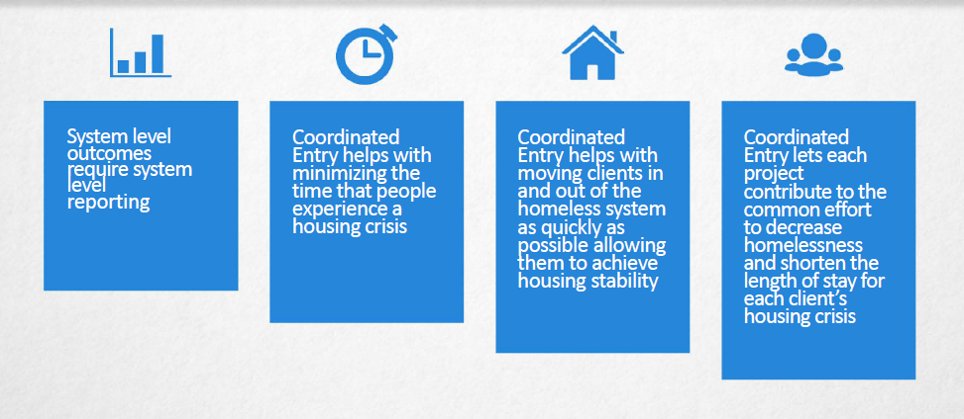

Slide 3
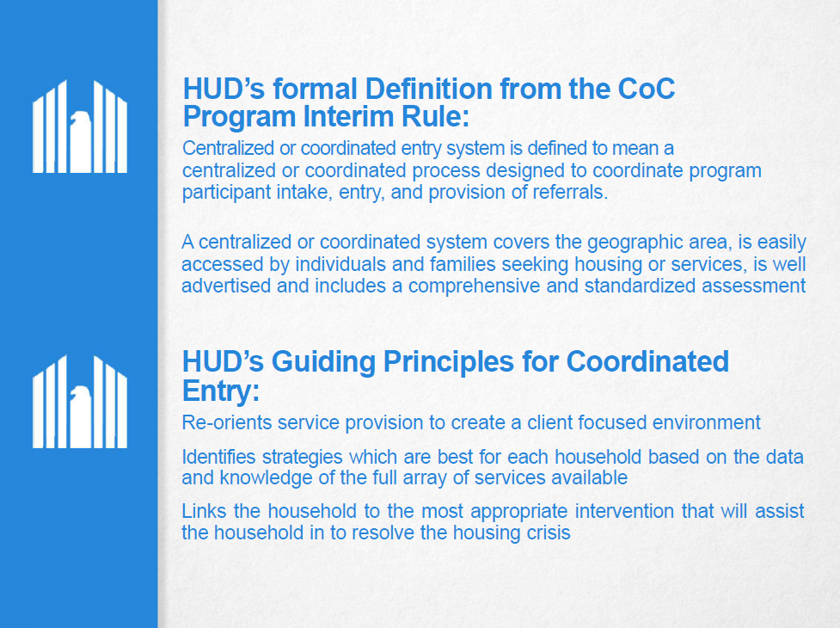

Slide 4


Slide 5
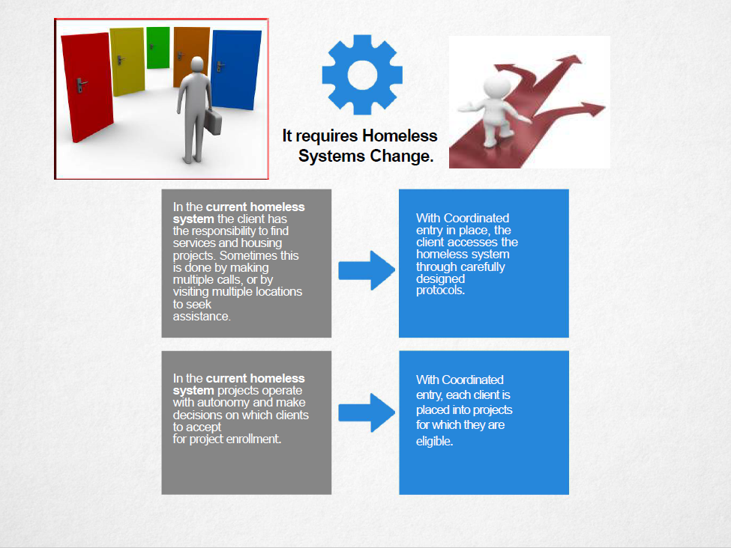

Slide 6
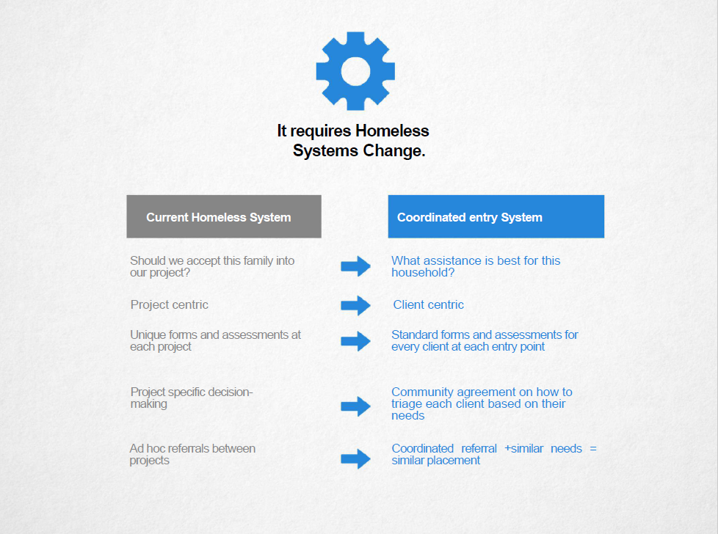

Slide 7
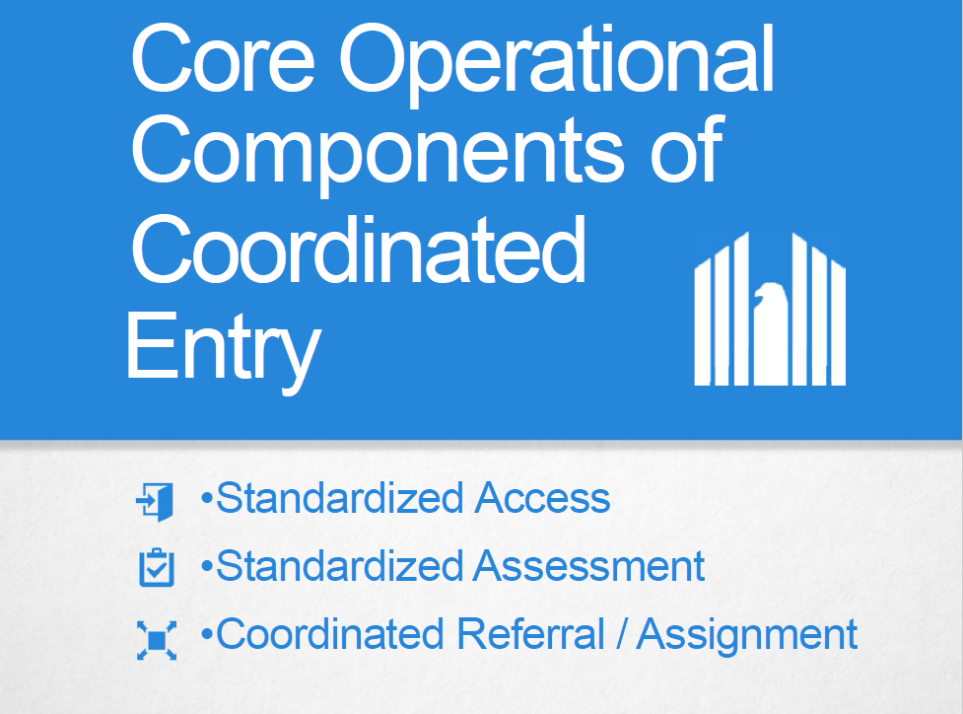

Slide 8


Slide 9
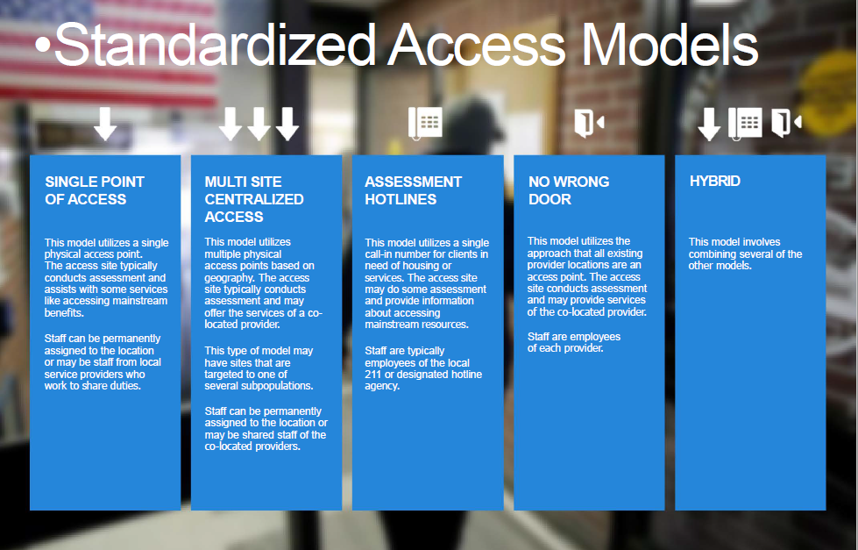

Slide 10
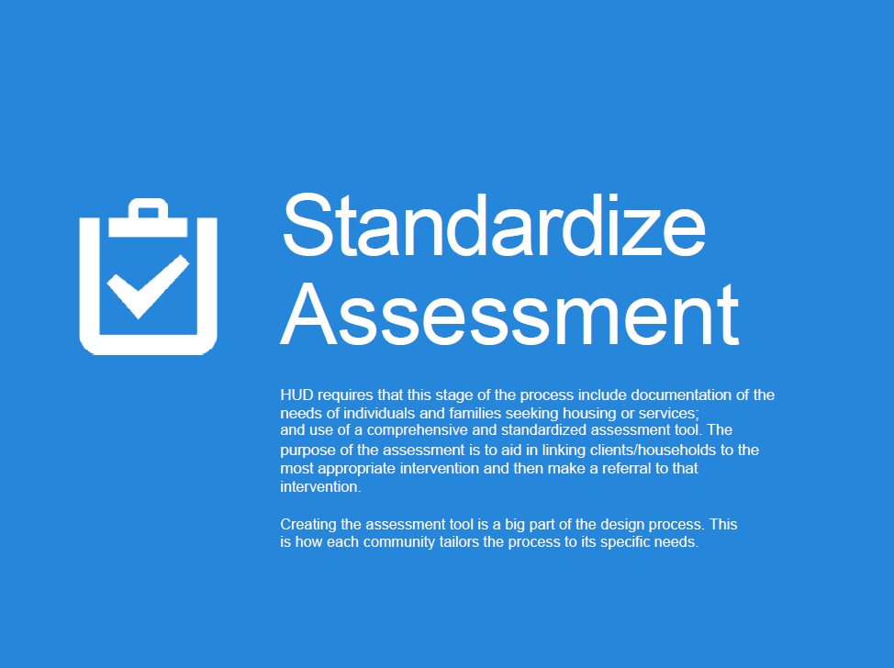

Slide 11
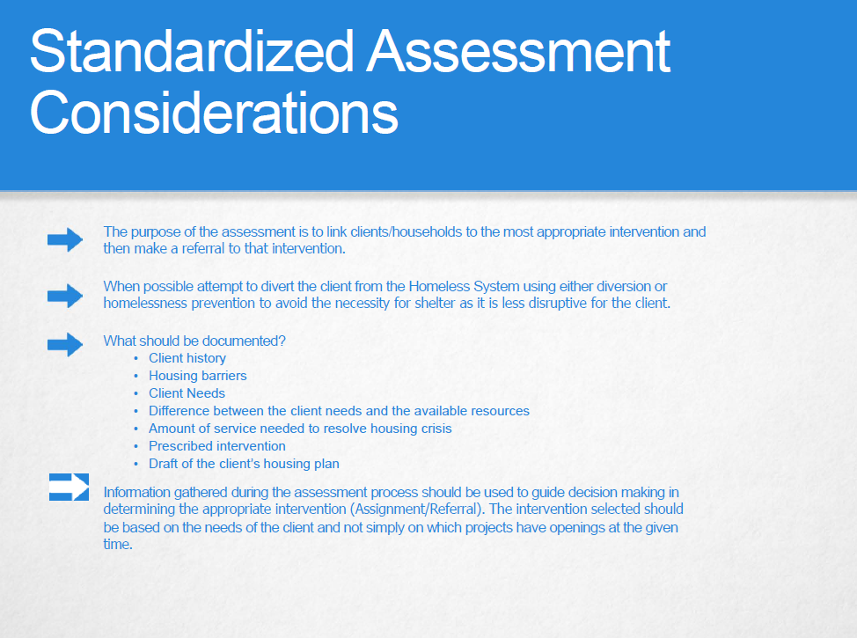

Slide 12
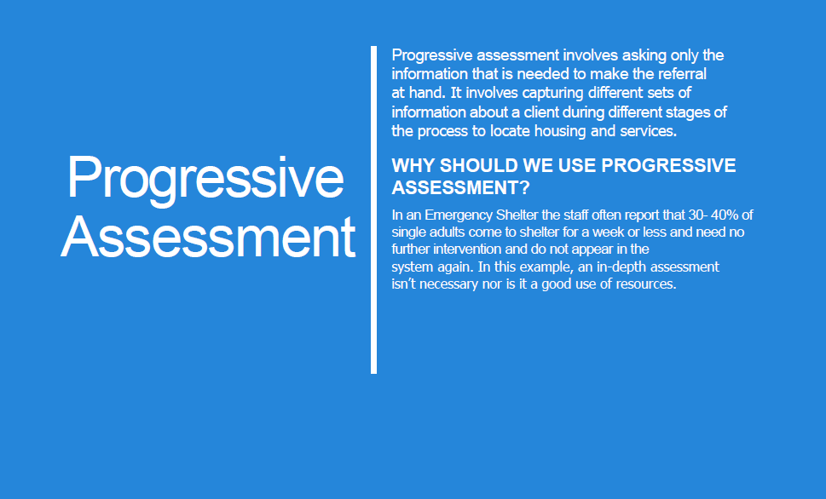

Slide 13
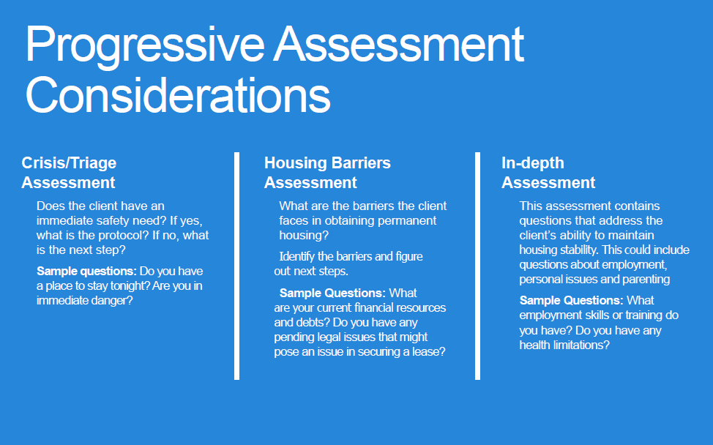

Slide 14


Slide 15
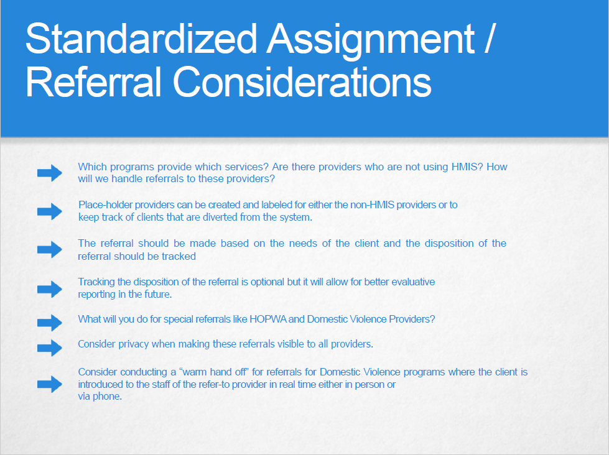

Slide 16
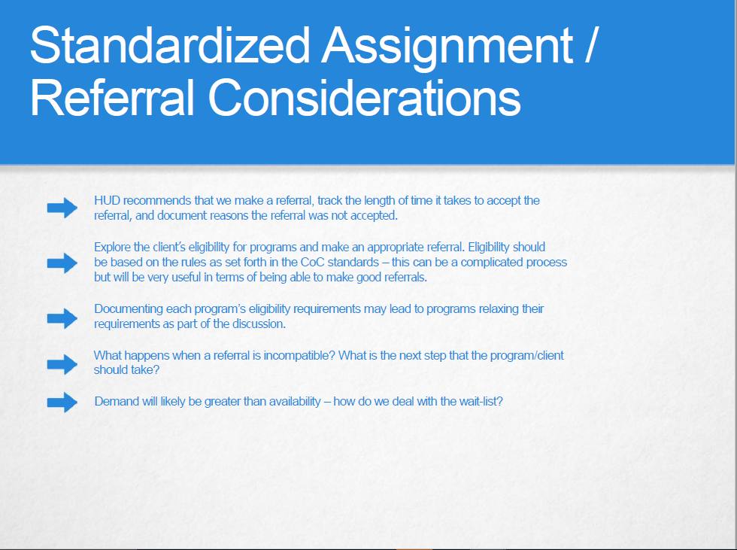

Slide 18
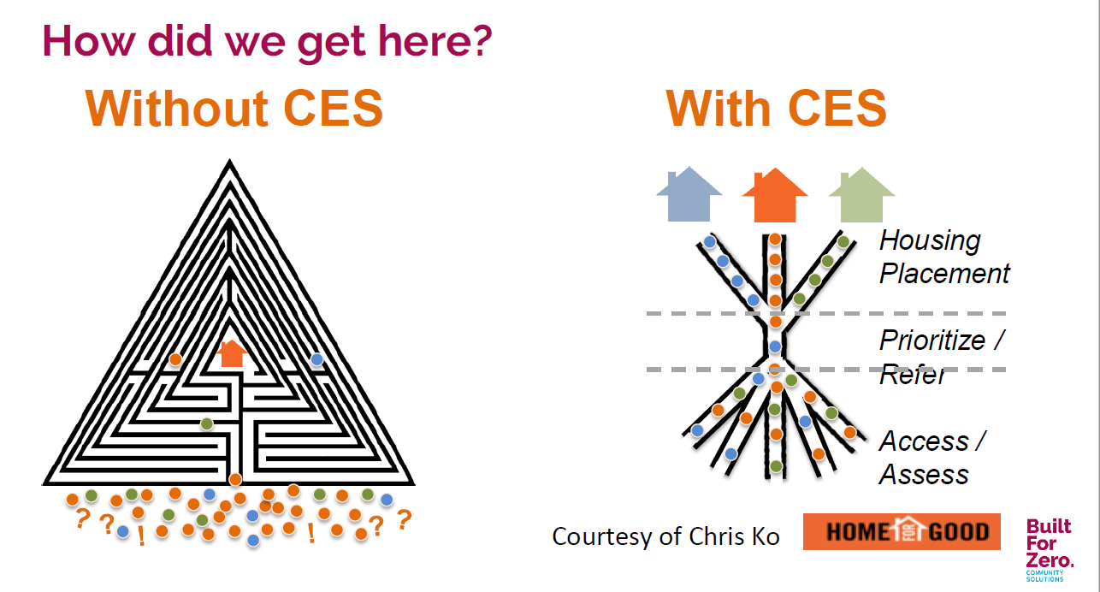

Slide 19
The Coordinated Entry Puzzle

Slide 31
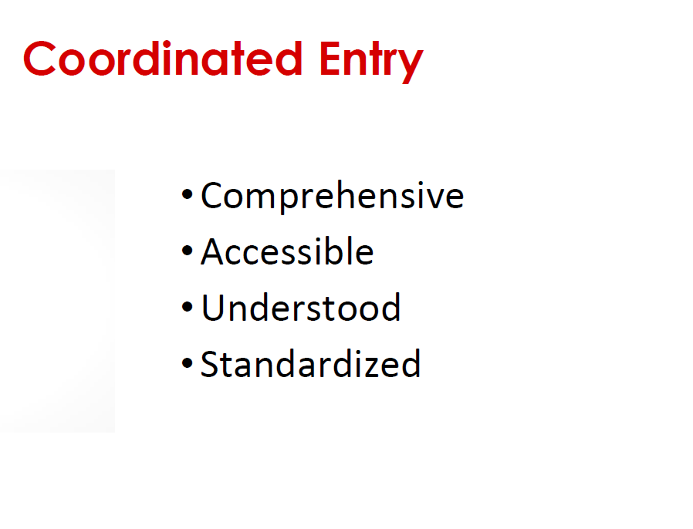

Slide 32
Principles?
Discussion

Slide 33
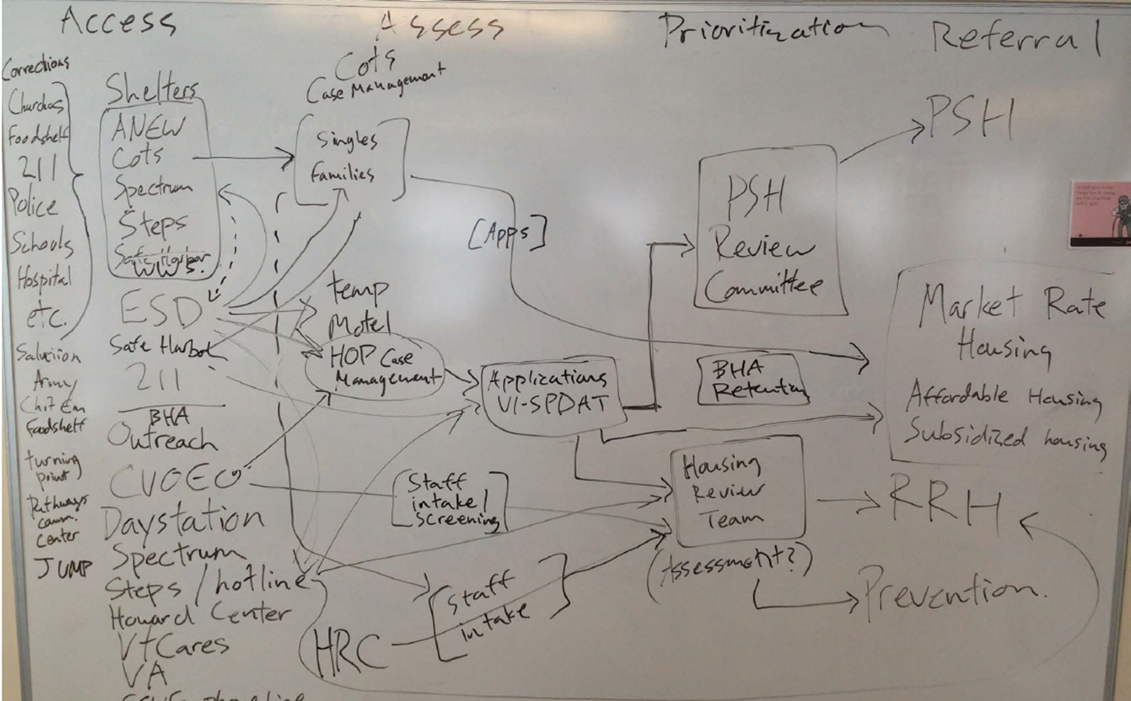
Our current system
(Why we need coordinated entry)

Slide 34
CCHA Progress so far
Established a process for access and prioritization to permanent supportive housing
  Use of the VI-SPDAT (for single adults)
  Use of the Committee for review of the prioritization list
HMIS Data Sharing Agreement – All agencies using HMIS/Service Point share HMIS information between agencies (with client permission)
We built an inventory of homeless assistance resources: permanent supportive housing, transitional housing, financial assistance (rapid re-housing, homelessness prevention), and case management (short term, long term)

Slide 35
PSH Process
VI-SPDAT (common assessment)
  Added to By name list outside HMIS
  Score 10 or above referred to PSH Review Committee
    Some exceptions – case by case review
PSH Review Committee
  Includes PSH stakeholders
  Reviews priority list and PSH vacancies to make referrals to PSH projects

Slide 36
PSH Process
Need to improve:
  Update prioritization principles for tie breakers
  Need to formalize case-conferencing practices
  Improve coordination for follow up (Housing Navigation)
    Navigating person through documentation/application process and getting to appropriate agency for program intake

Slide 37
Other collaborative processes
HOP Case management
  Coordinated assignments for case management
  Referrals come primarily from ESD/GA emergency motel program
Housing Review Team
  Weekly interagency meetings decide on prevention and rapid rehousing assistance

Slide 56
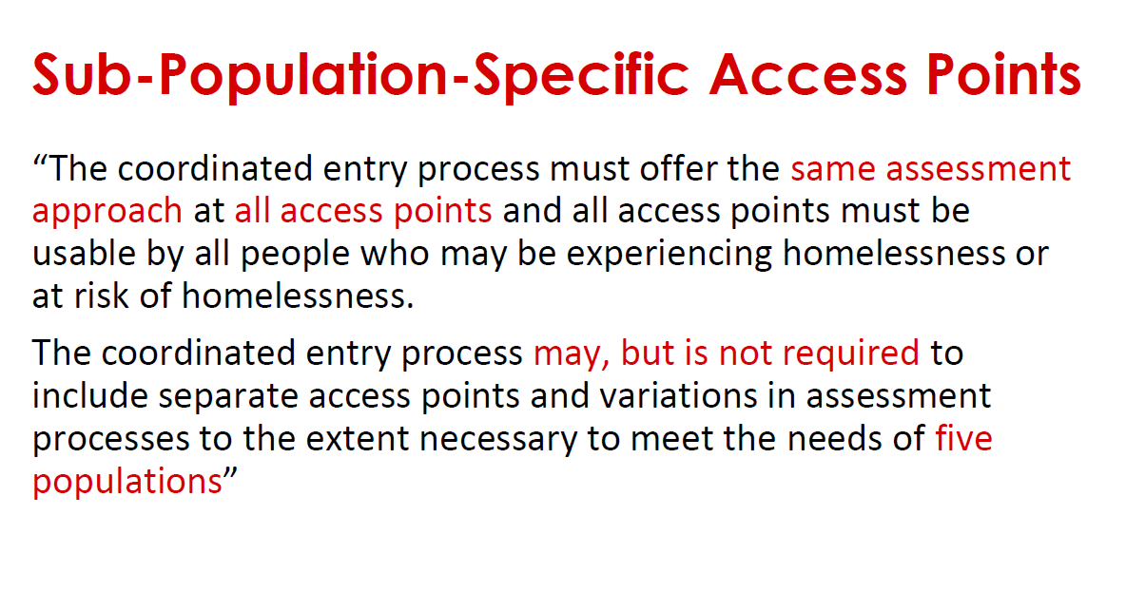

Slide 57
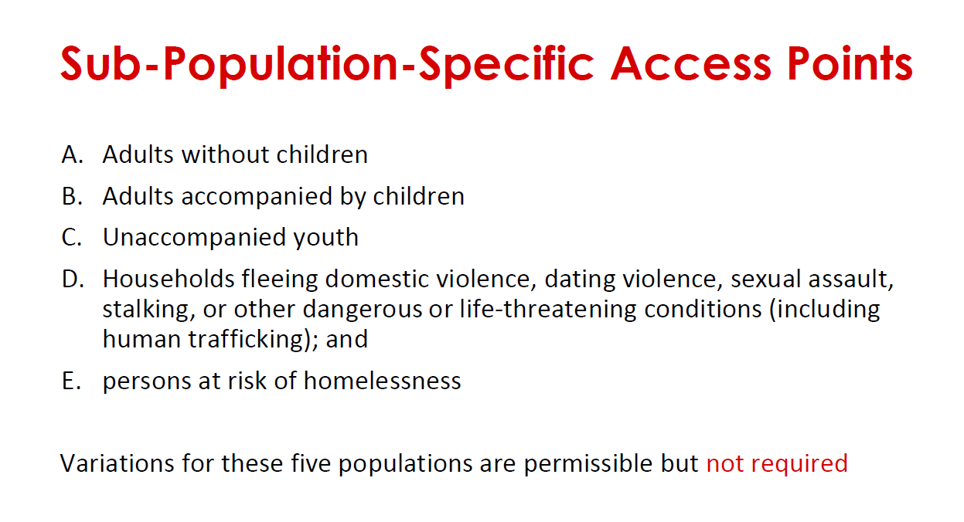

Slide 58
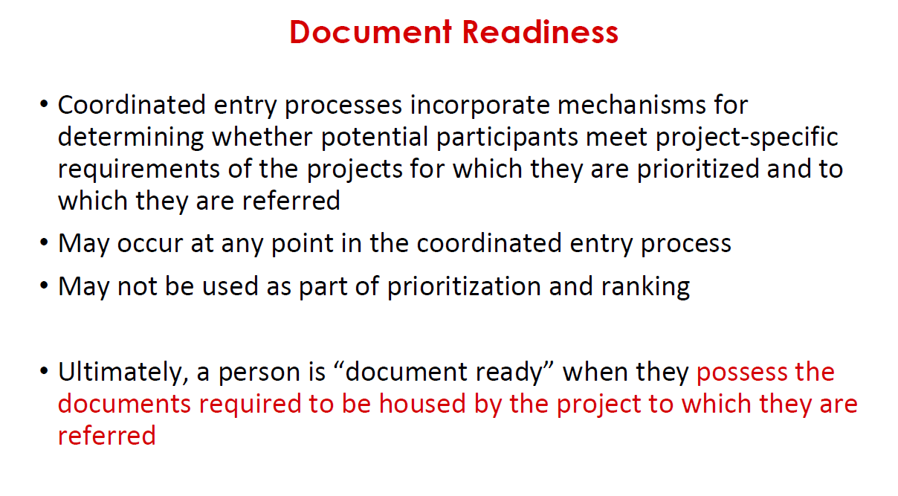

Slide 59
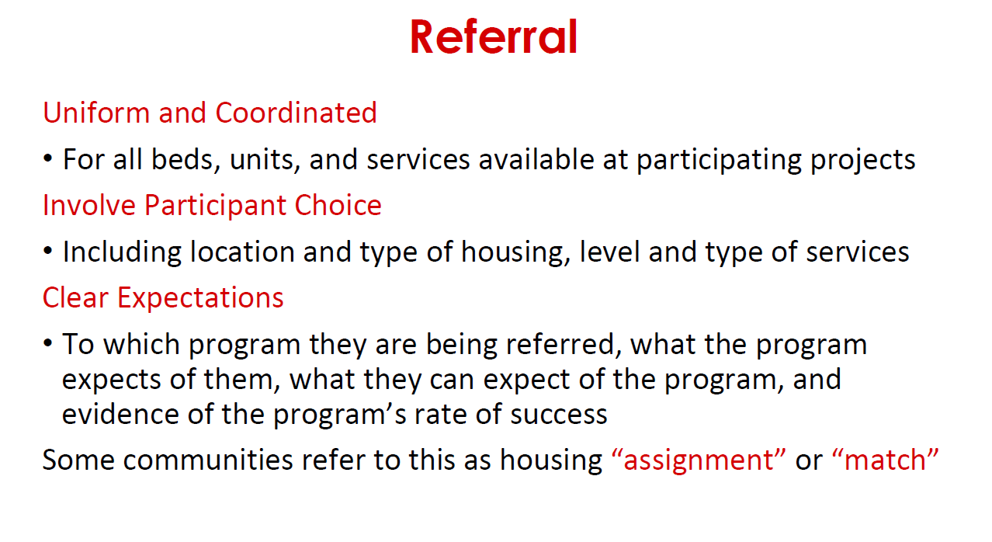

Slide 60
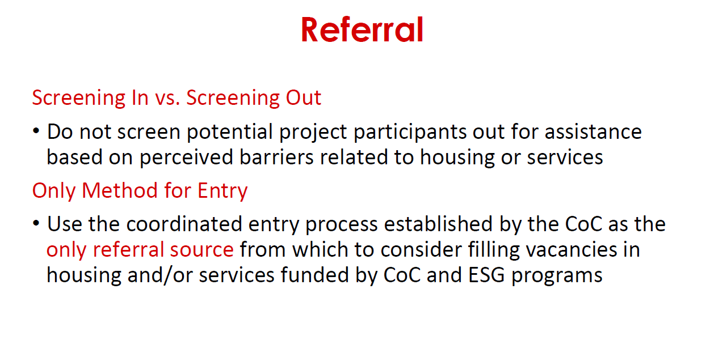

Slide 61
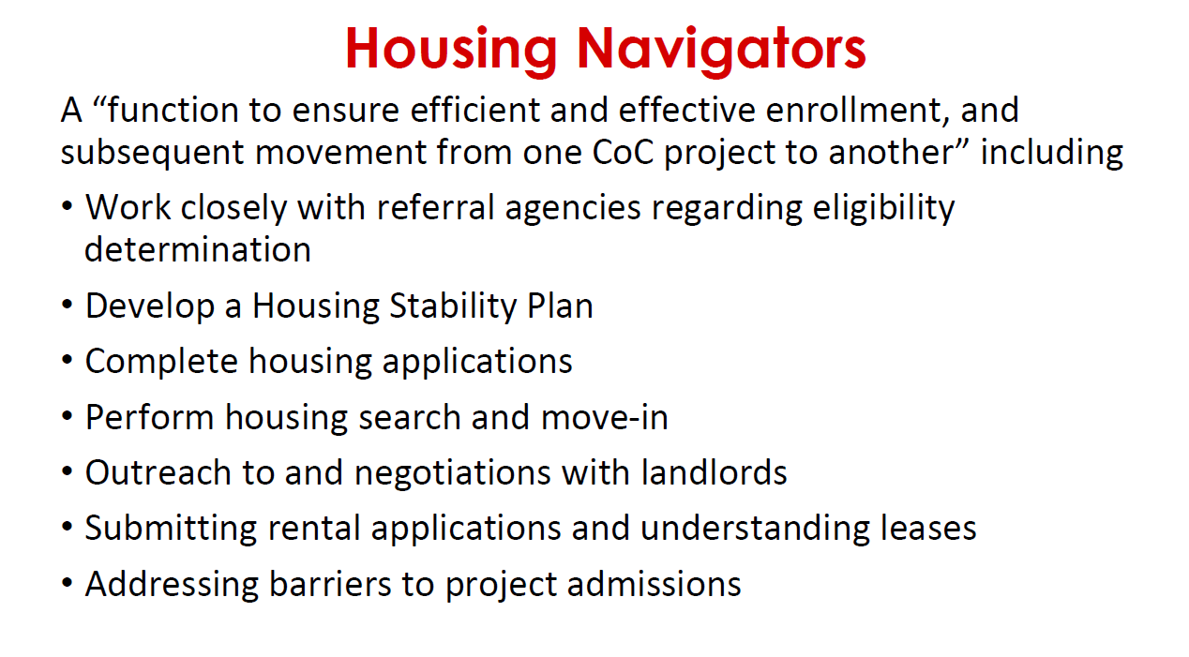

Slide 62
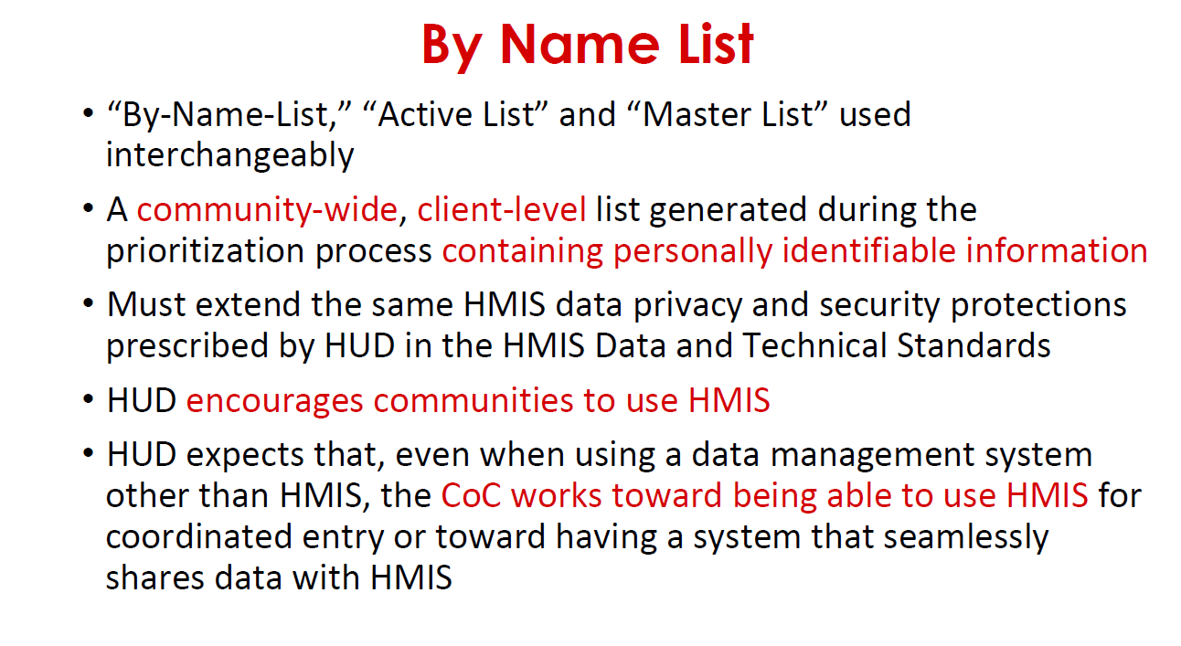

Slide 63
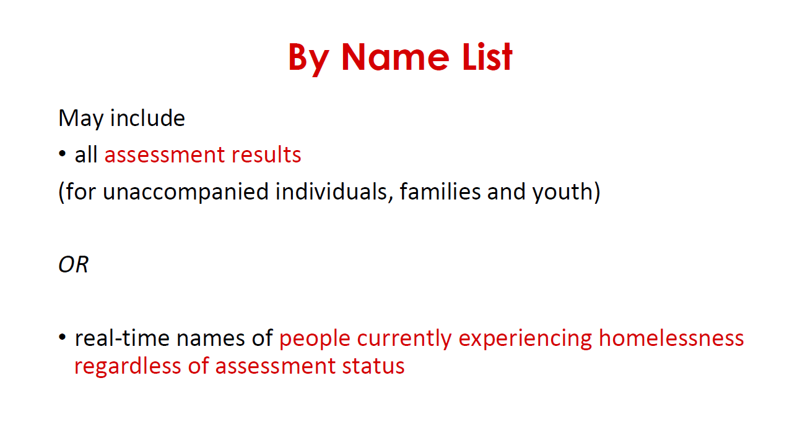

Slide 64
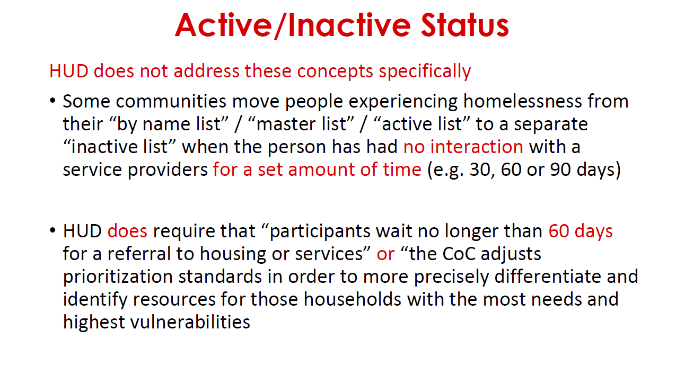

Slide 65
