Slide 10
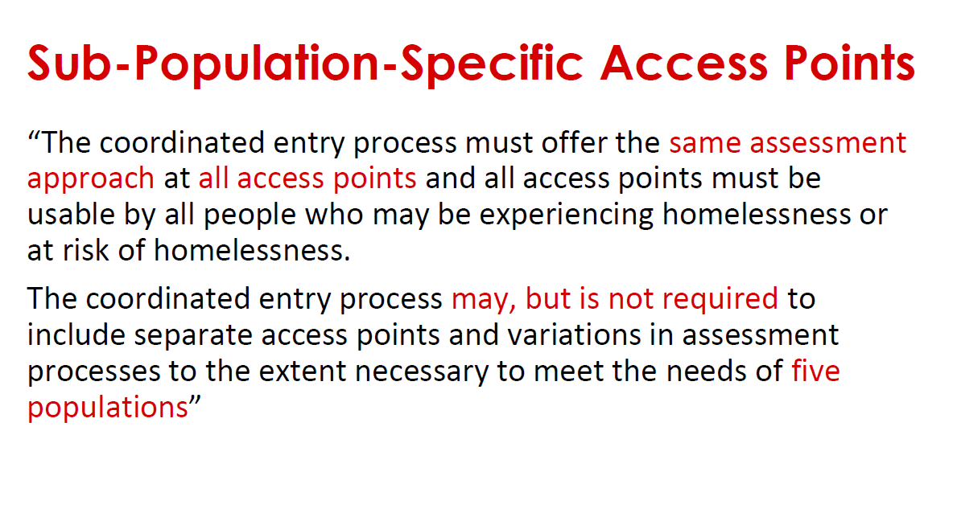

Slide 11
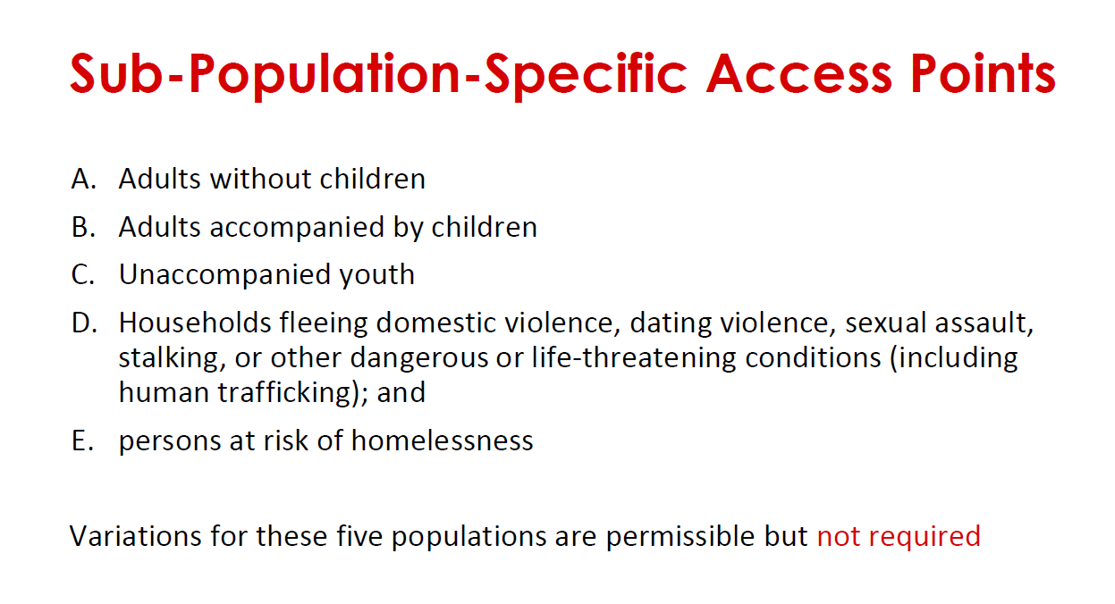

Slide 12
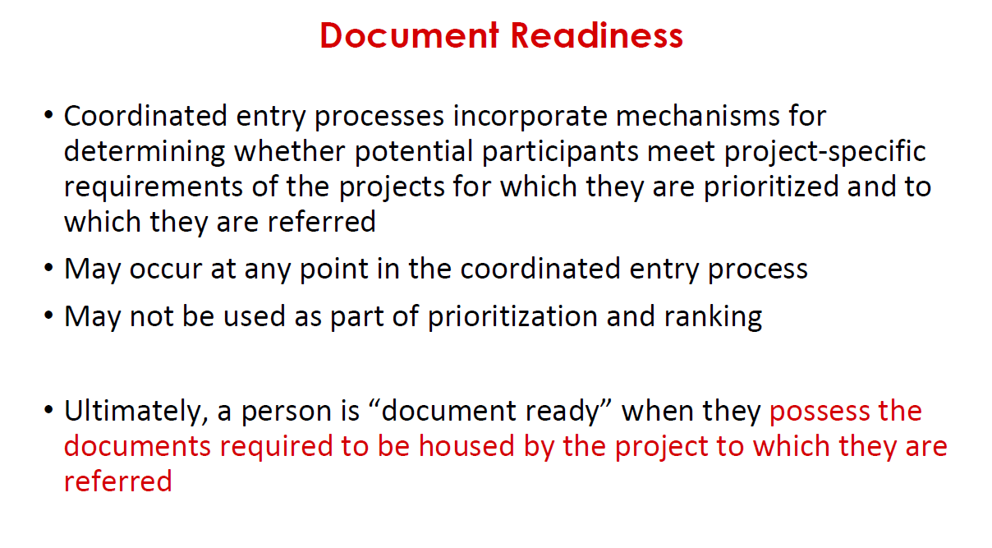

Slide 13
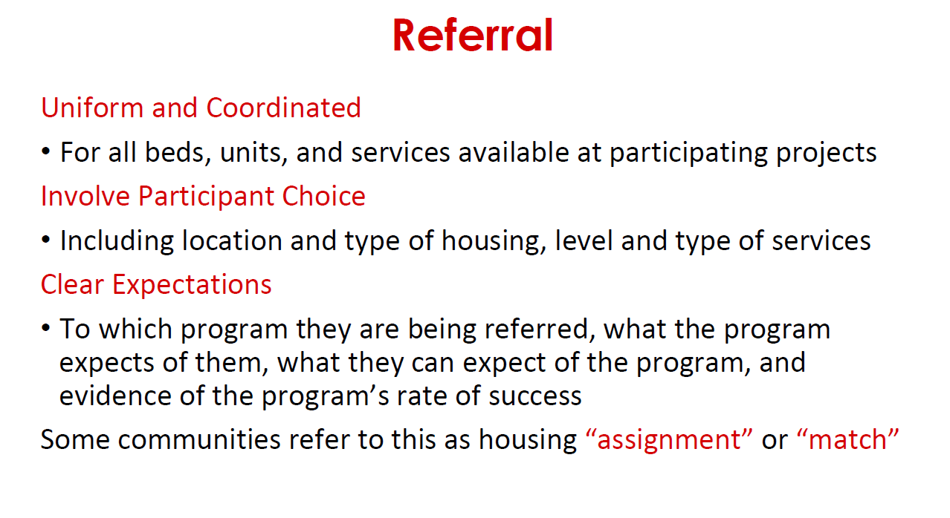

Slide 14
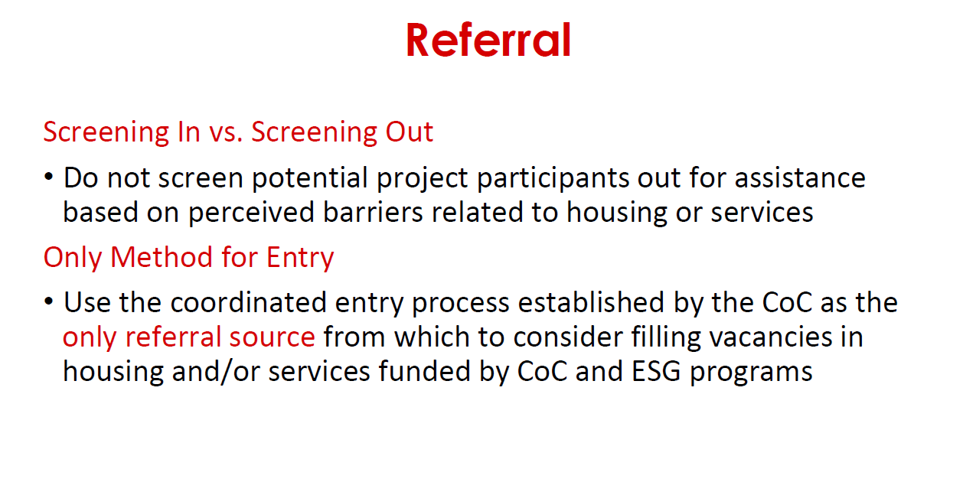

Slide 15
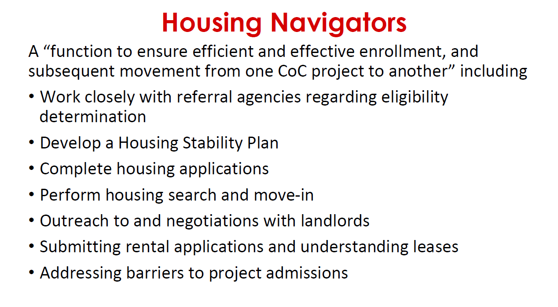

Slide 16
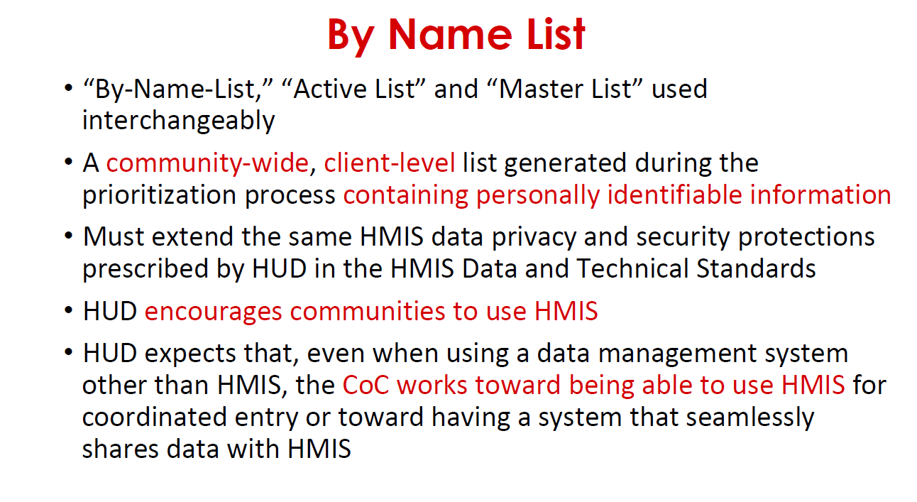

Slide 17
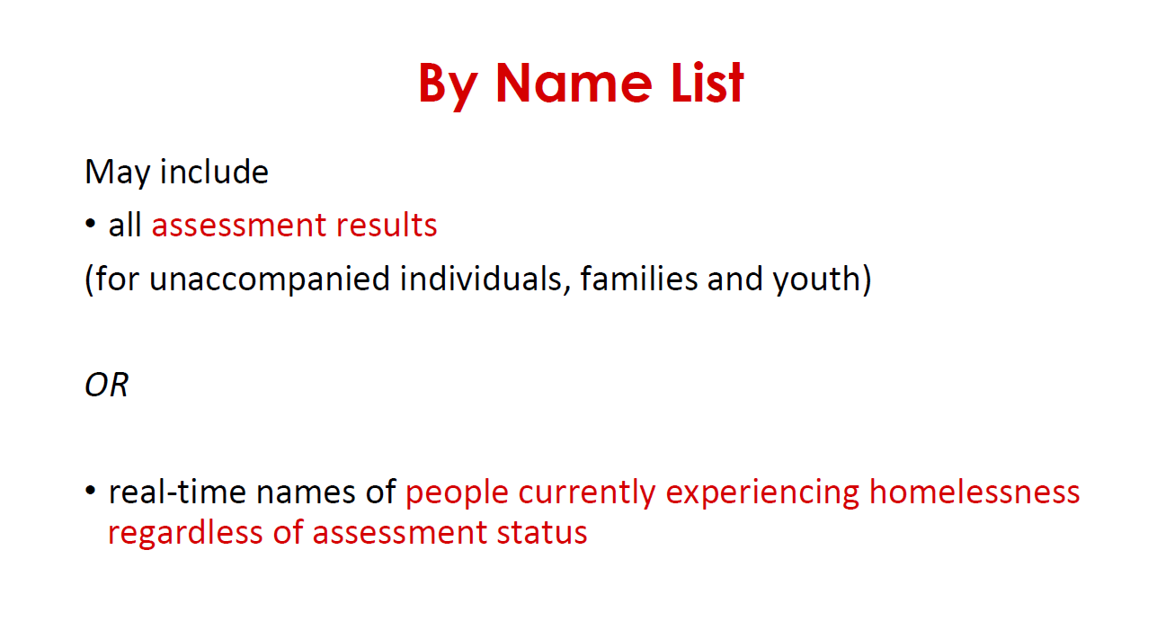

Slide 18
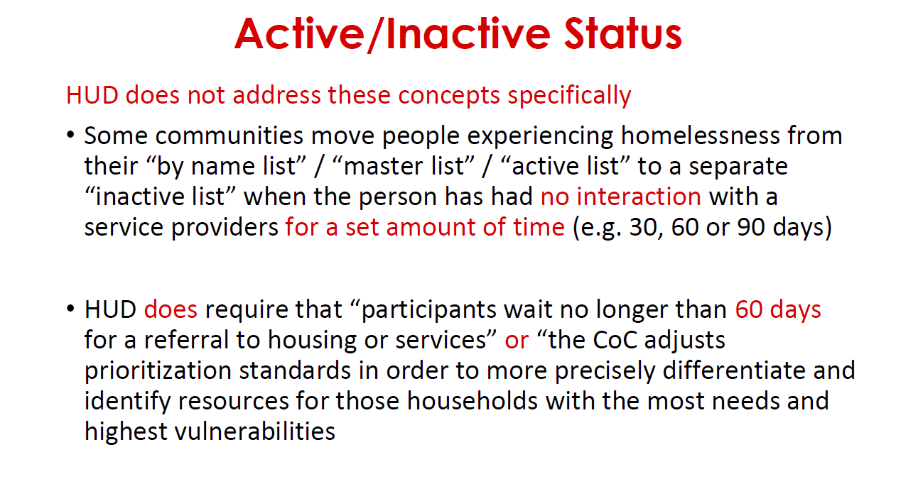

Slide 19

Types Of Prioritization & Matching
Primarily two:
Bucket Prioritization
Continuous Prioritization

Slide 20
Sample Distribution of Scores
1 2 3 4 5 6 7 8 10 11 12 13 14 15 16 17 18

Slide 21
Score “Buckets” for Matching
Mainstream PSH RRH
1 2 3 4 5 6 7 8 9 10 11 12 13 14 15 16 17 18

Slide 22
Continuous Matching
Low Medium Low
1 2 3 4 5 6 7 8 9 10 11 12 13 14 15 16 17 18
Notes:
High may get PSH, but gets next available resource, which in many communities may be RRH

Slide 23
Score | Frequency
5 | 34
6 | 37
7 | 34
8 | 37
9 | 44
10 | 53
11 | 60
12 | 47
13 | 26
14 | 21
15 | 17
16 | 4
17 | 1

Slide 24
Priotization
One of main purposes of CE is to ensure persons with most severe service needs and most vulnerable prioritized for housing and assistance

Slide 25
Prioritization
Communities decide what factors are most important for prioritization
Use all data and research to inform prioritization decisions
CE is meant to orient community to one or two principles for prioritization by which community can make resource utilization decisions

Slide 26
Some factors
Significant health or behavioral health challenges or functional impairments which require a significant level of support in order to maintain permanent housing;
High utilization of crisis or emergency services, including emergency rooms, jails, and psychiatric facilities to meet basic needs
The extent to which people, especially youth and children, are unsheltered
Vulnerability to illness or death
Risk of continued homelessness
Vulnerability to victimization, including physical assault or engaging in trafficking or sex work

Slide 27
Prioritization Questions
● What types of prioritization decisions are already being made? Are they based
on level of need, time spent waiting for available resources, or provider agency
preferences?
● Do variations in housing and supportive services availability and accessibility
throughout the CoC’s geography require varied prioritization strategies?
● Can prioritization be scored, quantified, or valued such that the priority list can
be regularly reviewed and updated?
● How will prioritization determinations be documented and communicated
among CoC housing and services providers?

Slide 28
Prioritization Questions
● How will a person’s priority level be updated when new information is revealed
or becomes available after the initial assessment?
● Will frequent users of CoC resources and/or mainstream resources be prioritized
differently; and if so, how?
● How will multiple existing and independently maintained waiting lists
be consolidated into a centralized priority list?
● What are the potentially different prioritization requirements established by funders (e.g., VA prioritization expectations for the Supportive Services for
Veteran Families program) that must be accommodated during the
referral process?

Slide 29
Prioritization Key Decisions
Which resources will be prioritized and which resources (e.g. immediate crisis response resources such as emergency shelter) will not be prioritized?
How will our community prioritize available housing and service resources? What criteria will be relevant for prioritization? Which populations should be targeted and how? Vulnerability? Length of homelessness? Sleeping location? Frequent service users?
How will our community prioritize for types of resources, e.g. Permanent Supportive Housing, Rapid Rehousing, Prevention Resources including Financial Assistance, Transitional Housing, Case Management?

Slide 30
Referral Questions
● Which entity or entities will manage the referral process? What resources will
be needed to ensure consistency and uniformity in the application of referral
decisions?
● How will the CoC’s change-management culture affect the complexity of the
coordinated entry referral system and its accuracy?
● How will providers handle letting go of paper and other manual processes
associated with the referral process? Will “backup” manual systems be tolerated;
if so, for how long?
● What are the expectations if the receiving agency takes too long to make a final
eligibility determination about a potential program participant? Will there be
exceptions for projects that are bound by eligibility verification requirements that
cannot be quickly facilitated?

Slide 31
Referral Questions
● What happens when the accepted referral ends up not being the best service
strategy for that participant? Can the receiving agency send the program
participant back to the referral entity or even back to assessment? And how will
this process be documented?
● Do scenarios and protocols need to be put in place for making referrals to
agencies that operate outside the CoC? What concessions on oversight, quality
assurance, acceptance policies and timeframes, and the use of data might be
needed in order to accommodate these additional resources? How will these
protocols and exceptions be documented in policies and procedures?
● How might the referral process need to respond to assessment that collected
inaccurate data about a potential participant, or to additional data disclosed by
the program participant late in the process?

Slide 32
Referral Key Decisions
How will referrals to specific projects be made? Will we utilize the HMIS? Will we use Review committees?
Will we use a By-name-list for prioritization and referral? Who will manage the BNL? How will it be managed?

