Slide 1
Coordinated Entry, The Resource Inventory
 |  |  |  |  | Gatekeeper 3 | Gatekeeper 4 |  | Short-term (<90 days) | Medium-term (90-365 days) | Long-term (> year) |  |  |  |  |  |  | Type of Subsidy 1 | Type of Subsidy 2 | Type of Subsidy 3 | Market Rate
Program | Type of Assistance | Primarily for Homeless | Prevention | HMIS | Gatekeeper 1 | Gatekeeper 2 |  | Single Adults | Families | Youth | Sober | Veterans | Corrections | DV | Eligibility |  | Graduation Plan | Notes | Number of Case Mgt FTEs | Amount available
Ready Set Rent | Addressing Barriers (Training) | FALSE | FALSE | FALSE | CHT |  |  | 0 | 0 | 0 | FALSE | FALSE | FALSE | FALSE | Applied for CHT housing, bad / no credit
Rent Right | Addressing Barriers (Training) | FALSE | FALSE | FALSE | CVOEO | Landlord |  | 0 | 0 | 0 | FALSE | FALSE | FALSE | FALSE
BHA Housing Retention & Rapid Rehousing Team | Case Management | TRUE | TRUE | FALSE | BHA | CHT |  | 0 | 0 | 0 | FALSE | FALSE | FALSE | FALSE
Canal St Case Mgt | Case Management | TRUE | FALSE | TRUE | VA | COTS |  | 0 | 0 | 0 | FALSE | TRUE | FALSE | FALSE
Community Health Team | Case Management | TRUE | FALSE | FALSE | UVM Medical Center |  |  | 0 | 0 | 0 | FALSE | FALSE | FALSE | FALSE
Corrections Case Mgt | Case Management | FALSE | FALSE | FALSE | Corrections |  |  | 0 | 0 | 0 | FALSE | FALSE | TRUE | FALSE
COTS Case Mgt | Case Management | TRUE | FALSE | FALSE | COTS |  |  | 35 | 70 | 0 | FALSE | FALSE | FALSE | FALSE
CVOEO Case Mgt | Case Management | TRUE | FALSE | TRUE | CVOEO | HOP Case Management |  | 0 | 0 | 0 | FALSE | FALSE | FALSE | FALSE
Hospital Inpatient and Outpatient | Case Management | FALSE | FALSE | FALSE | UVM Medical Center |  |  | 0 | 0 | 0 | FALSE | FALSE | FALSE | FALSE
Howard Case Mgt | Case Management | FALSE | FALSE | FALSE | Howard |  |  | 0 | 0 | 0 | FALSE | FALSE | FALSE | FALSE | Services extend beyond housing.

Slide 2
Coordinated Entry: Where we started
There were four categories of Action given to us. It was the framing we used to think about the system we would want to create. The first goal was to “populate” each category with its actors and its function.
ACCESS (Intake) |  |  | ASSESSMENT (intake) |  | PRIORITIZATION 1 |  | PRIORITIZATION 2 |  | PROGRAM
Access (Agency) | Triage | Urgent Assistance | Data Collection (Paper form) | Long Term Type of Assistance | Analysis and Conversation (Agencies) | Subpopulation Committee | Referral Committees | Type of Assistance | Programs
 |  |  |  |  |  |  |  |  | Single Adults
Referral >>>>> | Referral >>>>> | Referral >>>>> | VI-SPDAT | Permanent Supportive Housing | BHA | single adults | PSH Review Committee | Case Management | COTS Case Mgt
^^ When need is not urgent ^^ |  |  |  | Rapid ReHousing | CHT |  | Housing Review Team | Permanent Supportive Housing | 20 So. Willard
ANew Place | Is your need urgent? >> NO >> | Refer to Assessment>> |  | Transitional | CVOEO |  | Transitional Housing Committee | Permanent Supportive Housing | 30-42 King
BHA |  |  |  | Addressing Barriers | ESD |  | HOP Case Manager Group | Permanent Supportive Housing | Beacon Apts
CHT | Is your need urgent? >> YES >> | Shelter | some other form | Subsidy | Howard |  |  | Permanent Supportive Housing | Branches
Corrections |  | Mental Health |  | Financial Assistance | JUMP |  |  | Permanent Supportive Housing | Housing First
CVOEO |  | Medical |  | Case Management | Medical Center |  |  | Permanent Supportive Housing | New Horizons
ESD | << When urgent need is met, refer <<< | Detox |  |  | Pathways |  |  | Permanent Supportive Housing | Reallocation Project
Howard Center | <<< back to any Access Point <<<<<<<<< | Police |  |  | Phoenix |  |  | Permanent Supportive Housing | Sarah Cole
JUMP |  |  |  |  | Safe Harbor |  |  | Permanent Supportive Housing | VASH
CHCB |  |  |  |  | Spectrum |  |  | Transitional | ANew Transitional
Pathways |  |  |  |  | Steps |  |  | Transitional | Canal Street
Street Outreach Team |  |  |  |  | UVM Medical Center |  |  | Transitional | Dismas
Safe Harbor |  |  |  |  | VA |  |  | Transitional | Northern Lights
Spectrum |  |  |  |  | VSHA |  |  | Transitional | Pathways
Steps |  |  |  |  | VT CARES |  |  | Transitional | Phoenix Housing
UVM Medical Center |  |  |  |  | VT Veterans Services |  |  | Transitional | Safe Haven
VA |  |  |  |  | COTS |  |  | Transitional | Smith House
VT CARES |  |  |  |  | Etc. |  |  | FAMILIES | FAMILIES
VT Veterans Services |  |  |  |  |  | families | PSH Review Committee | Permanent Supportive Housing | Housing First
COTS |  |  |  |  |  |  | Housing Review Team | Permanent Supportive Housing | VASH
Here to Help Clinic |  |  |  |  |  |  | Transitional Housing Committee | Transitional | Canal Street
Churches |  |  |  |  |  |  | HOP Case Manager Group | Transitional | Family Supportive Housing
211 |  |  |  |  |  |  |  | Transitional | Sophie's Place
 |  |  |  |  |  |  |  | Youth | Youth
 |  |  |  |  |  | Youth | PSH Review Committee | Permanent Supportive Housing | 141 Maple
 |  |  |  |  |  |  | Housing Review Team
 |  |  |  |  |  |  | Transitional Housing Committee | Transitional | Pearl Street
 |  |  |  |  |  |  | HOP Case Manager Group | DV | DV
 |  |  |  |  |  | DV | PSH Review Committee | Case Management | Steps Case Mgt
 |  |  |  |  |  |  | Housing Review Team | Financial Assistance | Homeless Prevention Financial & Rental Assistance
 |  |  |  |  |  |  | Transitional Housing Committee | Financial Assistance | RRH Financial & Rental Assistance 3
 |  |  |  |  |  |  | HOP Case Manager Group | Transitional | Sophie's Place

Slide 3
Access Point
Triage
ANew Place
BHA
CHT
Corrections
CVOEO
ESD
Howard Center
JUMP
CHCB
Pathways
Street Outreach Team
Safe Harbor
Spectrum
Steps
UVM Medical Center
VA
VT CARES
VT Veterans Services
COTS
Here to Help Clinic
Churches
211
Etc.
Common interview questions and VI-SPDAT
Refer to Assessment
No
Our first task was to acknowledge the duress in which a client might be.
Are you in urgent need today?
Yes
Medical
Detox
Mental Health
Police
Shelter
Uvm Medical Center
Act I
Howard Center
Police
ANew Shelter
COTS Family Shelter
Emergency Housing (CWE)
Emergency Housing (regular)
Medical Respite
Spectrum Youth Shelter
Warming Shelter
Waystation
Urgent needs met; refer to access point.

Slide 4
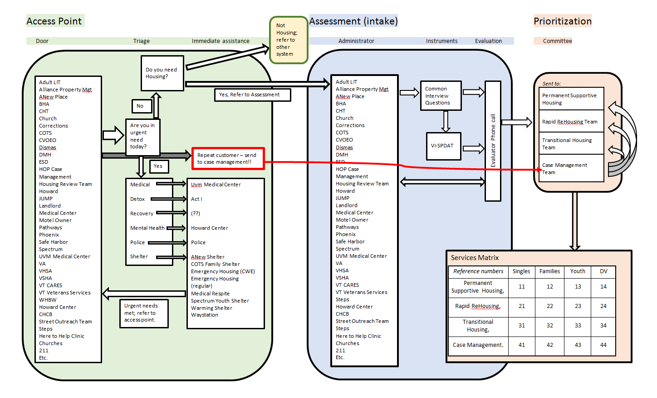
Then we populated the other categories. The access point, conducting triage, might meet urgent needs, then later it might collect information. We imagined first that we would have an instrument composed from the intake forms from all of the cooperating entities. This would give guidance to the administrator as to whether the VI-SPDAT is needed.

Slide 5
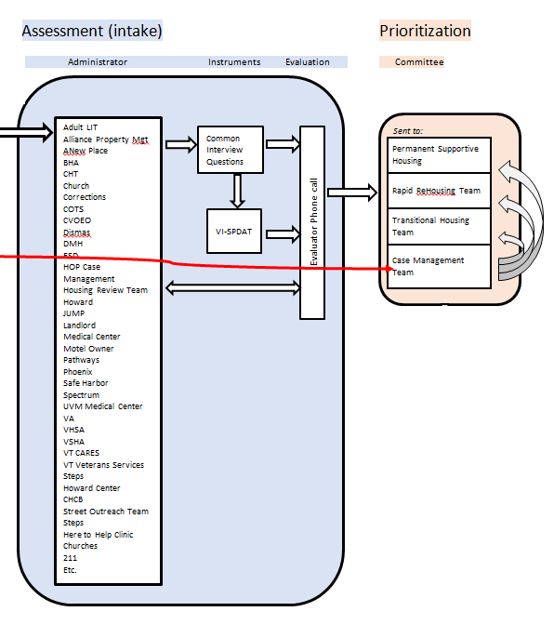
Then, this information in hand and entered into the HMIS, a call would be placed to the on-call expert evaluator, to determine which team the applicant would be forwarded to.
Alternatively, we might decide that evaluating the intake information is not so difficult, and the administrator of the intake could determine which team to forward the applicant to.
The applicant knows on the day of application what sort of housing assistance s/he will be offered.

Slide 6
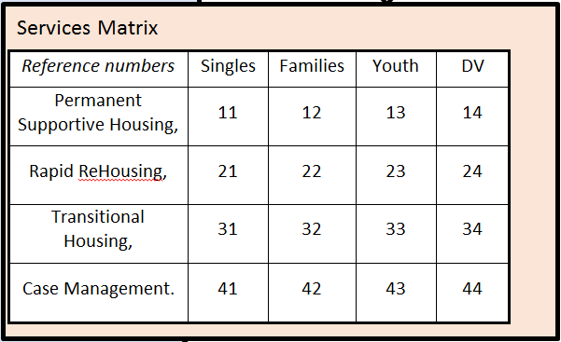
We immediately ran into a problem. There are at least four populations, and no fewer than three possible forms of housing distress to respond to. Plus we had other categories of action, such as Case Management, and “Subsidy” which we couldn’t quite place in the system we were imagining. I resorted to a matrix.
In a separate table, the resources (Smith house) can be listed under their key numbers, (31, which is transitional housing for single adults).

Slide 7
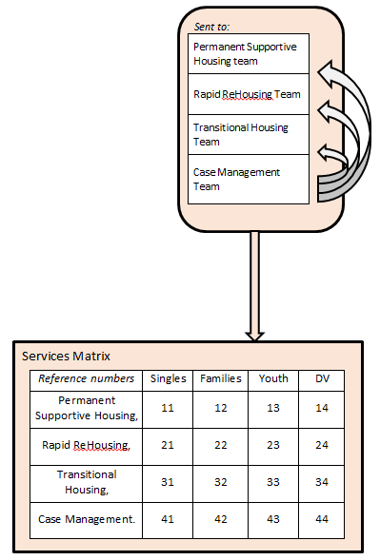
Each team handles a different set of resources,
Needs support to remain housed
Has most necessary resources, needs new location.
Needs extra supports before return to permanent housing environment.
Where the complexity of the client’s issues does not fit easily into the other categories.
Every Team handles all demographic categories. Since housing programs tend to specialize in a particular demographic, hopefully there will be very little need to choose between clients in different demographic groups.
Using the Resource Inventory, we will be able to assign key codes to each program. This has been done roughly in the spread sheet depicted on page two of this PP.

Slide 8
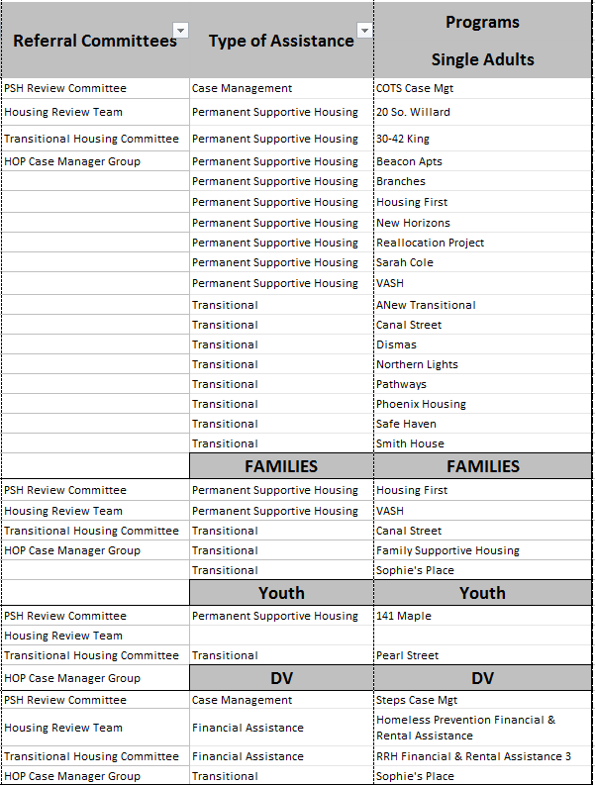
As seen in this close-up, and as depicted in the next portion of the flow-chart, below.

Slide 9
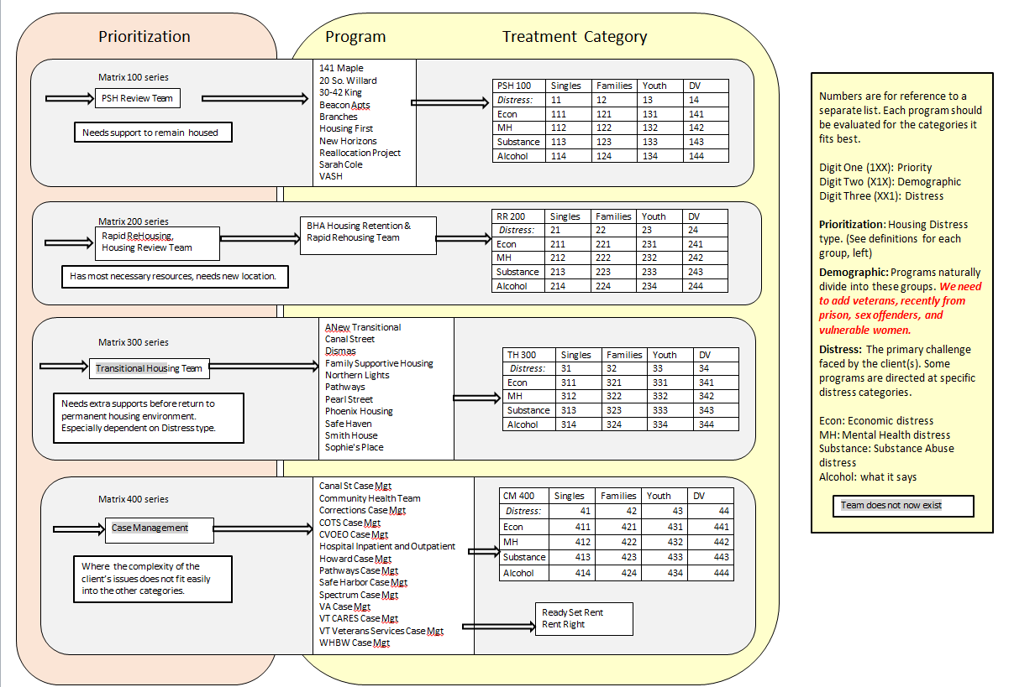
The idea of a treatment category may or may not be useful. Some programs may fit under a two digit designation, while others may need a three digit designation.

Slide 10
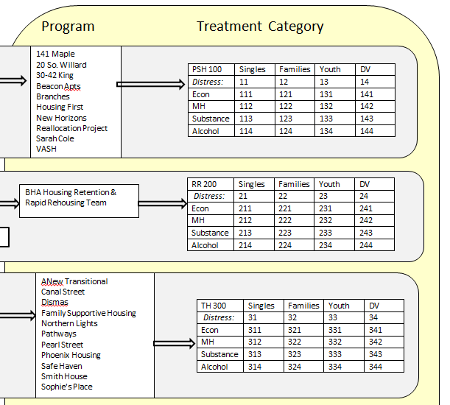
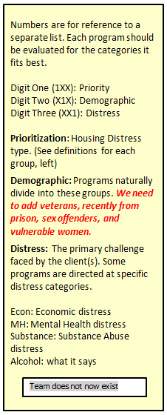
In any event, the Team evaluates the application and recommends a program placement to the client.

Slide 11
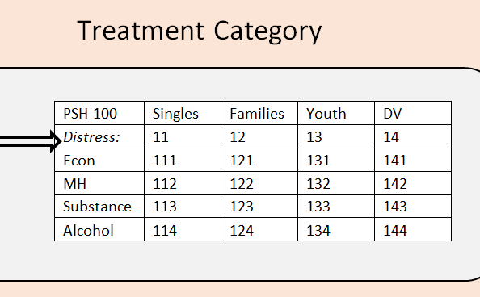
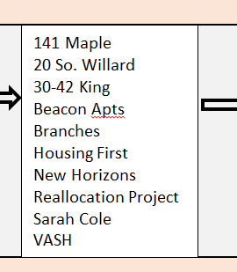
The Beacon Apts suggest another distress category: Recovery from a hospital stay.
The Dismas House reminds us that some facilities are for folks coming out of jail/prison, although DH takes its residents directly from incarceration.

Slide 12
There are resources for the homeless all over Chittenden County.
At this stage in the development of the Access Map, the list of providers hasn’t been cleaned up.
There are those who will want to provide “any-door” access, who are not listed, and those who will want to be a program, and not provide “any-door” access, who are listed.
There will be churches, towns and police departments who will join in our efforts.
So this list will need to be culled, and filled, over time, as we build our Coordinated Entry System.

Slide 13
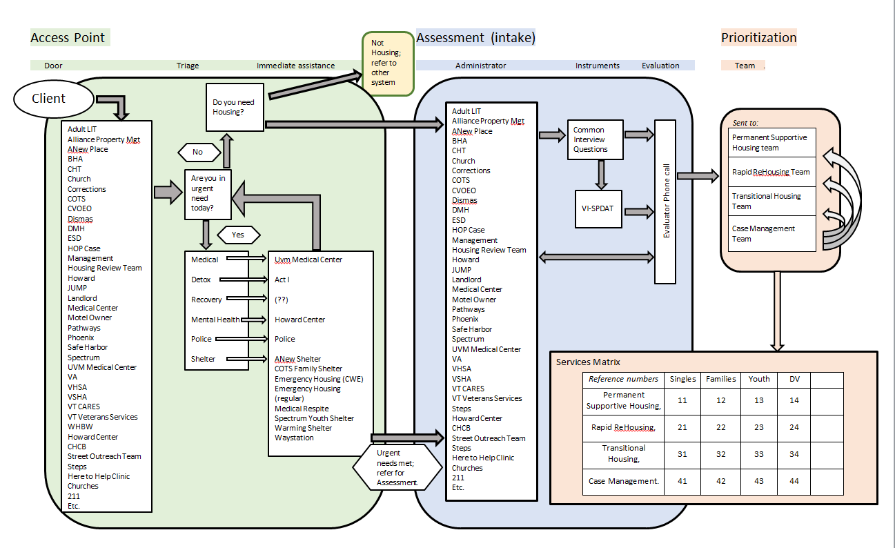
Coordinated Entry “Access Map” 2017-07-26

Slide 14
