Slide 1

Coordinated Entry Partnership Overview
Insert CoC Name
Insert Date

Slide 2
Introductions
Name
Organization
What role your organization plays in Coordinated Entry?
        Lead Agency, Assessment Partner, Referral Partner, no formal role, not yet determined
On a scale of 1-10, how familiar are you with Coordinated Entry and how it works?
Notes:
After Introductions – Optional Discussion Question
What burning questions do you have about Coordinated Entry?
Record the answers on whiteboard or flip chart. Review at the end of training. If there are still questions that have not been answered, discuss those questions or offer to bring back answers to the training attendees at a later time.

Slide 3

Introductory Discussion
What does the “system” currently look like for a person to get housing in our community? What works well with this system? What doesn’t work well?
OR
What did the “system” look like prior to Coordinated Entry for people your organization serves to get housing? What works well with this system? What doesn’t work well?
Notes:
Discuss for five minutes in small groups of 3-4 people, then have folks share out.

Slide 4
Today’s Agenda
What is Coordinated Entry? Why is it important?
Coordinated Entry Partnership
Coordinated Entry Process – Step by Step
Confidentiality and Information Sharing
The Process for Survivors of Domestic Violence
Outreach & Nondiscrimination
Training and Evaluation

Slide 5
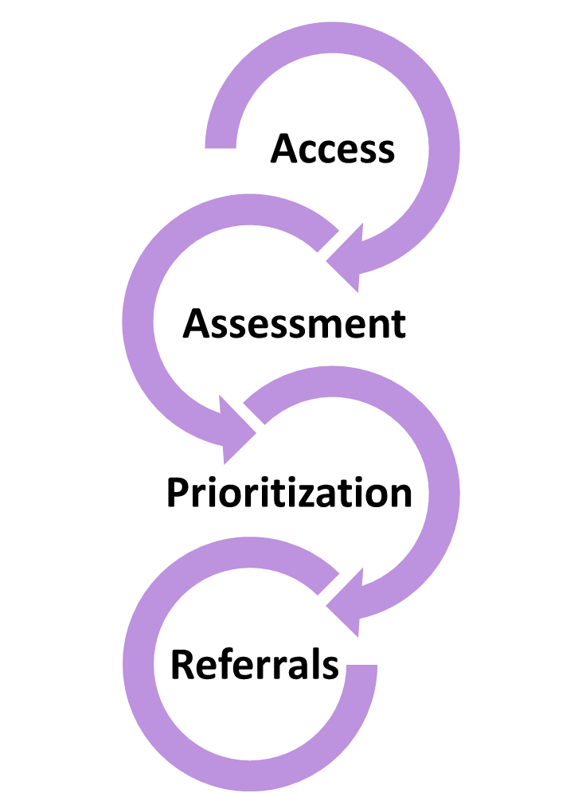
What is Coordinated Entry?
Overarching goals
Reorient system to focus on those being served
Minimize time and frustration accessing help
Maximize use of system resources
Identify service gaps for planning
Notes:
Coordinated entry is about ensuring that access to homeless services in our community is streamlined and that people experiencing or at-risk for homelessness are able to quickly access the assistance they need and for which they are eligible, without having to call or be turned away from multiple programs.
Review Goals.
Coordinated entry provides clarity around access, assessment, prioritization and referrals

Slide 6
Crisis Response System without Coordinated Entry (Boston example)
Emergency shelters
Street Outreach
Day & Meal
Programs
Healthcare for the Homeless
Youth
Programs
Staying with Friends/Family
Boston VA
County Jail/Prison
Psychiatric & Mainstream Hospitals
Detox/ Treatment
Pilgrim (Shelter)
Pine Street Inn (Shelter)
New England Center
(Shelter)
Woods Mullen
(Shelter)
DV Shelters
St. Francis House (Day and Overflow Shelter)
DMH Shelter
Source: Boston Mayors Task Force on Individual Homelessness
Long Island (Shelter)
DMH Safe Haven
Transitional Housing
Waitlists, screening criteria
Waitlists, screening criteria
Waitlists, screening criteria
Screening criteria, financial barriers
Permanent Supportive Housing
Public Housing
Affordable Housing
Market Rate Housing
Notes:
This is an example that came out of Boston’s coordinated entry planning.
Does it look familiar?
People in housing crisis or homeless knock on a lot of doors and go through a lot of doors on their way to permanent housing.
The path is confusing, it is frustrating, it’s not clear to providers or to clients
Navigating your way through slows your down

Slide 7
Clients face barriers & challenges
Difficult for individuals and families to access services and housing
Separate referral processes for each agency
Unique assessment at each agency
  Questionable how accurate we are in matching people
Difficult to know service and housing availability across the system
Challenge to evaluate effective utilization to manage achievement of goals

Slide 8
Before Coordinated Entry:
Should we accept this client into our program?
Client has to find services & housing. Multiple calls, visiting multiple locations
Inconsistent communication & understanding of what’s available
Different forms and assessments at each project
Ad-hoc referrals between projects
With Coordinated Entry:
What housing and services are best for this household, and available?
Client accesses help through clear doors and carefully designed protocols
Consistent, clear communication to partners & clients about what’s available
Standard forms and assessments for every client, no matter where they start
Community agreement on where to refer
Notes:
Coordinated Entry Re-orients our “System”
With Coordinated Entry:
We get to ask: What housing and services are best for this household, and available?
Instead of wasting time knocking on lots of doors and still ending up in back in the hallway, Clients get help through clear doors and carefully designed protocols
There is greater Transparency and Clarity for providers and clients about what’s available
Standard screening and housing needs assessment for every client, no matter where they start
Community agreement on where to refer

Slide 9
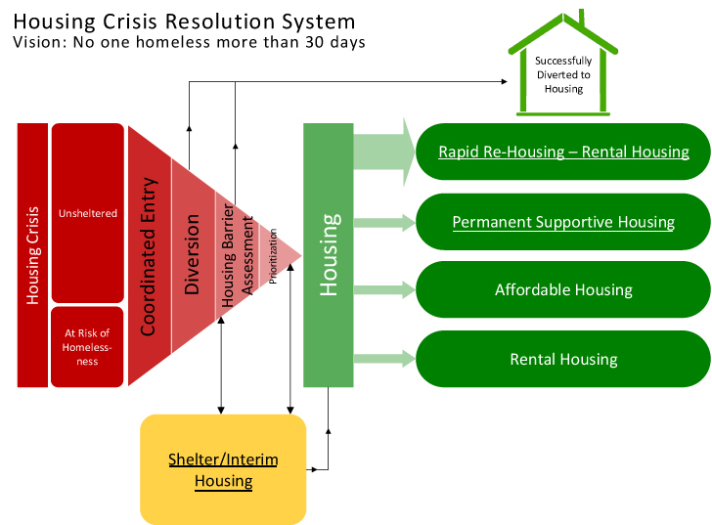
Crisis Response System with Coordinated Entry
Source: Focus Strategies Housing Crisis Resolution System
Notes:
Coordinated Entry Re-orients our “System”
It creates a clear pathway to permanent housing, making it easier for clients and providers to navigate.
Everyone experiencing a housing crisis receives a standard housing assessment.
The assessment helps to match people to the housing resource that best fits their needs. Limited housing programs for people who are homeless (like shelter + care and rapid re-housing vouchers) are then prioritized based on best fit and highest needs.
People have access to emergency shelter during their crisis, just as they do with our current system.

Slide 10
In Vermont, we believe that coordinated entry will help:
Improve referral appropriate-ness and coordination
Increase understanding among partners of what resources are available
Decrease the time that people experience homelessness
Help people move in and out of the homeless system as quickly as possible to achieve housing stability
Support community-wide or system level planning and outcomes
Notes:
The Vermont Coalition to End Homelessness (as the Balance of State Continuum of Care) is required by the US Department of Housing and Urban Development (HUD) to adopt a “centralized or coordinated assessment system” to coordinate program participant intake, assessment, and provision of referrals.
The requirements of this system are:
To cover the geographic area (the WHOLE Balance of State)
be easily accessed by individuals and families seeking housing or services, be well advertised,
Include one or more comprehensive and standardized assessment tools.
BUT it’s so much more
It’s not really about HUD or a mandate – It’s really about:
Different homeless programs coming together at the local level to create changes that result in better outcomes for clients facing a housing crisis.
And Vermont partners really believe that Coordinated entry can make a difference.

Slide 11
Coordinated Entry Partnership

Slide 12
Geographic Area & Population
Geographic Area
All counties in Vermont except for Chittenden County
  11 Local Continuums of Care operating as part of the Balance of State Continuum of Care
Population
All individuals and households experiencing a housing crisis
  Homeless or at-risk of homelessness
Notes:
Our Coordinated Entry system covers all of Vermont except for Chittenden County – this includes 11 local CoCs.
The Chittenden Continuum of Care has its own Coordinated Entry process.
Coordinated Entry focuses on serving all individuals and families that are experiencing or at-risk of homelessness, and uses the HUD/AHS definitions.

Slide 13
VCEH Coordinated Entry Committee
B-of-Statewide Planning & Adaptation
Training Support
Materials and Tools
Evaluation – What’s working?
Accountability to VCEH CE Policies & Procedures
Notes:
The Coordinated Entry Committee is a committee of the Vermont Council to End Homelessness – this committee provides planning and oversight of the Balance-of-State CoC-wide Coordinated Entry implementation.
In our local CoC, ________<agencies>_________________________ participate on this committee.
______<the local lead agency>_________________ reports back to this committee. The committee’s meetings are open to all and partners are invited to participate in the work of the committee.

Slide 14
CoC Name Coordinated Entry Partnership
Lead Agency
Insert Lead Agency
Assessment Partners
Insert Assessment Partners
Insert Referral Partners
Referral Partners
Notes:
The Vermont Coalition has adopted a local Coordinated Entry Partnership model that identifies three roles in each local CoC – a local lead agency, assessment partners and referral partners.
Lead agencies play a key role in shepherding the local partnership – identifying and training partners and supporting the overall flow of work. Lead agencies also act as the local “go to” for general housing crisis referrals. Looking to get connected to housing help? Go to your local lead agency. The Lead Agency can complete the housing assessment and refer households to the local list, and appropriate housing resource.
Assessment partners also complete the housing assessment and work closely with the Lead Agency to support prioritization and referrals to housing programs.
Finally, referral partners are educated organizations that know how to screen and make an appropriate referral to help individuals and families get connected through Coordinated Entry.

Slide 15
Shared Responsibilities of All Partners
Clients can access the Coordinated Entry process through any participating provider
Use Coordinated Entry process to accept clients into agreed upon housing projects
Work collaboratively to achieve responsive and streamlined access to available resources and services
Notes:
Lead agencies, assessment partners and referral partners are all participating providers in Coordinated Entry and they have different roles, but coordinated entry relies on shared accountability.
First, if an individual or family is homeless or has a housing crisis, participating providers help the household get connected through Coordinated Entry
Second, certain projects and housing programs only accept clients into their program through the coordinated entry process.
Finally, coordinated entry relies deeply on our collaborative spirit to help people access what they need to find housing stability.

Slide 16
Coordinated Entry Steps
Screening & Access
Assessment
Master List
Referral to Housing Program
Referral Partners use Housing Crisis Referral Form as initial screening tool
All individuals and families experiencing or at risk of homelessness and served by a Referral Partner are offered the opportunity for a referral (to coordinated entry)
Referral Partner submits Referral Form to Lead Agency within one business day
Notes:
The Housing Crisis Referral Form is really a tool for partners to be able to screen and make appropriate referrals. It collects basic information about the household, how to reach the head of household, and their current housing status. The referral form gives the lead agency the info they need to reach out and make contact with the client.
Client choice is fundamental in coordinated entry. So, while all clients are given the opportunity to participate, no one is required to participate. Partners should be able to explain coordinated entry in plain language to help people make informed choices. We’ll practice this later today.

Slide 17
Coordinated Entry Steps
Screening & Access
Assessment
Master List
Referral to Housing Program
The referral form can be found on the VCEH website:
http://helpingtohousevt.org/whatwedo/coordinatedentry/formsandtools/
Notes:
HANDOUT copies and/or open a copy of the referral form.
The pdf version has a drop down menu.
Referral forms are sent to _____<Local Lead Agency>_________________
Add information about where/how to send (email, etc).
Forms can be sent electronically to: _____________________________
______<Lead Agency>______ will reach out to the client as soon as possible (within 3 days) to schedule an appointment to complete the Housing Assessment.

Slide 18
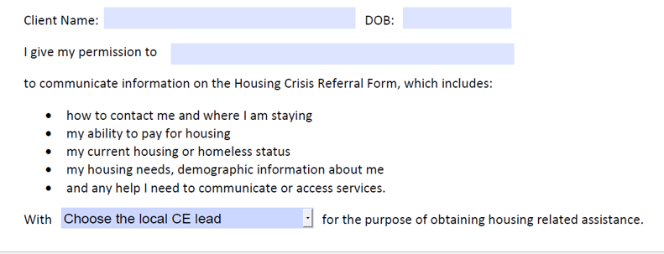
Referral Form – Client Permission
Notes:
The Referral Form includes a back page that provides “one-way”, “one-time” permission for the Referral Partner to share the form with the Lead Agency. This release does not allow the Lead Agency to share client information with another partner, or to communicate in an ongoing way with the Referral Partner.

Slide 19
Coordinated Entry Steps
Screening & Access
Assessment
Master List
Referral to Housing Program
Lead Agencies & Assessment Partners administer the VCEH Housing Assessment
All people experiencing homelessness presenting at Lead Agency or Assessment Partner are offered the chance to participate
When a Lead Agency receives a Referral Form, they reach out to the household within 3 days (sooner is better)
Lead Agencies & Assessment Partners aim to conduct the Housing Assessment within one week of referral or “walk in”
Notes:
A uniform housing assessment is a requirement and key step in coordinated entry.
The housing assessment collects some key information:
HMIS universal data elements, like demographics, income and housing status
Information to match a household to a housing program based, and information about previous service use and service needs
Questions to help identify barriers to housing stability.
Screens for other household needs in order to make referrals for other services.
Some parts of the Housing Assessment are optional, while others are required to be asked. And as always, a client can refuse to answer some or all of the questions.
The role of the housing assessment is to screen for eligibility and help make a decision about which housing program a household is referred to – will program A, B or C provide the right level of assistance?
Because the assessment is a key step in accessing housing resources, we want people to have the chance to complete the assessment as soon as they want, but we also know there are real constraints on our staffing across the State.
For that reason, we’ve set a goal of one week for the assessment. We will see how close we can get to meeting this goal – and that will help us understand where we may need to shift or find resources to support the assessment process.

Slide 20
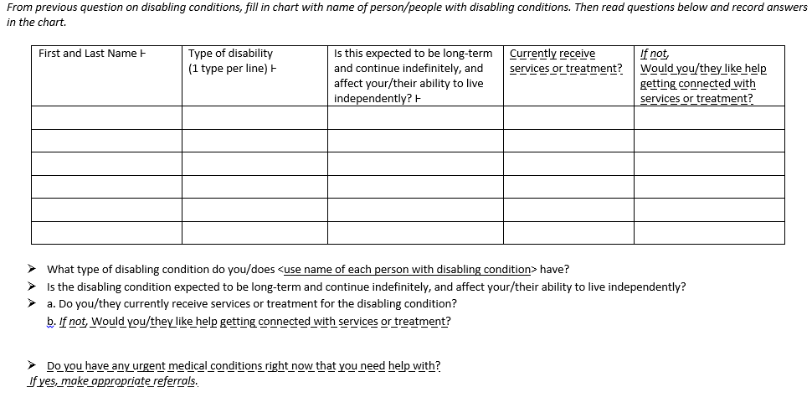
Instructions for assessors in italics
Step 2
Assessment
Step 3
Step 1
Master List
Referral to Housing Program
Screening & Access
All universal HMIS data elements marked with Ͱ
Includes the universal HMIS data elements
Guiding questions
Service referral questions are
dash underlined
Notes:
HANDOUT Assessment.
We aren’t going to walk through every section of the assessment. Instead, we want to highlight some parts.
The assessment is intended to be completed through an interview with a trained assessor. There is a separate required training for all assessors. The form includes instructions for the assessor, and guiding questions.
Some people may directly input the assessment into HMIS, but it’s expected that many will first record answers on paper. The form includes space to record responses and make notes.
You can also see that HMIS data elements are marked – Once that information is collected through the Assessment, it would only need to be updated later as household circumstances change.
The Assessment also notes which questions are being asked simply to make a service referral – for example medical care or insurance, employment supports, or connection to a homeless education liaison.

Slide 21
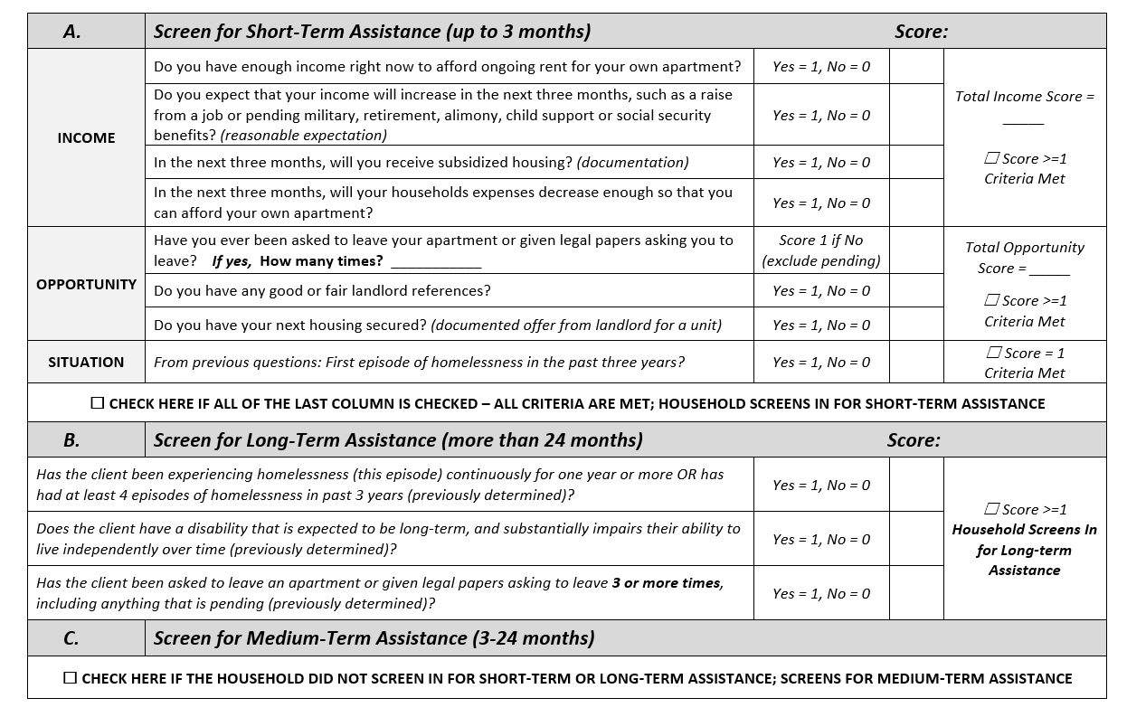
Level of Assistance Section
Notes:
One goal of the coordinated entry committee has been to match clients to the right level of homeless housing assistance. Does this client need short, medium or long-term help?
This section of the housing assessment uses a few measures of income, opportunity and situation to identify whether a household is best matched for one-time or few months of assistance with a connection to mainstream support services, a rental subsidy with services that lasts from a few months up to 2 years, or a long-term voucher combined with long-term support services.

Slide 22
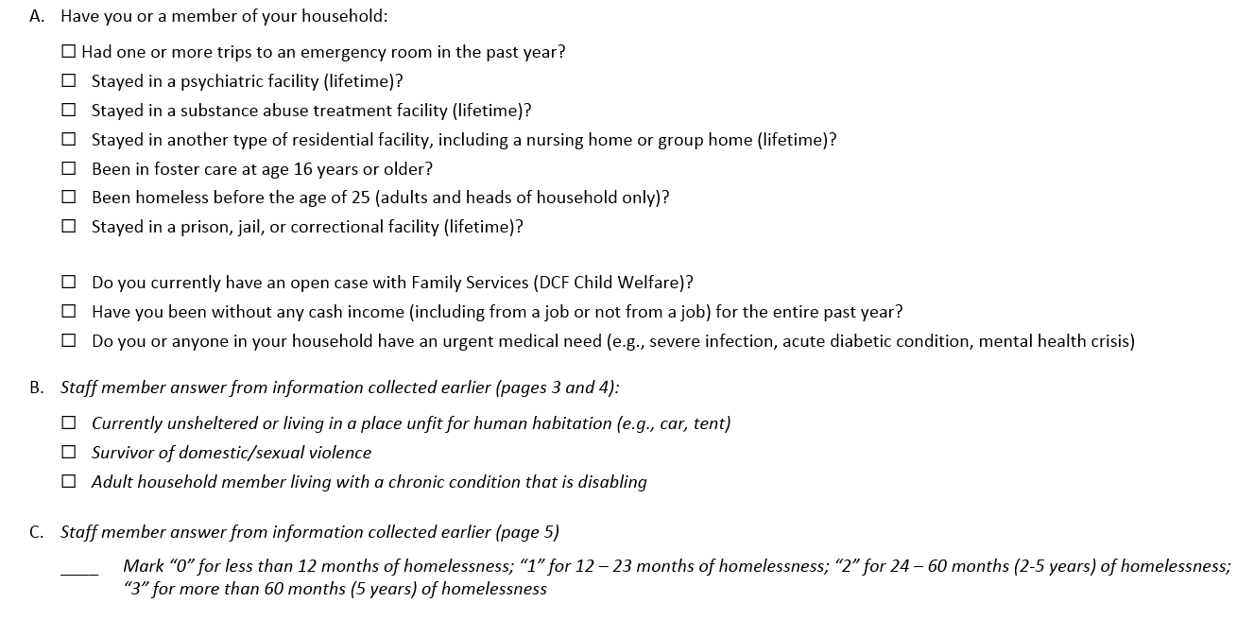
Complex Service Needs Section
Notes:
Complex service needs section looks at frequent use of other systems by household members, and combines this information with current circumstances and the length of homelessness over a lifetime.
This information is combined to calculate a complex service needs score which is used when housing resources are prioritized through the Master List.
This section and the information collected to determine the complex service needs score or points was previously approved by the Coalition last year as part of the policy on prioritization for permanent supportive housing.
Households that screen in for short-term assistance do not need to answer these questions.

Slide 23
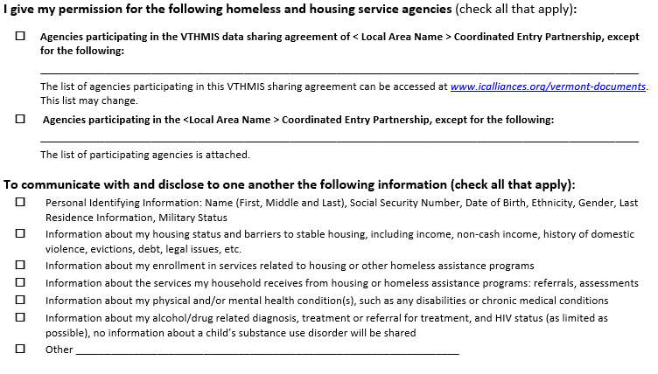
Housing Assessment – Client Permission
Notes:
HANDOUT copies of the Permission to Share Information (ROI) and Staff Review Tool.
Last year, the Coalition approved an Coordinated Entry Release of Information
This is an important tool for coordinated entry, that documents permission on which agencies have permission to communicate and disclose specific information in HMIS and/or through coordinated entry general.
The ROI and the staff review tool are on the Coalition’s website.
The release has an expiration data. Having a current release is necessary for a household to be on the Master List.

Slide 24
Scenarios Activity
Pass out Scenarios Activity, including Complex Service Needs and Level of Assistance sections.
Notes:
Give 10-15 mins for small groups to determine complex service needs scores and level of assistance

Slide 25
Master List
Screening & Access
Assessment
Master List
Referral to Housing Program
Each Local Coordinated Entry Partnership has a local “Master List” that includes all households (individuals and families) experiencing homelessness in the local CoC.
The Master List is used to guide referrals to openings in:
Rapid Re-housing (RRH) programs
Permanent Supportive Housing (PSH) programs
Notes:
Once an assessment is completed, a household is placed on a local Master List. This is a community-wide list of all households that have been identified as currently homeless and seeking housing help.
When Rapid Re-housing and Permanent Supportive Housing programs have openings, they will enroll individuals and families from the Master List.
At this point, you may have realized that we haven’t been talking about homelessness prevention or transitional housing designated for homeless households. These resources will be come part of the Coordinated Entry process in 2018, but there are no specific policies and procedures yet for prevention.
Also, one of the areas we want feedback is naming the list – “master list” is descriptive, but perhaps others have a better suggestion.

Slide 26
Local Master List
Lead Agency and Assessment Partners place households on the List within 3 days of assessment
Managed by the Local Lead Agency
First generated from HMIS, then others added to the manually, outside of HMIS
Reviewed at least monthly by the Local Partnership
Refer and enroll from List into housing projects according to the prioritization policy
Notes:
Each CoC has their own Master List. Only <LEAD AGENCY> and Assessment Partners can place households onto the list, and the goal is to complete this process (placing a household on the Master List) within 3 days of an assessment.
Those agencies using HMIS for coordinated entry will place a household on the Master List simply by entering the household into coordinated entry. Servicepoint can generate and export the list, and other households can be added to the list manually (outside of HMIS). The Master List can use unique IDs in place of names.
It’s important that Coordinated Entry Partners review the list at least monthly to keep it current. Only agencies that are part of the Local Coordinated Entry Partnership (and have signed the Partnership Agreement) should review the list. And all clients on the Master List must have signed a ROI form.
We all share accountability to refer and enroll households from the List into housing projects according to the prioritization policy.
In our CoC, we review the Master List: <Add information here>

Slide 27
Order of Priority on the Master List
  1. Chronic Homelessness + Complex Service Needs Score
Non-Chronic Homelessness + Disability, then
    Unsheltered or living in an emergency shelter/safe haven + Complex Service Needs Score
    Living in transitional housing (homeless prior to entry) + Complex Service Needs Score
    3. Non-Chronic Homelessness, no Disability + Complex Service Needs Score
Notes:
Households on the Master List are sorted according to the order on the slide.
This order of priority was developed and approved last year by the Coalition as part of the permanent supportive housing policy. It follows federal guidance prioritization for Permanent Supportive Housing.
You can see how the complex service needs information from the housing assessment used here.
You can also see that those households experiencing chronic homelessness are near the top of the list. Let’s reminder ourselves how chronic homelessness is defined.

Slide 28

Definition of Chronic Homelessness
An individual or head of household with a disability (long-term)
AND
Literally homeless
AND
Homeless continuously for at least 12 months OR 4 times in the last 3 years (that equals at least 12 months)
Notes:
To meet the definition, an individual or the head of a household must have a long-term disability
And be literally homeless – (for example, camping outside, in an emergency shelter, a publicly-funded motel stay, and so on)
Finally, they need to have been continuously homeless for the past 12 months or more. Or, if they could have had at least 4 episodes of homelessness in the past 3 years that add up to 12 months of total time homeless.

Slide 29

Referral to Participating Housing Programs
Screening & Access
Assessment
Master List
Referral to Housing Program
Continuum of Care (CoC) Program-funded
        Shelter+Care
              Rapid Re-housing
Housing Opportunity Grant Program-funded
    Rapid Re-housing
Supportive Services for Veteran Families
    Rapid Re-housing
Notes:
These programs are required to enroll households through the coordinated entry process.
Referrals can happen at regularly scheduled monthly or bi-weekly meetings.
But households should be referred to programs and enroll in between meetings when there program openings. Don’t wait for a meeting.
Others housing programs are encouraged to use Coordinated Entry and the Master List process to enroll clients also.

Slide 30
Housing Programs in Insert CoC Name
Insert List of Housing Programs in CoC that will take from Master List
Notes:
Optional Discussion Question:
What other housing projects/programs in our area could potentially fill openings from the master list that are not required to?

Slide 31
Referral to Participating Housing Programs
Permanent Supportive Housing (Shelter + Care):
Order of priority +
program-specific eligibility (e.g., youth, CRT, etc.)
Rapid Re-housing (RRH):
Short-Term RRH: First-come, first-serve basis to households that screen in for short-term Level of Assistance
Medium-Term RRH: Order of priority for households that screen into medium-term Level of Assistance
Notes:
When there is an opening in a Shelter Plus Care program, that household at the top of the Master List is the first household referred for that opening.
Short-term Rapid Re-housing (less than 3 months of assistance) can be provided on a first-come, first-serve basis to households that screen in for a short-term Level of assistance.
Openings for Medium-term Rapid Re-housing, like a CoC RRH voucher, are offered based on both the order or priority and those that screen in for a medium-term level of assistance. We’ll look at some examples in a moment.
Individuals and families still need to meet the eligibility requirements for the program – for example, verified chronic homeless status, eligible for services, etc.
If a client is not accepted into the program after being referred. The Housing program will document the reason in ServicePoint and/or writing and share with the Partnership.

Slide 32

Referral to Participating Housing Programs
Can a household be referred for Medium-term Rapid Re-housing if they screen for Long-term Permanent Supportive Housing?
Reasonable expectation for increased income (documented): tenure in current job, expected completion of training/certification, pending benefits (military, retirement, social security, alimony, child support), OR
Documented opportunity of receiving subsidized housing or an assisted living placement before rental assistance would end
Notes:
Remember that the housing assessment identifies households as a good match for short-term, medium-term or long-term assistance. But what if a family wants to enroll in a medium-term Rapid Re-housing program but the Housing Assessment has screened the family in for long-term assistance?
Households who have higher housing barriers or service needs can access time-limited rental assistance, as long as they have a documented “housing sustainability plan”, and we’ve identified specifically what criteria needs to be a part of a housing sustainability plan.
While all households should have a housing stability plan, we’ve only recommended that households need this high level of documentation – that is, only those households who want to enroll in lower level of assistance than identified by the housing assessment.

Slide 33
Master List Activity
Complete the Master List Activity in small groups or as a larger group
Notes:
Provide small groups 5-10 minutes to complete.

Slide 34
Master List Activity

Slide 35
Master List Activity
Answers
RW and Doug would be offered PSH.
2. a. Medium-Term
b. Emily, JD, Pete, and Osnium612 would be offered medium-term RRH.
3. Amos, JD, Deb, and Sarah would be offered short-term rental assistance.
Notes:
RW – because RW meets the definition of chronically homeless and has the highest complex service needs score, so long as RW met the basic eligibility requirements for the project and chooses to participate. The next opening would be offered to Doug, and so on.
Emily, JD, Pete and Osnium612
3. Amos, JD, Deb, and Sarah; Deb and Sarah have both been identified as good candidates for short-term assistance. JD and Amos have been identified as good candidates for medium-term assistance, but have their Housing Sustainability Plans documented.

Slide 36

Declined Referrals
If a household refuses a referral to a housing program, their name remains on the Master List until the next opening in a housing program.
Notes:
What if a client says “no” when they are offered the chance to enroll in a program?
We’ve decided that client choice is paramount.
If a client says “no”, they simply go back on the Master List until they are no longer homeless.

Slide 37
Local Process to Take Households off Master List
Insert local processes here: i.e. HRT, CE Committee meeting, frequency, who attends, who contacts client, etc.

Slide 38
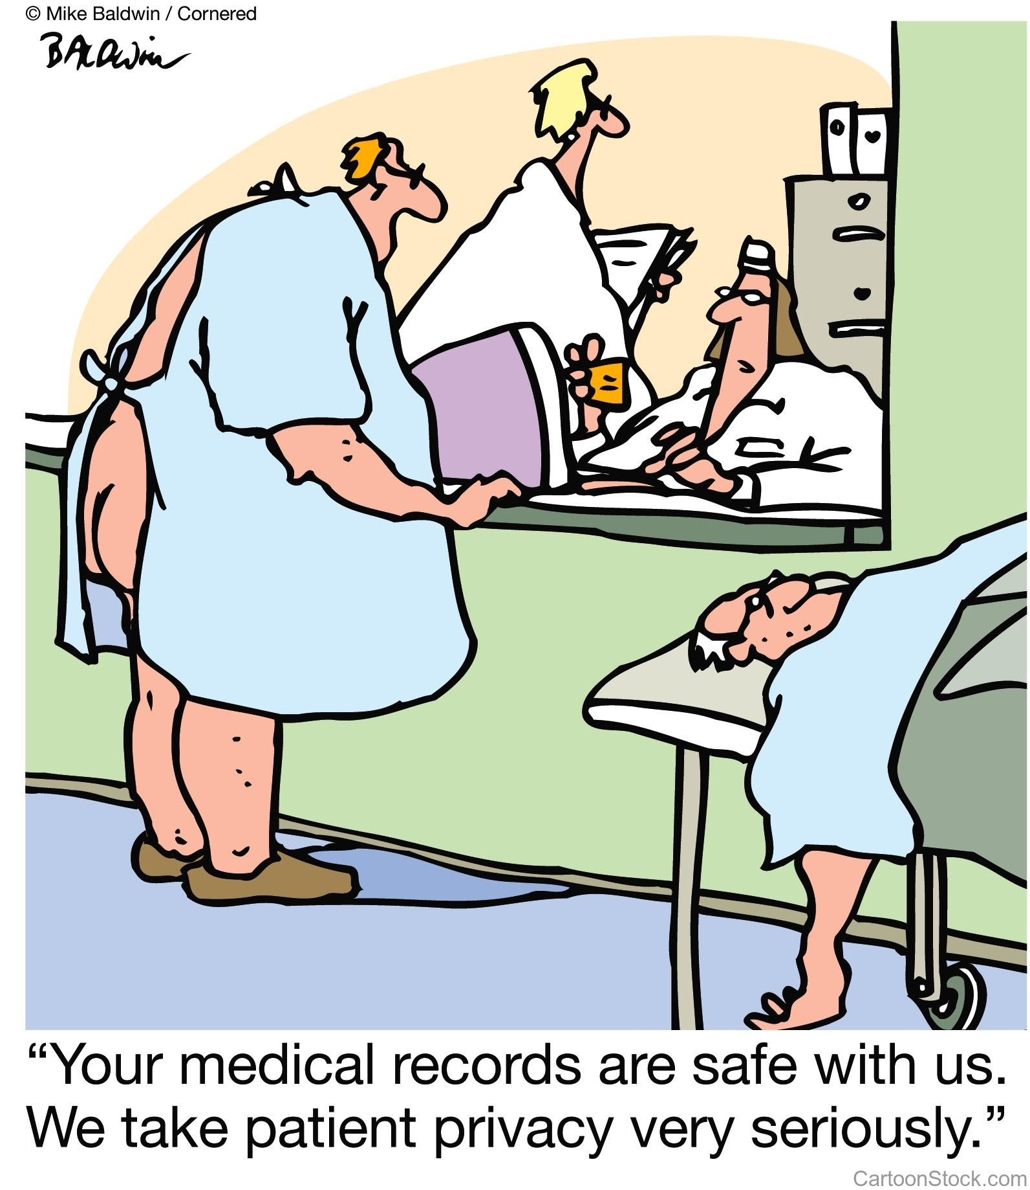
Confidentiality, Information & Data Sharing in Coordinated Entry
Notes:
It’s fundamental to coordination that partners be ability to share information and data appropriately.
Why?
Reduce the amount of time spent clients spend answering basic questions
Reduce the amount of time someone spends telling their story to service providers
Faster access to services and housing help
Allows agencies to focus on meeting someone’s unique needs
Eliminate duplicate intake paperwork
Coordinate multiple services better
We have a variety of tools, policies and procedures to help us make sure we share information and data appropriately. Even so, we will all need to remember to take a common sense approach that recognizes the dignity and privacy of every client.

Slide 39

Information & Data Sharing
Share information and data both “in” and “out” of VTHMIS
Client permission required – federal rules: HIPAA, 42 cfr Part 2, VAWA, etc.
None, Some or All - Clients can choose partial sharing
Shared responsibility to know and follow client permissions
See Confidentiality Policies & Principles, HMIS Security Standards & ROI
Notes:
We’ve developed strong principles and policies on confidentiality, and Coordinated Entry protocols that allow for the maximum client choice in how to participate, and what personal information can be shared with other agencies.
With this client-centered approach to information sharing comes a lot of shared responsibility for making share that all partners are respecting client consent on including what information is shared, how it is shared (for example in HMIS or not), and who information is shared with.
Sharing information is not “all or nothing” – a client could choose to participate and be added to the Master List, but without use of their name.
For those using HMIS, there is also annual security training required.

Slide 40
Confidentiality Activity
Pass out Confidentiality Principles and Policy and quiz.
Notes:
15-20 minutes. Have participants complete the quiz on their own or in small groups. Regroup and discuss answers.

Slide 41
Domestic Violence, Sexual Violence, Dating Violence and Stalking
Access:
Victim service providers and non-victim service providers work together to ensure equal access to Coordinated Entry and all housing-related resources
Client choice around where to access Coordinated Entry and be served
Notes:
It’s really important that Coordinated Entry be implemented in a way that allows for victims fleeing domestic violence to access housing resources safely.
On the next few slides, we’ll explain options for how victim service providers and victims can participate safely in coordinated entry. Victim service providers refer to those agencies whose primary purpose is to serve victims fleeing domestic or sexual violence.
In our CoC – this is ______<INSERT AGENCY NAME>______________.
Meeting the needs of survivors requires all of us, not just domestic violence shelters, to be working together, so that no matter where a client presents for help, they can be served safely and quickly.

Slide 42
Domestic Violence…
Safety & Confidentiality:
All partners trained in safety planning and clearly explain options of data sharing for clients to make an informed, safe decision
Survivors have the option of having a non-identifiable unique ID to be placed on the Master List
Survivors assessed at DV agencies will not be entered into HMIS
Notes:
Here’s a few key points about safety and confidentiality. Some of these points have been mentioned earlier.
All partners will be trained on safety planning and how to explain options to clients so they can make safe, informed, choices.
Victim Service providers are prevented from using ServicePoint.
Survivors can participate anonymously in the coordinated entry process by using a non-identifiable unique ID.

Slide 43
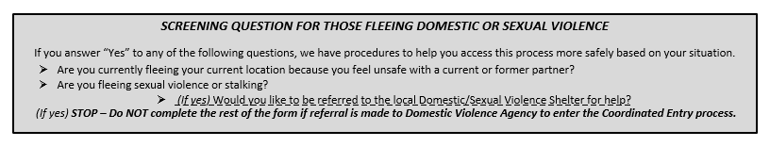
Domestic Violence…
Procedures:
      If yes, Client has a choice to be referred to victim service provider and placed on Master List with non-identifiable unique ID, provided to Lead Agency by victim service provider
      If no, Client continues Coordinated Entry process with non-victim service provider
Notes:
At each step of the coordinated entry process – screening and assessment, the forms help to screen clients and offer the opportunity to refer the client first to the local domestic violence shelter for help.

Slide 44
Domestic Violence…
Procedures, continued:
      If completing the assessment with a non-victim service provider, every client can:
          Choose not to have their information shared in HMIS. Partners should offer the choice, and help the client make their own choice about what is safe for them.
          Choose not to have their name used or other identifying information on the Master List. Use the unique ID.
      All clients who have experienced domestic/sexual violence should be offered a service referral to the local victim service agency.
Notes:
At each step of the coordinated entry process – screening and assessment, the forms help to screen clients and offer the opportunity to refer the client first to the local domestic violence shelter for help.

Slide 45
Domestic Violence…
Procedures:
Insert Name of local victim-service provider: Insert Role in CE Partnership (Assessment Partner or Referral Partner)
Facilitator Note: If victim-service provider is Assessment Partner, use next two slides. If Referral Partner, use the following two slides and give examples with real agencies in your CoC.

Slide 46

Domestic Violence…
Procedures:
Survivor completes Assessment with victim-service provider; provider sends unique ID & score to insert Lead Agency for master list.
Enters insert victim-service provider name.
Facilitator Note: This is slide 1 for CoCs in which victim-service provider is assessment partner.

Slide 47
Domestic Violence…
Procedures:
Survivor provided with soft referral to insert victim-service provider to do Assessment.
If person discloses they are currently fleeing DV/SV, they’re asked if they’d like to complete Housing Assessment with victim-service provider name.
Yes
Enters insert non-victim service provider.
Survivor completes Assessment with insert non-victim service provider.
No
Facilitator Note: This is slide 2 for CoCs in which victim-service provider is assessment partner.

Slide 48
Domestic Violence…
Procedures:
Housing Assessment is completed with assessment partner, who places client on Master List or sends unique ID and score to Lead Agency Name for master list.
Survivor completes Referral Form with victim-service provider, who then sends referral form to assessment partner of client’s choice, with unique ID attached to form.
Enters insert victim-
service provider.
Facilitator Note: This is slide 1 for CoCs in which the victim-service provider is a referral partner.

Slide 49
Domestic Violence…
Procedures:
Survivor is provided with a soft referral to the victim-service
provider to complete referral form.
Survivor completes Referral Form with victim-service provider, who sends referral form to assessment partner of client’s choice, with unique ID attached to form.
If person discloses they’re fleeing DV/SV, they’re asked if they’d like to complete referral form with victim-service provider.
Yes
Enters insert non-victim service provider.
Survivor completes referral form with non-victim service provider and is assessed or referred to assessment partner.
No
Assessment completed with non-victim service provider.
Facilitator Note: This is slide 2 for CoCs in which victim-service provider is referral partner.

Slide 50
Emergency Shelter & Coordinated Entry
Coordinated Entry does not interfere with current process for
people seeking emergency shelter.
Require written protocol for coordination & communication between shelter providers, Economic Services and 2-1-1 to streamline access:
  Emphasize ease of access
  Include: contact info for each agency, intake hours and process, shelter hours, population(s) served
  Protocols reviewed by VCEH Coordinated Entry Committee
Notes:
The most important thing to say here is that no one needs to go through the assessment process, go through the lead agency, or be on the master list in order to access emergency shelter. The coordinated entry process does not interfere with accessing emergency shelter and services.
In fact, at each step in the process, it’s very important for partners to first triage urgent needs.
That said, the Coordinated Entry requires that there is a written protocol in each local CoC between all of the providers who help clients access emergency shelters or emergency housing through general assistance at Economic Services.
The protocol should emphasize ease of access for people seeking emergency shelter, and also clearly document contact information for agencies, intake hours, shelter hours, population(s) served, and the intake process for each agency.

Slide 51
Emergency Shelter & Coordinated Entry
Economic Services General Assistance, XXX Shelter, and 2-1-1 are Referral Partners:
Refers to Lead Agency within 3 calendar days
XXXX Emergency Shelter is an Assessment Partner:
Provides shelter guests with an opportunity to complete Housing Assessment within 1 week of entry
XXXX Emergency Shelter is the Lead Agency:
Provides shelter guests with an opportunity to complete Housing Assessment within 1 week of entry
Notes:
Customize this slide.
Emergency shelters may choose to participate in coordinated entry as a referral partner or assessment partner.
If a shelter is a referral partner, they are encouraged to make a referral as soon as possible.
For shelters that are assessment partners, guests would be offered the opportunity to complete the Housing Assessment within 1 week. We recognize that sometimes guests need time to stabilize when they come into shelter.

Slide 52

Outreach & Advertisement
Outreach
To educate local agencies on Coordinated Entry
Advertisement
To inform people how to get connected to housing resources and services
  Flyers at locations where clients may present
  Advertisement the Point in Time Count or at other regularly planned local events
Notes:
For coordinated entry to work, people need to know about it.
We need to make sure that community agencies know how to make a referral, and use the process developed. We also want to make sure that agencies know how to become a formal partner.
OPTIONAL DISCUSSION QUESTION: What other community partners do you feel need to know about or participate in Coordinated Entry? Who else in your organization needs to understand Coordinated Entry?
And, we need to make sure that people having a housing crisis know where to turn for help.
HANDOUT Flyers. Our local Partnerships is responsible for advertising coordinated entry with flyers, at events or through the Point in Time count to make sure that the public knows how to access help.
Advertising for Coordinated Entry might mean that each organization is promoting publicly that people in housing crisis seek help from another agency.

Slide 53
Ensuring Fair & Equal Access to Coordinated Entry
Non-Discrimination
People are eligible and able to fully participate in Coordinated Entry regardless of race, color, national origin, religion, sex, disability, the presence of children, marital status, age, sexual orientation, gender identity and receipt of public assistance.
Americans with Disability Act
People will disabilities are eligible and able to fully participate in Coordinated Entry; accommodations as needed regarding assessment location and process
People with low English language levels
People will low English language levels are eligible and able to fully participate in Coordinated Entry
Notes:
We also have to make sure that everyone is able to access the coordinated entry process and that we are fair in the way that referrals and assessments are completed. Equal access regardless of the households characteristics.
In particular, we need to make sure that we are reaching out to populations that may have a hard time accessing help because of their disability or English language skills.
Optional Facilitator Questions:
As a Lead Agency, we will: <Insert Affirmative Outreach>
What are some ways that your agency reaches out to these groups now?
What are some ways that we could make sure the process is fair, welcoming and that everyone has equal access?

Slide 54

Complaints of Unfair Treatment
Participant Information and Complaint Process Form (clickable)
Explains Coordinated Entry process
Highlights non-discrimination and confidentiality
requirements
Details complaint process
Notes:
All CoCs are using the same form to describe coordinated entry and make sure all clients now how to file a complaint.
Handout Participant Info & Complaint Form.

Slide 55
Complaints of Unfair Treatment
Procedure:
Client sends written complaint to Insert Lead Agency Name.
Insert Lead Agency Name responds to complaint within 5 business days with a decision regarding any further action.
    If the complaint is not about Coordinated Entry, Lead Agency refers client to the agency the complaint is about for the client to follow the agency’s internal complaint process.
If client is unsatisfied with response, they may send written complaint to the VCEH Coordinated Entry Committee.

Slide 56
Participant Notice Activity
Pass out Participant Info & Complaint Process Handout, pair up and practice
Notes:
Give 6 minutes for pairs to practice. 4 minutes to report back.

Slide 57

Coordinated Entry Overview for all Partners
Housing Assessment for all Assessors
Service Point & Coordinated Entry for all HMIS users
Provided by ICA to each region, as needed
Notes:
This is the Coordinated Entry Overview that all Partners receive.
All staff administering the Housing Assessment need to attend a training on the Housing Assessment. And all staff using ServicePoint for coordinated entry would receive HMIS training.
Next Assessment Training is: <Insert Here>
Next ServicePoint HMIS Training is: <Insert Here>
OPTIONAL DISCUSSION QUESTION: As a local Coordinated Entry Partnership, what would an effective training plan to ensure that we train new Coordinated Entry staff and partners?

Slide 58

Evaluation
Annually: survey partners, collect consumer feedback
Every 6 months, review local CoC and aggregate data:
# of participating organizations
# of referrals to housing programs and # of housing placements
Length of Master List, # of HH on the list > 3 months, # of recurring HH
Unmet needs based on the Master List (by type)
Notes:
It’s really important to continuously improve the process by understanding what’s working locally and across the state. We need to make sure that coordinated entry is working for clients.
Evaluation is a part of the VCEH Coordinated Entry Committee’s work.
<LEAD AGENCY> will work with the partnership to make sure we are surveying local partners and collecting feedback from consumers through a survey or focus group.
We’ve also proposed some key data points that will help the Coalition to understand the effectiveness of Coordinated Entry, and help us understand unmet needs in different regions and across the state.
The VCEH committee would present an annual summary report with analysis to the VCEH Board.

Slide 59
Thank you!
Notes:
OPTIONAL DISCUSSION QUESTION:
What are three things that your organization might need to change to participate in Coordinated Entry?

