Slide 1

Coordinated Entry
Review of Policies & Procedures
November 2017
Notes:
Home Slide
Start Recording
**SARAH**
Welcome to the Vermont Coalition to End Homelessness Webinar to review the draft Coordinated Entry Policies & Procedures
This webinar will be recorded and archived on the Coalition’s website: helpingtohousevt.org
Housekeeping – Muted during the presentation; feel free to use the chat box to ask questions at any point; we will likely wait until the end to answer questions; and we will open up the microphones at that time
Introduce the presenters, many of whom have been on the CE Committee since its beginning
Sarah Phillips - VT Agency of Human Services, Office of Economic Opportunity
Amos Meacham - Pathways Vermont (Assessment Partner)
Kara Casey - VT Network Against Domestic & Sexual Violence
dawn butterfield - Capstone Community Action (Lead Agency)
Renee Weeks - Upper Valley Haven (Lead Agency)
Brooke Jenkins - Good Samaritan Haven (Assessment Partner)
Ask for folks participating to introduce themselves by name and agency and role (if known) in the chat box

Slide 2
Today’s Agenda
What is Coordinated Entry? Why do we need it?
Coordinated Entry Planning: Where are we in the process?
Review of Draft Coordinated Entry Policies & Procedures
Question & Answers
Notes:
**SARAH**
Walkthrough the Agenda
Goals of Webinar:
No matter what your understanding of CE at the start, you will know what is happening in the VCEH regarding CE
2) Share information so that the VCEH CE Committee can get feedback on the policies and procedures preliminary draft

Slide 3
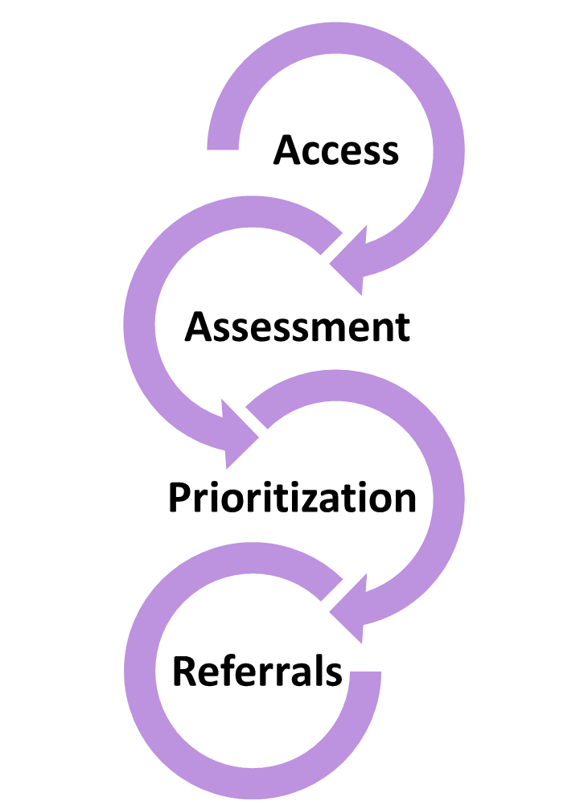
What is Coordinated Entry?
Overarching goals
Reorient system to focus on those being served
Minimize time and frustration accessing help
Maximize use of system resources
Identify service gaps for planning
Notes:
**SARAH**
POLL: Please take this quick poll for us to take the temperature of where people are in their familiarity with Coordinated Entry. On a scale of 1-5, how familiar are you with what Coordinated Entry is and how it works? No judgement! (Leave 30 seconds for poll and briefly discuss results.)
Coordinated entry is about ensuring that access to homeless services in our communities is streamlined and that households experiencing or at-risk for homelessness are able to quickly access the assistance they need and for which they are eligible, without having to call or be turned away from multiple programs.
Goals
Some things you will hear us say over and over again about Coordinated Entry: Access, Assessment, Referrals

Slide 4
Current Crisis Response System (Boston example)
Emergency shelters
Street Outreach
Day & Meal
Programs
Healthcare for the Homeless
Youth
Programs
Staying with Friends/Family
Boston VA
County Jail/Prison
Psychiatric & Mainstream Hospitals
Detox/ Treatment
Pilgrim (Shelter)
Pine Street Inn (Shelter)
New England Center
(Shelter)
Woods Mullen
(Shelter)
DV Shelters
St. Francis House (Day and Overflow Shelter)
DMH Shelter
Source: Boston Mayors Task Force on Individual Homelessness
Long Island (Shelter)
DMH Safe Haven
Transitional Housing
Waitlists, screening criteria
Waitlists, screening criteria
Waitlists, screening criteria
Screening criteria, financial barriers
Permanent Supportive Housing
Public Housing
Affordable Housing
Market Rate Housing
Notes:
**DAWN**
This is an example that came out of Boston’s coordinated entry planning.
Does it look familiar?
People in housing crisis or homeless knock on a lot of doors and go through a lot of doors on their way to permanent housing.
The path is confusing, it is frustrating, it’s not clear to providers or to clients
Navigating your way through slows your down

Slide 5
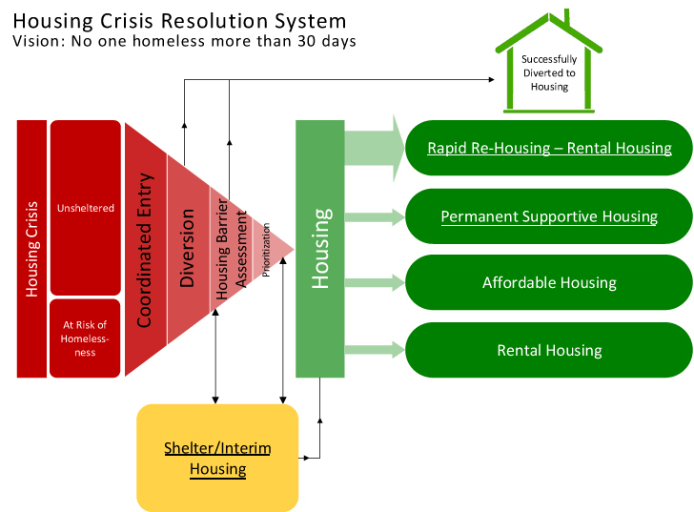
Crisis Response System with Coordinated Entry
Source: Focus Strategies Housing Crisis Resolution System
Notes:
**DAWN**
Coordinated Entry Re-orients our “System”
It creates a clear pathway to permanent housing, making it easier for clients and providers to navigate.
Everyone experiencing a housing crisis receives a standard housing assessment.
The assessment helps to match people to the housing resource that best fits their needs. Limited housing programs for people who are homeless (like shelter + care and rapid re-housing vouchers) are then prioritized based on best fit and highest needs.
People have access to emergency shelter during their crisis, just as they do with our current system.

Slide 6
With Coordinated Entry…
What housing & services are best for this household, and available?
Client accesses help through clear doors and carefully designed protocols
Consistent, clear communication to partners & clients about what’s available
Standard forms and assessments for every client, no matter where they start
Community agreement on where to refer
Notes:
**DAWN**
With Coordinated Entry:
We get to ask: What housing and services are best for this household, and available?
Instead of wasting time knocking on lots of doors and still ending up in back in the hallway, clients get help through clear doors and carefully designed protocols
There is greater transparency and clarity for partners and clients about what’s available, a standard screening and housing needs assessment for every client, no matter where they start
And, our community has a shared understanding and agreement on where to refer a client

Slide 7
Why Coordinated Entry?
In Vermont, we believe that coordinated entry can help:
Improve referral appropriateness and coordination
Increase understanding among partners of what resources are available
Decrease the time that people experience homelessness
Help people move in and out of the homeless system as quickly as possible allowing them to achieve housing stability
Support community-wide or system level planning and outcomes
Notes:
**AMOS**
The Vermont Coalition to End Homelessness (as the Balance of State Continuum of Care) is required by the US Department of Housing and Urban Development (HUD) to adopt a coordinated entry system to coordinate client intake, assessment, and provision of referrals.
BUT it’s not really about HUD or a mandate – It’s really about:
Different homeless programs coming together at the local level to create changes that result in better outcomes for clients facing a housing crisis.
And Vermont partners really believe that Coordinated entry can make a difference.

Slide 8

Where are we now with Coordinated Entry?
Coordinated Entry Committee in place since 2014
Lead Agencies identified for all local Continuums of Care (CoCs)
Coordinated Entry Partnership Agreement approved, with Confidentiality Policies & Principles
Coordinated Entry Permanent Supportive Housing Policy approved
Coordinated Entry Release of Information approved
helpingtohousevt.org/whatwedo/coordinatedentry/formsandtools
Notes:
**AMOS**
Members of the Coalition have been meeting since early 2014 to learn about Coordinated Entry – We’ve looked at what’s working already in Vermont to build on existing strengths in coordination, and we’ve looked at what other states and Continuums of Care have implemented.
In 2016, the Vermont Coalition to End Homelessness adopted a “Local Coordinated Entry Partnership” model which designates a lead agency in each local Continuum of Care, with other local providers opting to be an assessment or referral partner. The Partnership Agreement, which was formally approved by the Coalition, outlines roles and responsibilities within the local partnership. It also includes an appendix on Confidentiality Policies and Principles for Coordinated Entry in Vermont.
The Coalition also adopted a policy on access and prioritization for Permanent Supportive Housing and approved a Release of Information that can be used to support client-approved information sharing through coordinated entry.

Slide 9
Where are we now with Coordinated Entry?
Preliminary drafts for review:
Policies & Procedures
Housing Crisis Referral Form
Housing Assessment
helpingtohousevt.org/whatwedo/coordinatedentry/formsandtools
Feedback due: November 21, 2017
Final drafts presented: December VCEH board meeting
Final vote on materials: January VCEH board meeting
Notes:
*AMOS*
The Coalition is required to have written policies and procedures for Coordinated Entry. The Committee has shared a preliminary draft. Our draft builds on Vermont’s planning efforts, pilots, and already approved policies and tools - like the partnership agreement and the prioritization policy on permanent supportive housing. The Policies and Procedures also include a referral form and a housing assessment. A lot of providers have ‘test run’ the referral and assessment tools and provided important feedback on early versions.
Today, we are going to walk through the draft. We want your feedback on the draft during the month of November. We invite you to ask lot of questions today and at the end of the webinar, we will make sure you know how to share your feedback later
In December, a final draft will be presented for a vote by the Coalition board in January.

Slide 10
Coordinated Entry Policies & Procedures
Notes:
*AMOS*
Let’s dig in.
As we go forward, please feel free to write questions in the chat box. We may pause and answer questions as we go, and we will save time for questions at the end also.

Slide 11
Geographic Area & Population
Geographic Area
All counties in Vermont except for Chittenden County
  11 Local Continuums of Care operating as part of the Balance of State Continuum of Care
Population
All individuals and households experiencing a housing crisis
  Homeless or at-risk of homelessness
Notes:
**KARA**
Our Coordinated Entry system covers all of Vermont except for Chittenden County – this includes 11 local CoCs.
The Chittenden Continuum of Care is developing its own Coordinated Entry processes, and has a similar planning process.
Coordinated Entry focuses on serving all individuals and families that are experiencing or at-risk of homelessness, and uses the HUD/AHS definitions.

Slide 12
Local Coordinated Entry Partnership
Lead Agency
Leads local Coordinated Entry Partnership
Assessment Partners
Conduct Housing Assessment for “in-house” clients
Place clients on the local Master List
Uses the Housing Crisis Referral Form to refer households to Lead Agency
for Assessment
Conducts Housing Assessment
Manages local Master List
Coordinate Referrals to Housing Interventions with the Lead Agency
Referral Partners
Notes:
**KARA**
The Vermont Coalition has adopted a local Coordinated Entry Partnership model that identifies three roles in each local CoC – a local lead agency, assessment partners and referral partners.
Lead agencies play a key role in shepherding the local partnership – identifying and training partners and supporting the overall flow of work. Lead agencies also act as the local “go to” for general housing crisis referrals. Looking to get connected to housing help? Go to your local lead agency. The Lead Agency can complete the housing assessment and refer households to the local list, and appropriate housing resource.
Assessment partners also complete the housing assessment and work closely with the Lead Agency to support prioritization and referrals to housing programs.
Finally, referral partners are educated organizations that know how to screen and make an appropriate referral to help individuals and families get connected through Coordinated Entry.

Slide 13
Lead Agencies
Addison CoC: Charter House
Bennington CoC: BROC – Community Action in Southwestern Vt
Franklin & Grand Isle CoC: Champlain Valley Office of Economic Opp.
Lamoille CoC: Capstone Community Action
Northeast Kingdom CoCs: Northeast Kingdom Community Action
Rutland CoC: Homeless Prevention Center
Southern Windham CoC: Groundworks Collaborative
Southern Windsor-Windham CoC : Springfield Supported Housing
Washington CoC: Capstone Community Action
Windsor North & Orange CoC: Upper Valley Haven
Notes:
**KARA**
Here are the agencies that have been designated by their local Continuums of Care to be the Lead Agency in the local Coordinated Entry Partnership.

Slide 14
Shared Responsibilities
Clients can access the Coordinated Entry process through any participating provider
Use Coordinated Entry processes to accept clients into agreed upon housing projects
Work collaboratively to achieve responsive and streamlined access to available resources and services
Notes:
**BROOKE**
Lead agencies, assessment partners and referral partners are all participating providers in Coordinated Entry and they have different roles, but coordinated entry relies on shared accountability.
First, if an individual or family is homeless or has a housing crisis, participating providers help the household get connected through Coordinated Entry
Second, certain projects and housing programs only accept clients into their program through the coordinated entry process.
Finally, coordinated entry relies deeply on our collaborative spirit to help people access what they need to find housing stability.

Slide 15

Outreach & Advertisement
Outreach
To educate local agencies on Coordinated Entry
Advertisement
To inform people how to get connected to housing resources and services
  Flyers at locations where clients may present
  Advertisement the Point in Time Count or at other regularly planned local events
Notes:
**BROOKE**
For coordinated entry to work, people need to know about it.
We need to make sure that community agencies and partners know how to make a referral, and use the process developed. We also want to make sure that agencies know how to become a formal partner.
And, we need to make sure that people having a housing crisis know where to turn for help. We’ve recommended that, at a minimum, local Coordinated Entry Partnerships use flyers to advertise where to get help and that the Point in Time count, as well as other local events, are be used to advertise to the public. The Coordinated Entry Committee could help develop materials.
Advertising for Coordinated Entry might mean that your organization is promoting publicly that people in housing crisis seek help from another agency.

Slide 16
Coordinated Entry Steps
Screening & Access
Assessment
Master List
Referral to Housing Program
Referral Partners use Housing Crisis Referral Form as initial screening tool
All individuals and families experiencing or at risk of homelessness and served by a Referral Partner are offered the opportunity for a referral (to coordinated entry)
Referral Partner submits Referral Form to Lead Agency within one business day
Notes:
**RENEE**
The Housing Crisis Referral Form is really a tool for partners to be able to screen and make appropriate referrals. It collects basic information about the household, how to reach the head of household, and their current housing status. The referral form gives the lead agency the info they need to reach out and make contact with the client.
Client choice is fundamental in coordinated entry. So, while all clients are given the opportunity to participate, no one is required to participate. Partners should be able to explain coordinated entry in plain language to help people make informed choices.
You’ll see a number of time tables in the Coordinated Entry steps, and we want feedback on time tables specifically. From conversations with providers, sending the referral form to the lead agency within one business day seemed appropriate and reasonable.

Slide 17
Coordinated Entry Steps
Screening & Access
Assessment
Master List
Referral to Housing Program
Lead Agencies & Assessment Partners administer the VCEH Housing Assessment
All people experiencing homelessness presenting at Lead Agency or Assessment Partner are offered the chance to participate
When a Lead Agency receives a Referral Form, they reach out to the household within 3 days (sooner is better)
Lead Agencies & Assessment Partners aim to conduct the Housing Assessment within one week of referral or “walk in”
Notes:
*RENEE*
A uniform housing assessment is a key requirement and step in coordinated entry.
The draft housing assessment collects some key information:
It collects the HMIS universal data elements, like demographics, income and housing status
It asks for key information to match a household to a housing program based, and information about previous service use and service needs
It includes questions to help identify barriers to housing stability.
And, it screens for other household needs in order to make referrals for other services.
We’ve suggested that some parts of the Housing Assessment are optional, while others are required. And as always, a client can refuse to answer some or all of the questions.
The role of the housing assessment is to screen for eligibility and help make a decision about which housing program a household is referred to – will program A, B or C provide the right level of assistance?
Because the assessment is a key step in accessing housing resources, we’ve suggested that people be offered the chance to complete the assessment as soon as they want, but we also know there are real constraints on our staffing across the State. For that reason, we’ve set a goal of one week for the assessment.

Slide 18
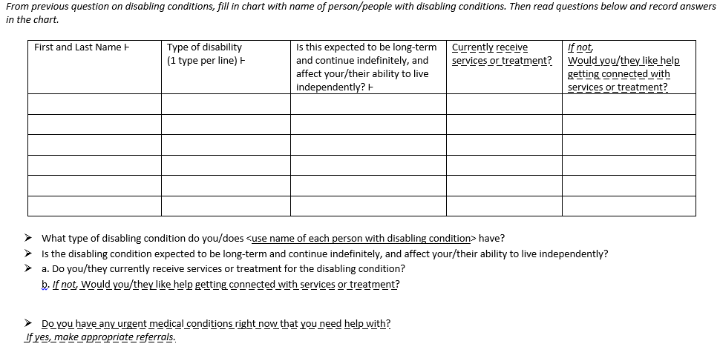
Instructions for assessors in italics
Step 2
Assessment
Step 3
Step 1
Master List
Referral to Housing Program
Screening & Access
All universal HMIS data elements marked with Ͱ
Includes the universal HMIS data elements
Guiding questions
Service referral questions are
dash underlined
Notes:
*RENEE*
We aren’t going to walk through every section of the assessment. Instead, we want to highlight some parts.
The assessment is intended to be completed through an interview with a trained assessor.
The form includes instructions for the assessor, and guiding questions.
Some people may directly input the assessment into HMIS, but it’s expected that many will first record answers on paper. The form includes space to record responses and make notes.
You can also see that HMIS data elements are marked – Once that information is collected through the Assessment, it would only need to be updated later as household circumstances change.
The Assessment also notes which questions are being asked simply to make a service referral – for example medical care or insurance, employment supports, or connection to a homeless education liaison.

Slide 19
Complex Service Needs Section
Have you or a member of your household:
☐ Had one or more trips to an emergency room in the past year?
☐ Stayed in a psychiatric facility (lifetime)?
☐ Stayed in a substance abuse treatment facility (lifetime)?
☐ Stayed in another type of residential facility, including a nursing home or group home (lifetime)?
☐ Been in foster care at age 16 years or older?
☐ Been homeless before the age of 25 (adults only)?
☐ Do you currently have an open case with Family Services (DCF Child Welfare)?
☐ Have you been without any cash income (including from a job or not from a job) for the entire past year?
☐ Do you or anyone in your household have an urgent medical need (e.g., severe infection, acute diabetic condition, mental health crisis)
B. Staff member answer from information collected earlier (pages 3 and 4):
☐ Currently unsheltered or living in a place unfit for human habitation (e.g., car, tent)
☐ Survivor of domestic/sexual violence
☐ Adult household member living with a chronic condition that is disabling
C. Staff member answer from information collected earlier (page 5)
____ Mark “0” for less than 12 months of homelessness; “1” for 12 – 23 months of homelessness; “2” for 24 – 60 months (2-5 years) of homelessness; “3” for more than 60 months (5 years) of homelessness
Notes:
*RENEE*
Complex service needs section looks at frequent use of other systems by household members, and combines this information with current circumstances and the length of homelessness over a lifetime.
This information is combined to calculate a complex service needs score which is used when housing resources are prioritized through the Master List.
This section and the information collected to determine the complex service needs score or points was previously approved by the Coalition last year as part of the policy on prioritization for permanent supportive housing.

Slide 20
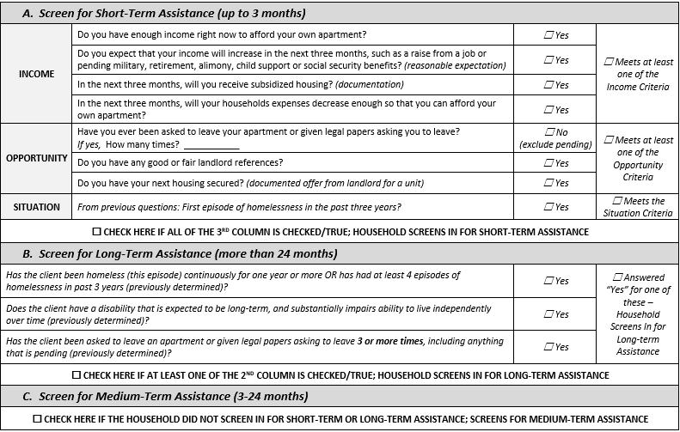
Level of Assistance Section
Notes:
*RENEE*
One goal of the coordinated entry committee has been to match clients to the right level of homeless housing assistance. Does this client need short, medium or long-term help?
This section of the housing assessment uses a few measures of income, opportunity and situation to identify whether a household is best matched for one-time or few months of assistance with a connection to mainstream support services, a rental subsidy with services that lasts from a few months up to 2 years, or a long-term voucher combined with long-term support services.

Slide 21
Master List
Screening & Access
Assessment
Master List
Referral to Housing Program
Each Local Coordinated Entry Partnership has a local “Master List” that includes all households (individuals and families) experiencing homelessness in the local CoC.
The Master List is used to guide referrals to openings in:
Rapid Re-housing (RRH) programs
Permanent Supportive Housing (PSH) programs
Notes:
**BROOKE**
Once an assessment is completed, a household is placed on a local Master List. This is a community-wide list of all households that have been identified as currently homeless and seeking housing help.
When Rapid Re-housing and Permanent Supportive Housing programs have openings, they will enroll individuals and families from the Master List.
At this point, you may have realized that we haven’t been talking about homelessness prevention or transitional housing designated for homeless households. This resources will be come part of the Coordinated Entry process next year, but the draft policies and procedures don’t yet incorporate prevention.
Also, one of the areas we want feedback is naming the list – “master list” is descriptive, but perhaps others have a better suggestion.

Slide 22
Local Master List
Lead Agency and Assessment Partners place households on the List within 3 days of assessment
Managed by the Local Lead Agency
First generated from HMIS, then others added to the manually, outside of HMIS
Reviewed at least monthly by the Local Partnership
Refer and enroll from List into housing projects according to the prioritization policy
Notes:
**BROOKE**
Each CoC will have their own Master List. Only Lead Agencies and Assessment Partners can place households onto the list, and the goal is to complete this process within three days of a completed assessment.
Those agencies using HMIS will “refer” a household to the Master List. Servicepoint can generate an excel list, and other households can be added to the list manually.
The Master List can use unique IDs in place of names.
It’s important that Coordinated Entry Partners review the list at least monthly to keep the list current. Only agencies that are part of the Local Coordinated Entry Partnership (and have signed the Partnership Agreement) should review the list. And all clients on the Master List must have signed a release of information form.
Partners share accountability to refer and enroll households from the List into housing projects according to the prioritization policy.

Slide 23
Order of Priority on the Master List
Chronic Homelessness + Complex Service Needs (Points)
NonChronic Homelessness + Disability, then
    a. Unsheltered or living in an emergency shelter/safe haven
    i. Then, homeless at least 12 months + Complex Service Needs (Points)
    ii. Then, homeless < 12 months + Complex Service Needs (Points)
  b. Living in transitional housing (homeless prior to entry) + Complex Service Needs (Points)
3. NonChronic Homelessness w/o Disability + Complex Service Needs (Points)
Notes:
**SARAH**
Households on the Master List are sorted according to the order on the slide.
This order of priority was developed and approved last year by the Coalition as part of the permanent supportive housing policy. It follows federal guidance prioritization for Permanent Supportive Housing.
You can see how the complex service needs information from the housing assessment used here.
You can also see that those households experiencing chronic homelessness are near the top of the list. Let’s reminder ourselves how chronic homelessness is defined.

Slide 24

Definition of Chronic Homelessness
An individual or head of household with a disability (long-term)
AND
Literally homeless
AND
Homeless continuously for at least 12 months OR 4 times in the last 3 years (that equals at least 12 months)
Notes:
**SARAH**
To meet the definition, an individual or the head of a household must have a long-term disability
And be literally homeless – (for example, camping outside, in an emergency shelter, a publicly-funded motel stay, and so on)
Finally, they need to have been continuously homeless for the past 12 months or more. Or, if they could have had at least 4 episodes of homelessness in the past 3 years that add up to 12 months of total time homeless.

Slide 25
Order of Priority on the Master List
Chronic Homelessness + Complex Service Needs (Points)
NonChronic Homelessness + Disability, then
    a. Unsheltered or living in an emergency shelter/safe haven
    i. Then, homeless at least 12 months + Complex Service Needs (Points)
    ii. Then, homeless < 12 months + Complex Service Needs (Points)
  b. Living in transitional housing (homeless prior to entry) + Complex Service Needs (Points)
3. NonChronic Homelessness w/o Disability + Complex Service Needs (Points)
Notes:
**SARAH**
With that reminder, here’s the order of priority, one more time. You can see that tier 2 has an added layer of making sure that those households that almost (but not quite) meet the definition of chronic homelessness are still near the top. That’s folks in group 2.a.i.

Slide 26

Referral to Participating Housing Programs
Screening & Access
Assessment
Master List
Referral to Housing Program
Continuum of Care (CoC) Program-funded
        Shelter+Care
              Rapid Re-housing
Housing Opportunity Grant Program-funded
    Rapid Re-housing
Supportive Services for Veteran Families
    Rapid Re-housing
Notes:
**dawn**
These programs are required to enroll households through the coordinated entry process.
Referrals can happen at regularly scheduled monthly or bi-weekly meetings.
But households should be referred to programs and enroll in between meetings when there program openings. Don’t wait for a meeting.
Others housing programs are encouraged to use Coordinated Entry and the Master List process to enroll clients also.

Slide 27
Referral to Participating Housing Programs
Permanent Supportive Housing (Shelter + Care):
Order of priority + program-specific eligibility requirements (e.g., disability, youth, CRT eligibility, etc.)
Rapid Re-housing (RRH):
Short-Term RRH: First-come, first-serve basis to households that screen in for short-term Level of Assistance
Medium-Term RRH: Order of priority for households that screen into medium-term Level of Assistance
Notes:
**dawn**
When there is an opening in a Shelter Plus Care program, that household at the top of the Master List is the first household referred for that opening.
Short-term Rapid Re-housing (less than 3 months of assistance) can be provided on a first-come, first-serve basis to households that screen in for a short-term Level of assistance.
Openings for Medium-term Rapid Re-housing, like a CoC RRH voucher, are offered based on both the order or priority and those that screen in for a medium-term level of assistance. We’ll look at some examples in a moment.
Individuals and families still need to meet the eligibility requirements for the program – for example, verified chronic homeless status, eligible for services, etc.
If a client is not accepted into the program after being referred. The Housing program will document the reason in ServicePoint and/or writing and share with the Partnership.

Slide 28

Referral to Participating Housing Programs
Can a household be referred for Medium-term Rapid Re-housing if they screen for Long-term Permanent Supportive Housing?
Reasonable expectation for increased income (documented): tenure in current job, expected completion of training/certification, pending benefits (military, retirement, social security, alimony, child support), OR
Documented opportunity of receiving subsidized housing or an assisted living placement before rental assistance would end
Notes:
**dawn**
Remember that the housing assessment identifies households as a good match for short-term, medium-term or long-term assistance. But what if a family wants to enroll in a medium-term Rapid Re-housing program but the Housing Assessment has screened the family in for long-term assistance?
We’ve recommended that higher needs households be able to access time-limited rental assistance, as long as they have a documented “housing sustainability plan”, and we’ve identified specifically what criteria needs to be a part of a housing sustainability plan.
While all households should have a housing stability plan, we’ve only recommended that households need this high level of documentation – that is, only those households who want to enroll in lower level of assistance than identified by the housing assessment.

Slide 29
Example
Notes:
**dawn**
Test Case 1: Agency A has one opening for Permanent Supportive Housing. Who would Agency A offer the opening to?
RW – because RW meets the definition of chronically homeless and has the highest complex service needs score, so long as RW met the basic eligibility requirements for the project and chooses to participate. The next opening would be offered to Doug, and so on.

Slide 30
Example
Notes:
**dawn**
Test Case 2:
Agency B has four openings in it’s Rapid Re-housing Project that offers 12 months of rental assistance.
Would 12 months be considered short-term or medium-term? (Medium-term)
Who would Agency B offer the openings to?
Emily, JD, Pete and Osnium612
Although Emily has been identified as a good candidate for long-term housing assistance, she has met the documentation requirements for Housing Plan Sustainability. JD, Pete and Osnium612 are the candidates next highest on the list that have been identified as candidates for medium-term assistance.

Slide 31
Example
Notes:
**dawn**
Test Case 3: Agency C has funding to support four clients this month. Providing short-term rental assistance is done on a first-come, first-serve basis.
Who would Agency C offer rental assistance to?
Amos, JD, Deb, and Sarah
Deb and Sarah have both been identified as good candidates for short-term assistance. JD and Amos have been identified as good candidates for medium-term assistance, but have their Housing Sustainability Plans documented.

Slide 32

Declined Referrals
If a household refuses a referral to a housing program, their name remains on the Master List until the next opening in a housing program.
Notes:
**dawn**
What if a client says “no” when they are offered the chance to enroll in a program?
We’ve decided that client choice is paramount.
If a client says “no”, they simply go back on the Master List until they are no longer homeless.

Slide 33

Confidentiality, Information & Data Sharing in Coordinated Entry
Notes:
**SARAH**
It’s fundamental to coordination that partners be ability to share information and data appropriately.
Why?
Reduce the amount of time spent clients spend answering basic questions
Reduce the amount of time someone spends telling their story to service providers
Faster access to services and housing help
Allows agencies to focus on meeting someone’s unique needs
Eliminate duplicate intake paperwork
Coordinate multiple services better
We have a variety of tools, policies and procedures to help us make sure we share information and data appropriately. Even so, we will all need to remember to take a common sense approach that recognizes the dignity and privacy of every client.

Slide 34

Information & Data Sharing
Share information and data both “in” and “out” of VTHMIS
Client permission required – federal rules: HIPAA, 42 cfr Part 2, VAWA, etc.
None, Some or All - Clients can choose partial sharing
Shared responsibility to know and follow client permissions
See Confidentiality Policies & Principles, HMIS Security Standards & ROI
Notes:
**RENEE**
We’ve developed strong principles and policies on confidentiality, and Coordinated Entry protocols that allow for the maximum client choice in how to participate, and what personal information can be shared with other agencies.
With this client-centered approach to information sharing comes a lot of shared responsibility for making share that all partners are respecting client consent on including what information is shared, how it is shared (for example in HMIS or not), and who information is shared with.
Sharing information is not “all or nothing” – a client could choose to participate and be added to the Master List, but without use of their name.
For those using HMIS, there is also annual security training required.

Slide 35
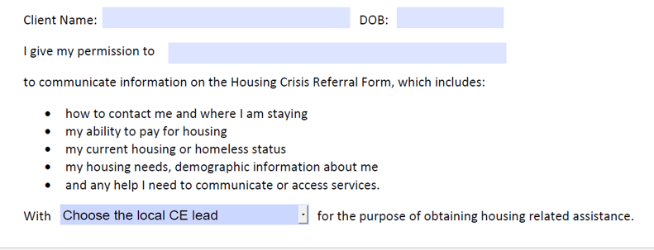
Referral Form – Client Permission
Notes:
**RENEE**
The Referral Form includes a back page that provides “one-way”, “one-time” permission for the Referral Partner to share the form with the Lead Agency. This release does not allow the Lead Agency to share client information with another partner, or to communicate in an ongoing way with the Referral Partner.

Slide 36
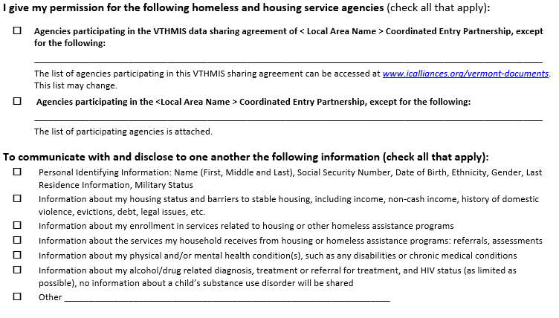
Housing Assessment – Client Permission
Notes:
**RENEE**
Last year, the Coalition approved an Coordinated Entry Release of Information
This is an important tool for coordinated entry, that documents permission on which agencies have permission to communi9cate and disclose specific information in HMIS and/or through coordinated entry general.
There’s a tool on the Coalition’s website that staff can use to explain the release to clients.
The release has an expiration data. Having a current release is necessary for a household to be on the Master List.

Slide 37
Domestic Violence, Sexual Violence, Dating Violence and Stalking
Access:
Victim service providers and non-victim service providers work together to ensure equal access to Coordinated Entry and all housing-related resources
Client choice around where to access Coordinated Entry and be served
Notes:
*KARA*
It’s really important that Coordinated Entry be implemented in a way that allows for victims fleeing domestic violence to access housing resources safely.
On the next few slides, we’ll explain options for how victim service providers and victims can participate safely in coordinated entry. Victim service providers refer to those agencies whose primary purpose is to serve victims fleeing domestic or sexual violence. This includes all of the member agencies in the VNADSV.
Meeting the needs of survivors requires all coordinated entry partners, not just domestic violence shelters, to be working together, so that no matter where a client presents for help, they can be served safely and quickly.

Slide 38
Domestic Violence…
Safety & Confidentiality:
Non-victim service providers trained in safety planning and clearly explain options of data sharing for clients to make an informed, safe decision
Survivors have the option of having a non-identifiable unique ID to be placed on the Master List
Survivors assessed at DV agencies will not be entered into HMIS
Notes:
**KARA**
Here’s a few key points about safety and confidentiality. Some of these points have been mentioned earlier.
All partners will be trained on safety planning and how to explain options to clients so they can make safe, informed, choices.
Victim Service providers are prevented from using ServicePoint.
Survivors can participate anonymously in the coordinated entry process by using a non-identifiable unique ID.

Slide 39
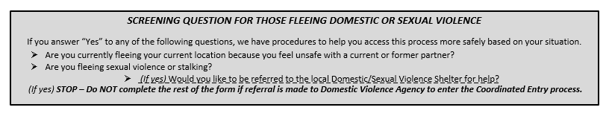
Domestic Violence…
Procedures:
      If yes, Client is referred to victim service provider and placed on Master List with non-identifiable unique ID, provided to Lead Agency by victim service provider
      If no, Client continues Coordinated Entry process with non-victim service provider
Notes:
**KARA**
At each step of the coordinated entry process – screening and assessment, the forms help to screen clients and offer the opportunity to refer the client first to the local domestic violence shelter for help.

Slide 40
Emergency Shelter & Coordinated Entry
Coordinated Entry does not interfere with current process for
people seeking emergency shelter.
Require written protocol for coordination & communication between shelter providers, Economic Services and 2-1-1 to streamline access:
  Emphasize ease of access
  Include: contact info for each agency, intake hours and process, shelter hours, population(s) served
  Protocols reviewed by VCEH Coordinated Entry Committee
Notes:
**BROOKE**
The most important thing to say here is that no one needs to go through the assessment process, go through the lead agency, or be on the master list in order to access emergency shelter. The coordinated entry process does not interfere with accessing emergency shelter and services.
In fact, at each step in the process, it’s very important for partners to first triage urgent needs.
That said, the Coordinated Entry Committee has recommended that there be a written protocol in each local CoC between all of the providers who help clients access emergency shelters or emergency housing through general assistance at Economic Services.
The protocol should emphasize ease of access for people seeking emergency shelter, and also clearly document contact information for agencies, intake hours, shelter hours, population(s) served, and the intake process for each agency.

Slide 41
Emergency Shelter & Coordinated Entry
If Emergency Shelter is a Referral Partner:
Refer to Lead Agency within 3 calendar days
If Emergency Shelter is an Assessment Partner:
Provide client with an opportunity to complete Housing Assessment within 1 week of entry
Notes:
**BROOKE**
Emergency shelters may choose to participate in coordinated entry as a referral partner or assessment partner. Some are actually lead agencies, like the Upper Valley Haven.
If a shelter is a referral partner, they are encouraged to make a referral as soon as possible.
For shelters that are assessment partners, guests would be offered the opportunity to complete the Housing Assessment within 1 week. We recognize that sometimes guests need time to stabilize when they come into shelter.

Slide 42

Coordinated Entry Overview for all CE Partners
Recorded webinar and available in person, by request
Train the trainer for Lead Agencies
Housing Assessment for all assessors
Recorded webinar and one annual in-person training
Train the trainer for Lead Agencies
Service Point & Coordinated Entry for all HMIS users
Provided by ICA to each region, as needed
Notes:
*BROOKE*
Over the next 6 months, the Coalition and the Coordinated Entry Committee will provide a lot of training to local CoCs and partners to implement Coordinated Entry, once approved in January.
We will also need to provide training ongoing. All partners need to receive an overview of the Coordinated Entry process that goes into details about steps, partner roles, confidentiality, safety planning, fair housing, equal access, ADA, and evaluation.
This training would be required for all Partners.
All staff administering the Housing Assessment would need to attend a training on the Housing Assessment. And all staff using ServicePoint for coordinated entry would receive HMIS training.
The Coordinated Entry Committee would provide training curricula, and training could be provided by webinar and/or in person. Lead Agencies would be able to provide training.

Slide 43

Evaluation
Annually, each Local Partnership: survey partners, collect consumer feedback
Every 6 months, review local CoC and aggregate data:
# of participating organizations
# of referrals to housing programs and # of housing placements (by type)
Length of Master List, # of HH on the list > 3 months, # of recurring HH
Unmet needs based on the Master List (by type)
Notes:
*BROOKE*
Even with everyone’s feedback, we are not going to get things perfect on day one (or even day 30). It’s really important to continuously improve the process by understanding what’s working locally and across the state. We need to make sure that coordinated entry is working for clients.
Evaluation is a part of the VCEH Coordinated Entry Committee going forward and we’ve proposed some key steps and indicators.
The local lead agency will play a key role to help make sure local evaluation happens by surveying local partners and collecting feedback from consumers through a survey or focus group. The Committee would provide survey tools.
We’ve also proposed some key data points that will help the Coalition to understand the effectiveness of Coordinated Entry, and help us understand unmet needs in different regions and across the state.
The VCEH committee would present an annual summary report with analysis to the VCEH Board.

Slide 44
Questions?
Feedback?
Notes:
*SARAH*
Sarah leads, others jump in as relevant

