Slide 1
VAWA Housing Protections
Kara Casey
Director of Economic Empowerment
Vermont Network

Slide 2
What we will cover
Overview of:
VAWA 2013’s housing protections for survivors of domestic violence, dating violence, sexual assault, and stalking. 2022 update
Fair housing laws that provide safeguards for survivors including state laws

Slide 3
VAWA
The original Violence Against Women Act, passed in 1994 and authored by then-Senator Joseph R. Biden, was the first federal legislation acknowledging domestic violence and sexual assault as crimes and provided federal resources to encourage community-coordinated responses to combating violence against women. Up for renewal every five years, each VAWA reauthorization has built on existing protections and programs to better meet the needs of survivors. (NNEDV)

Slide 4
What Federal housing programs are covered?
Federal housing programs are subject to VAWA protections include:
Public Housing
Section 8 Housing Choice Vouchers
Project-based Section 8
Section 202 Supportive Housing for the Elderly
Section 811 Supportive Housing for People with Disabilities
§ 236 Multifamily Rental Housing
§ 221(d)(3) Below Market Interest Rate
HOME
Housing Opportunities for Persons with AIDS
McKinney-Vento Act Homelessness Programs
Rural Development Multifamily programs
Low Income Housing Tax Credit
Housing Trust Fund
USDA RD Voucher Program*
Title 38 Housing Assistance*

Slide 5
Who is covered?
VAWA protects anyone who is: (a) a victim of actual or threatened domestic violence, dating violence, sexual assault, or stalking, or an “affiliated individual” of the victim; AND (b) living in, or seeking admission to, a federally assisted housing unit covered by VAWA.

Slide 6
What rights does VAWA offer?
Rights for victims of domestic violence, dating violence, sexual assault, and stalking include:
If you are applying for housing, you can’t be denied just because you are a victim.
You can’t be evicted or lose your federal rental assistance just because violence has been committed against you.
Acts of violence against you are not considered to be serious or repeated violations of your lease or good cause for evicting you or ending your federal housing assistance*

Slide 7
Lease Bifurcation: A public housing authority or landlord may “bifurcate” or split a lease to evict a DV abuser while allowing the victim to stay
Protection for tenants remaining in housing after lease bifurcation- If the individual who is evicted is the sole tenant eligible to receive the housing assistance, the PHA or landlord must provide the remaining tenant an opportunity to establish eligibility or a reasonable time to move or establish eligibility for another covered housing program.
The landlord must follow federal, state, and local law in evicting the abuser

Slide 8
Preserving Section 8 Voucher for Survivor: PHA can terminate Sec 8 assistance to the abuser while preserving assistance to survivor. If a family breakup results from DV, “the PHA must ensure that the victim retains assistance.” 24 C.F.R. § 982.315.
Voucher Portability: If a Section 8 voucher family moves out in violation of a lease, PHA has grounds to terminate their subsidy. VAWA provides an exception for survivors who must move for safety. Many PHAs prohibit Sec 8 voucher tenants from moving during the 1st year of their lease, or from moving more than once during a 12-month period. However, these policies do NOT apply when the move is needed for safety. See 24 C.F.R. § 982.314

Slide 9
Emergency Transfers: Survivors living in federally assisted housing often need to move or “transfer” to another subsidized unit to protect their safety.
VAWA 2013 mandates each federal agency to adopt a model emergency transfer plan to be used by PHAs and owners.
Transfer plan must allow survivor tenants to transfer to another available and safe unit assisted under covered housing program if (1) tenant expressly requests the transfer and (2) either tenant reasonably believes that she is threatened with imminent harm from further violence if she remains or tenant is a victim of sexual assault that occurred on premises within 90 days of request
Transfer plan must ensure confidentiality so that PHA or owner does not disclose location of new unit to abuser
Notes:
https://helpingtohousevt.org/whatwedo/dvsv/

Slide 10
VAWA 2022
VAWA was reauthorized, new provisions go into effect Oct 1, 2022
Adds covered Federal Housing Programs and expands language
Creates a Gender Based Violence Prevention Office and VAWA Director at HUD to help oversee and implement existing housing protections/help coordinate the departments response to survivors of violence
Protection against “nuisance ordinances”
Prohibits retaliation
The bill also amends the federal definition of “homelessness- adding “ is experiencing trauma or a lack of safety related to..”

Slide 11
What documentation can be accepted?

Slide 12
HUD form 5382

Slide 13
Confidentiality & Notice

Slide 14
PHA, owner, landlord must keep confidential: Any information that is given by the victim to the landlord to certify their status as a victim and cannot be shared unless:
it is requested or consented to by the victim/survivor, in writing;
it is required for use in an eviction proceeding; or
it is otherwise required by law.

Slide 15
PHAs, owners and managers must provide HUD notice along with the agency-approved, self certification form to applicants and tenants
at the time an applicant is denied residency;
at the time the individual is admitted;
and
with any notification of eviction or termination of assistance.
Notes:
Must be language accessible

Slide 16
Other Housing Laws that provide protection to victims/survivors
Federal Fair Housing Act- prohibits landlords from discriminating on the basis of sex. “Few courts have addressed whether the Fair Housing Act prohibits discrimination against women who have experienced domestic violence, but some courts have recognized that discrimination against victims of domestic violence is illegal sex discrimination when it is based on gender stereotypes. It is also likely that policies that discriminate against victims of domestic violence would constitute illegal sex discrimination due to their disparate impact, unless a landlord could prove that there was a very good reason for the policy.” ACLU
Housing protections for victims of abuse, sexual assault and stalking- This law addresses non-discrimination, lock changes, early lease termination and confidentiality. Forms can be found here: https://helpingtohousevt.org/whatwedo/dvsv/
Safe at home program- An address confidentiality program through the Vermont Secretary of State’s office.

Slide 17
Documents and resources
HUD VAWA forms: https://www.hud.gov/program_offices/housing/mfh/violence_against_women_act
National Housing Law Project: https://www.nhlp.org/initiatives/protections-for-survivors-of-domestic-and-sexual-violence/
Safe Housing Partnerships: https://safehousingpartnerships.org/
VCEH: https://helpingtohousevt.org/whatwedo/dvsv/
Vermont Network: https://www.vtnetwork.org/

Slide 18
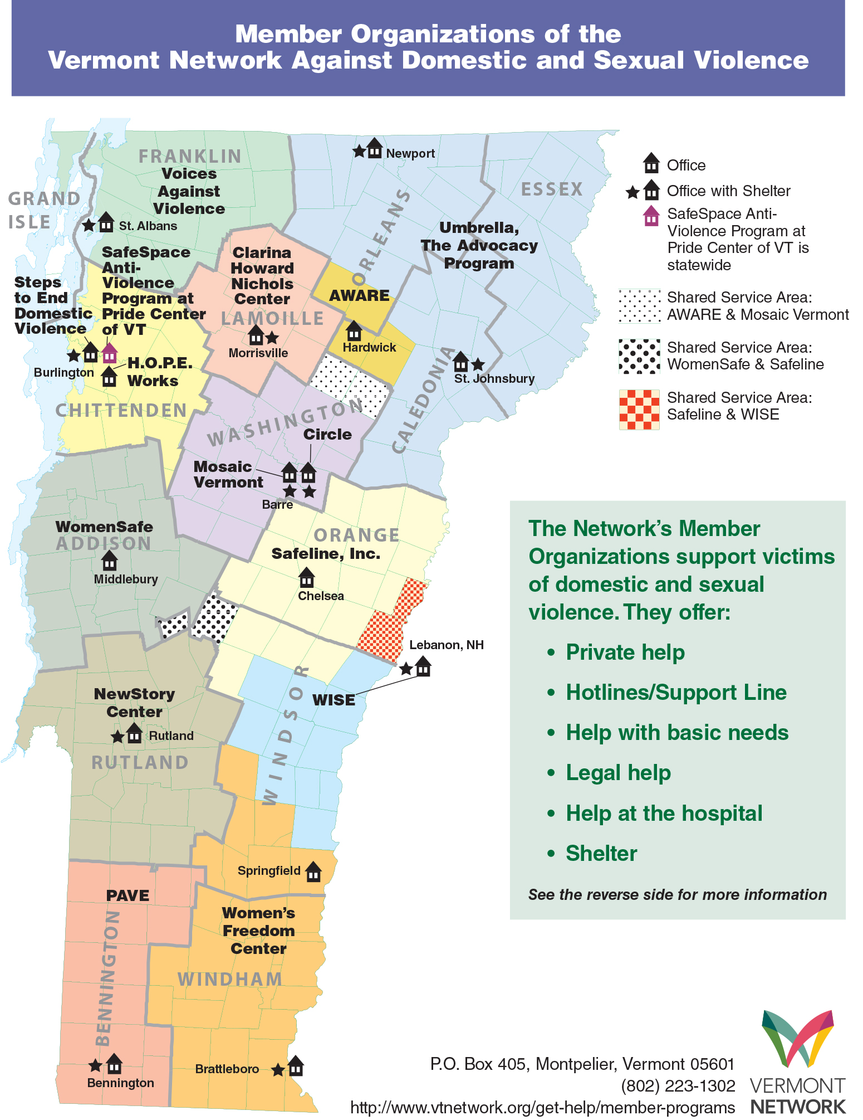

Slide 19
Kara Casey
Director of Economic Empowerment
kara@vtnetwork.org
1-802-223-1302 ext. 1105

