Slide 1
Legislative Advocacy 101 Homelessness Awareness Day 2024

Slide 2
HHAV’s Legislative Priorities
Strategy 1: Accelerate Production of Affordable Housing
VHCB funding - $110m one-time and $26m base
VHIP - $10m for improving rental housing
VHFA - $25m for VT Homeownership Program
Manufactured homes - $15m for a variety of programs
Strategy 2: Reimagine Emergency Housing
Bridge from current funding to July 1, ask of $12m more in Budget Adjustment
Reimagine Emergency Housing after July 1
Strategy 3: Enhance Services and Subsidies
Increase permanent supportive housing units
Establish a statewide place-based supportive services fund
Notes:
Kara & Bev

Slide 3
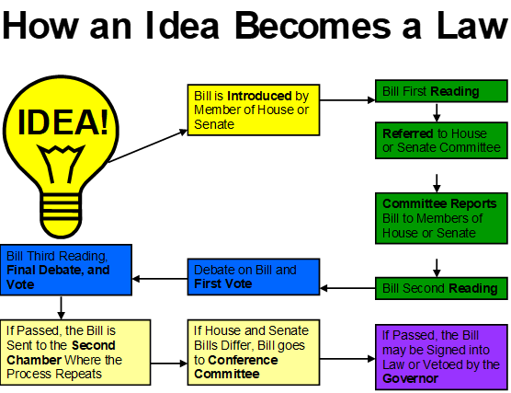
Notes:
Kara

Slide 4
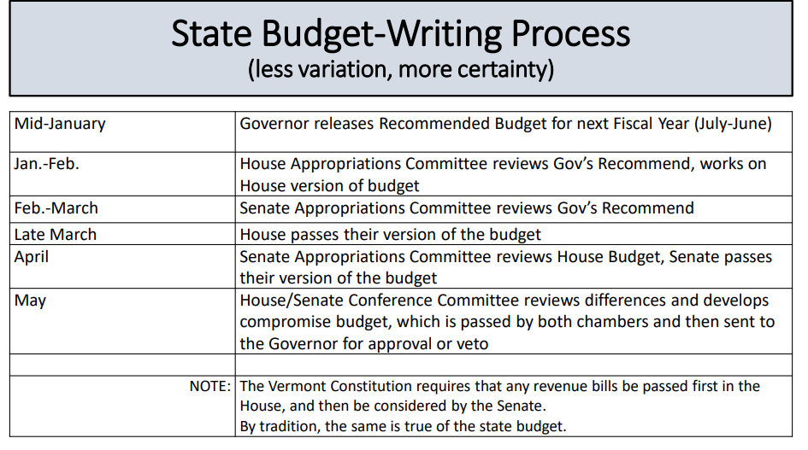
Notes:
Beverly

Slide 5
Legislative Committees and Legislative Website
https://legislature.vermont.gov/
Notes:
Kara & Bev

Slide 6
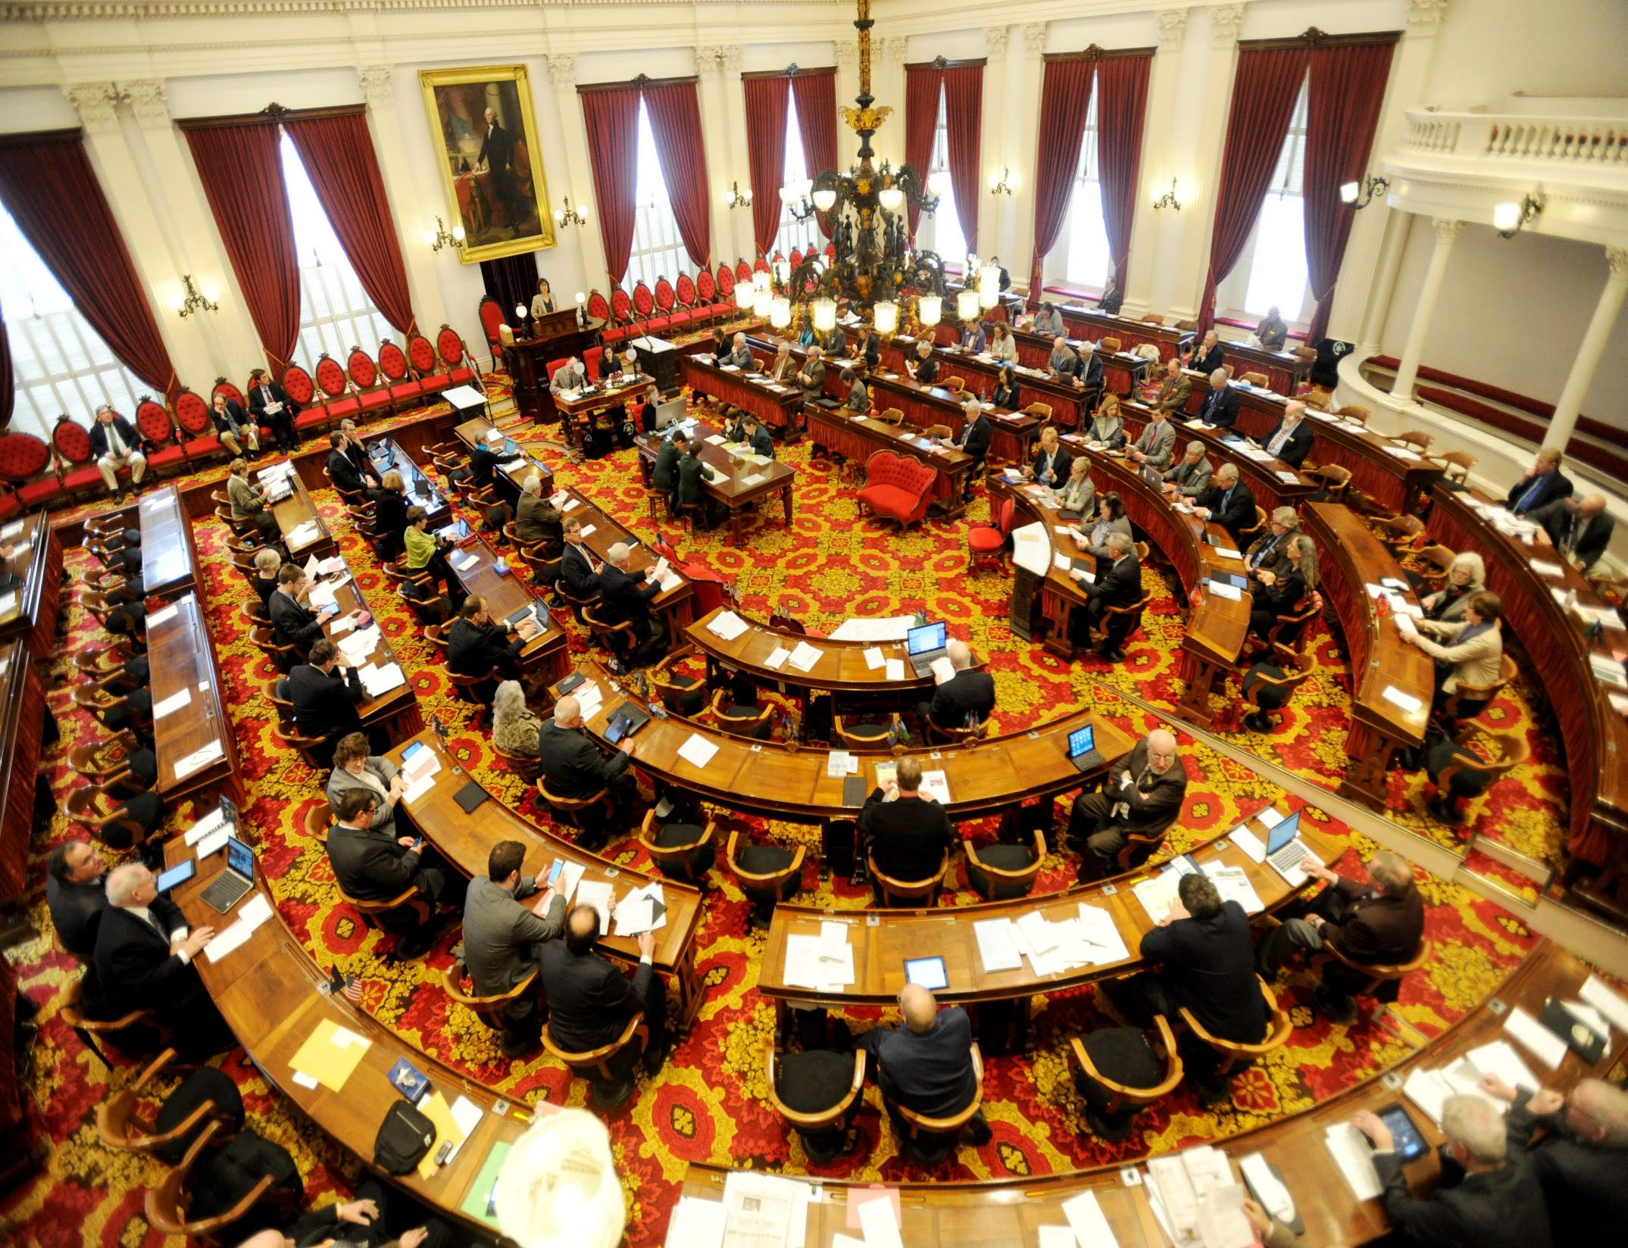
Vermont is a great place for policy advocacy!
Citizen Legislature
No offices or staff
Direction access, but legislators are very busy
Notes:
Legislators are approachable- no offices or staff. We have a citizen legislature.
Kara

Slide 7
Effective Citizen Advocacy -3 Key Phrases
• “Pleasant, Patient, Persistent” –then repeat …
• “Compelling, not comprehensive”
• “It’s a team sport!”
Notes:
Bev

Slide 8
Effective Citizen Advocacy:
Who are you?
Why are you a trusted messenger on this issue?
Give your “target” a little bit of the context as well as the “story” – who you are, why this matters to you, why this matters to the community.
Notes:
Bev-
Advocates’ stories matter! • You are here because there are issues you care about – that impact your life, work, family, and community – that you want to and can impact. • Because of your connections in the community and to specific programs and services, often only you can provide important information and context for an issue that will make change possible. • Lobbyists and professional advocates aren’t “real people” – legislators really do want to hear from you.

Slide 9
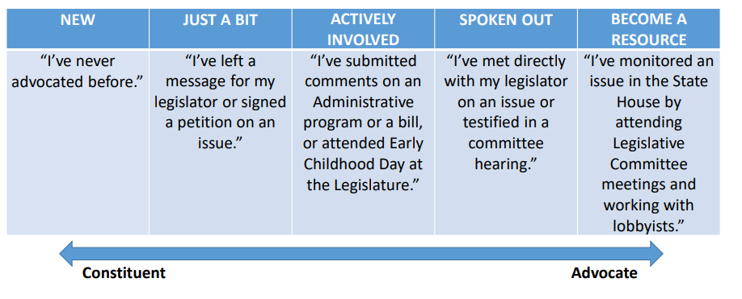
Moving from Constituent to Advocate- Spectrum of Engagement
Notes:
Bev

Slide 10
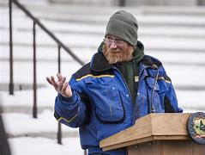
How To Connect
Send an email, letter, call, or ask to testify
You don’t have to come to the statehouse! You can ask your legislator to meet with you in the community.
Notes:
Kara

Slide 11
Commitment:
Ask your legislator to do something!
What do you plan to do about this issue?
If this bill is introduced, will you support it? Will you champion the bill?
End with a follow- up plan
Notes:
Kara

Slide 12
Thank you!
Kara Casey- kara@vtnetwork.org
Beverly Boget- Beverly@vecaa.org

