Slide 1

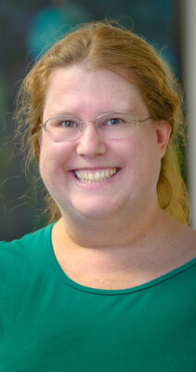
Upper Valley Coalition for Housing Solutions
"Cultivating Creative Solutions through Partnerships"

Slide 2

Partnering with Landlords for Support
This event is a free event for any landlord who is partnering to help support housing for clients in the community.
It is an event for current landlords or people thinking that they may be interested in supportive housing as an option.
Information shared about funding and additional supports for landlords who are choosing to support our overall goals of housing solutions.

Slide 3
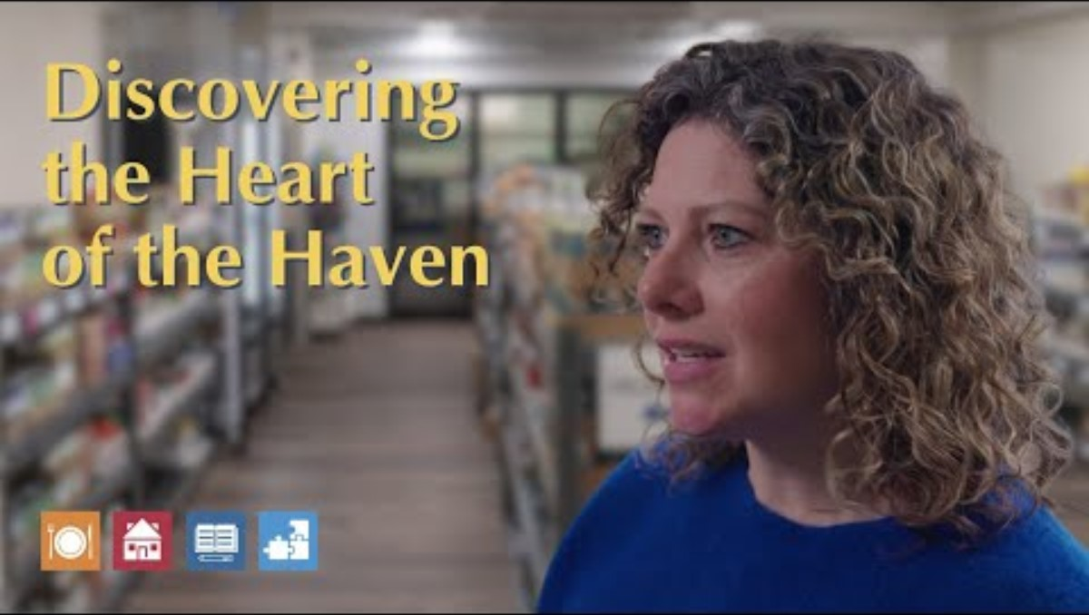
Education & Awareness
Marisa, a community member and past volunteer, as she takes her first full tour of the campus and reflects on what she saw and learned about the breadth of our work.

Slide 4
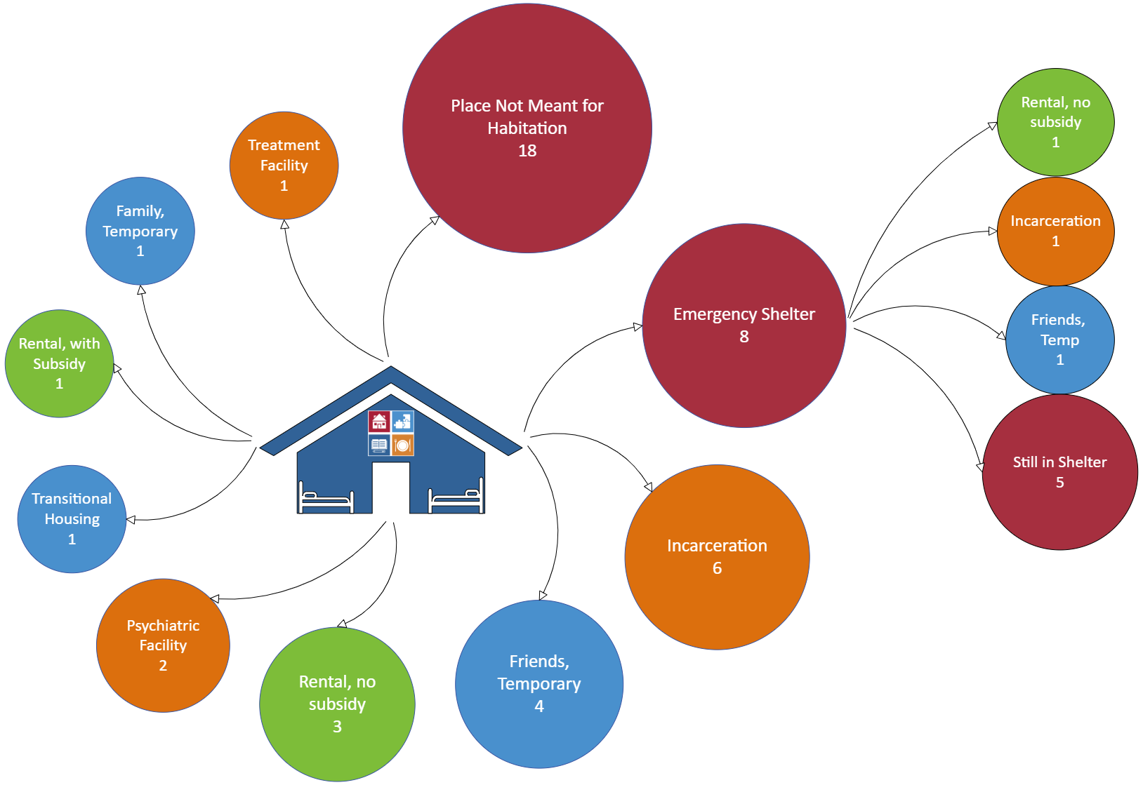
House Calls at the Haven
We are excited to announce the availability of health care services at the Haven!
Who is eligible for a visit: We are able to care for adults, children, and pregnant women
Who will provide the care:
Family Medicine providers from Dartmouth Health’s Community Care Team.
Alena Shoemaker MD
Cory Howarth NP.
Meagan Adams is a community health worker and recovery coach
Roughly 12 documented visits
Pending Plans to include Community Nurse and Community Health Worker

Slide 5




Partnering with Lebanon/Grafton Co, NH for Seasonal Shelter
Demographic Information
72 Unique Guests
39 of 72 guests (54%) identify as disabled
3 guests are veterans
Age Range | Guests *
20-29 | 13
30-39 | 24
40-49 | 15
50-59 | 10
60+ | 9
Substance Use Disorder | Guests
No | 19
No answer | 32
Drug use | 9
Alcohol use | 5
Drug & alcohol | 7
Operations and Outcomes
Average Guest Count per Month
98 Nights Open
14 Guest capacity
170 Hotel rooms provided by VT & NH for overflow
42 Average age at entry
9 Returning LSS guests
Length of Stay | Guests
≤ 5 days | 27
6-10 days | 10
11-20 days | 11
21-30 days | 8
> 30 days | 16
Feb (28 nights)
Mar (31 nights)
April (15 nights)
* One guest declined to provide their DOB and gender/sex.
Jan (23 nights)

Slide 6
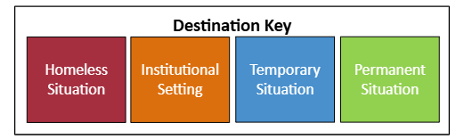
Exits from Winter Shelter
This visual shows the exit destinations for 45 of the 72 individuals who stayed in the seasonal shelter. The remaining 27 had unknown destinations.

Slide 7

Faith Partners for Housing Solutions

Slide 8
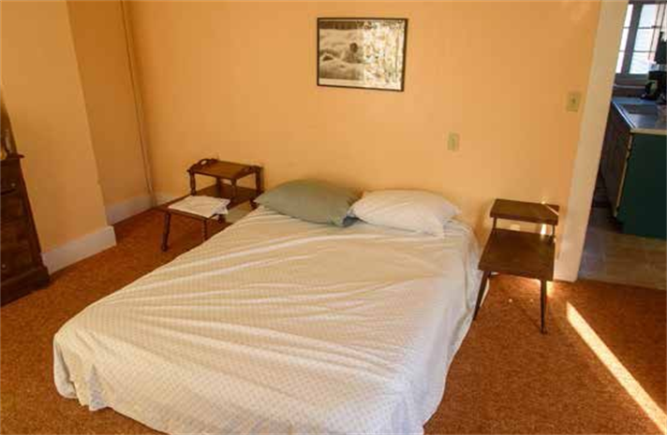
Faith Based Partnership In Randolph:
Charlie's Loft
This loft provides a small apartment that is available for up to 28 days. Another, St. John's - provides cots in their parish hall for overnight stays. Both are currently available to serve one household at a time. There are ongoing attempts to garner sufficient community volunteers to offer additional warming shelter capacity during winter months at St. John's.

Slide 9
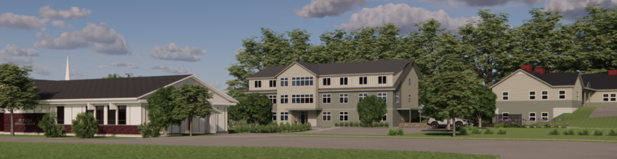
747 and St Paul's Episcopal Faith Community
White River Junction, VT
Twin Pines has partnered with St. Paul’s Episcopal Church in White River Junction and the Upper Valley Haven on an innovative project. Twin Pines to use a portion of the church’s two-acre property to create 18 one-bedroom apartments of permanent housing for the chronically homeless. Residents will receive supportive services from the Haven, located next door. St Paul's is offering support in community and social engagement in the building.

Slide 10
Community Policing Efforts in Hartford, VT
Community Engagement

Slide 11
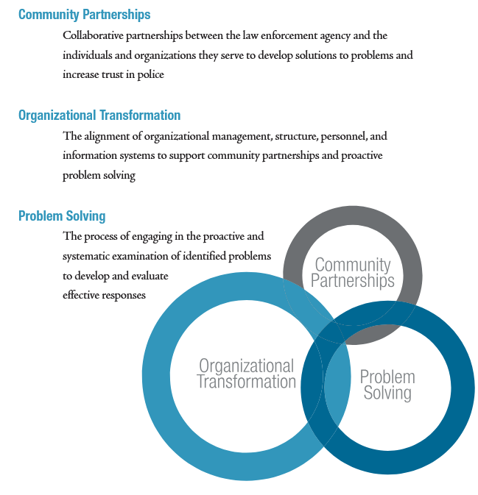
What is Community Policing?
Origins of this concept go back to the 1800s, but began widescale national implementation in the 1970s
Recognition that police are not the only guardians of a community, but everyone can be an active ally to promote safety, prevent crime, and improve quality of life in our neighborhoods
VT Governor Phil Scott recently released a 10-point plan to address criminal activity. One part of the plan was to better align social services, mental health resources, and law enforcement.
Source: US Department of Justice
Notes:
Organizational transformation – involves changes in climate and culture, transparency, emphasis on data, etc.
SOURCE:
https://portal.cops.usdoj.gov/resourcecenter/content.ashx/cops-p157-pub.pdf
https://www.ojp.gov/pdffiles/commp.pdf

Slide 12
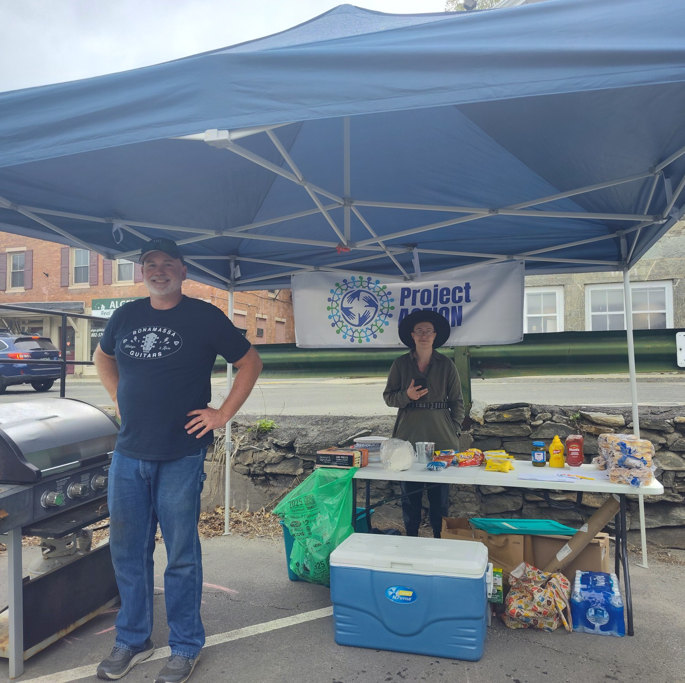
Springfield, VT – “Project ACTION”
Began as a community policing effort led by Springfield PD, but now is an independent 501c3
Project ACTION (Assembling Community To Improve Our Neighborhoods) is engaging community stakeholder in response to drug, crime and community health
Embedded a recovery specialist and mental health specialist in Springfield Police, created wraparound services with a community response
Crime has dropped significantly
Notes:
Springfield, VT Chief of Police Jeff Burnham spoke with the Hartford VT group during our initial launch
Other examples include Project Vision in Rutland

Slide 13

HartStat
Led by Hartford PD Outreach Division, beginning in early 2025
Monthly meeting with service providers
Police share statistics and data on locations with the most calls for service, types of calls
Invitation to service organizations to collaborate with police social worker on supporting individuals and households

Slide 14

Hartford Public Safety Coalition
Began in April 2025, in response to high rates of incidents in 2025, most of which are “quality of life” and not strictly speaking law enforcement
Monthly large-group meetings with police department, Hartford residents, and service providers

Slide 15
Hartford Public Safety Coalition
Residents identified concerns such as
  Substance use
  Harm reduction
  Dirty needles in residential areas
  Homelessness and camping in neighborhoods
  Lack of mental health supports
Monthly subcommittees based on topics identified as areas of concerns by residents
  Neighborhood Safety
  Substance Use
  Housing
  Accountability
Now, learning is happening around these issues, what services exist to address them, and gaps in the system.
Building trust with social service providers who shelter

