Slide 1
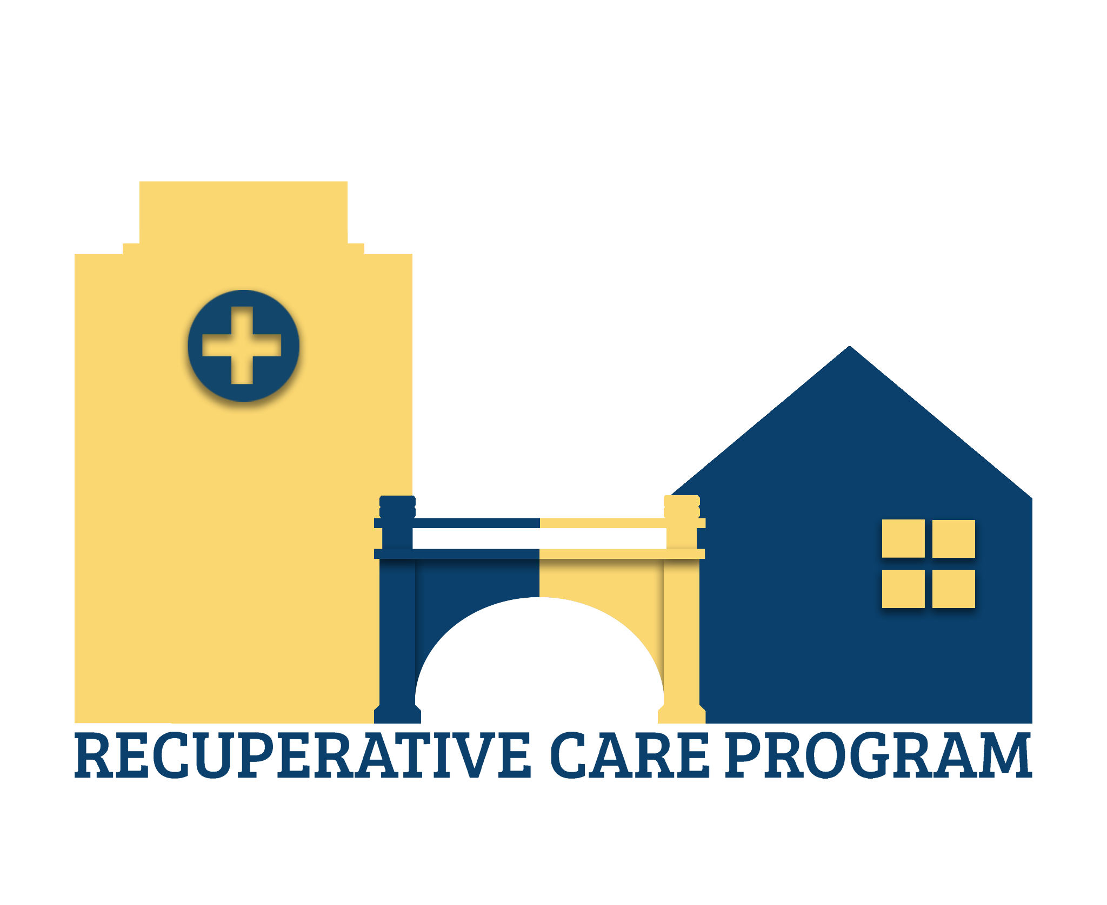
Lamoille Community House Recuperative Care Program
No one should be without a safe place to heal.

Slide 2

Background and History
How did RCP come to be?
Consultant for Homeless Health Equity grant identified it as a need after conversations with various providers.
Lamoille Health Collaborative members identified the gap of services for folks experiencing homelessness with complex medical, mental health, and substance use needs.
HHE consultant shifted work focus to help us create capacity to launch a program.
Partnership between Lamoille County Mental Health Services and Lamoille Community House allowed us to apply for HCBS grant for funding.

Slide 3
Background and History
“A barrier for the ED is getting those people placed in a reasonable amount of time –sometimes people can just end up in ED for endless amounts of time. Sometimes there’s a medical issue requiring them to go inpatient, but then there are requirements around eligibility.”
“…there is no structure to prevent being discharged [from the hospital] to a shelter or hotels…people are quickly back to the hospital, revolving door.”
“There’s no place for people experiencing homelessness to recover [from medical procedures etc.], it’s a yo yo.”
“We have this significant population in the state that have not, cannot and will not get the care that they need. The people who are left unhoused are the complex ones that need the care. The housing first model must have many models within – where is the supportive living, where there are services on site? Give them a home, a bed, with services and staffing etc.”
“We’re missing part of our system – with such complex needs, before too long, they can’t stay in shelter.”

Slide 4

Notes:
We first called it the Housing and Complex Needs program. But eventually changed it to the Recuperative Care Program after learning more from the National Health Care for the Homeless Council.

Slide 5
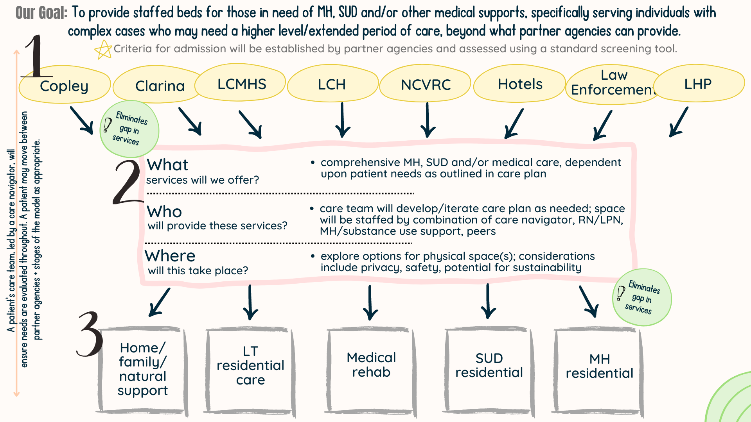
Notes:
Talk about how we weren’t sure how long of a program it would be. We spent many partner meetings trying to define what this program could be.

Slide 6
The Partners
Lead of program became Lamoille Community House because we had the staffing model to carry over and capacity to hire a director and staff for the program.
Physical location and HCBS grant holder - LCMHS
Partners that helped create the program, especially around admissions criteria include: Clarina Howard Nichols Center, Capstone, United Way, VDH, VCCI, Lamoille Health Partners, North Central Vermont Recovery Center, United Community Church of Morrisville, Copley Hospital, LCMHS.
Partners were instrumental in creation of admissions criteria, policies, and referral process.

Slide 7
The Pilot (year 1)
Launched July 2024 after 6-8 months of prep.
Utilized National institute for medical respite care framework.
Hired Director to set up, launch, and run program.
Funded first year through HCBS grant, held by LCMHS and subgranted to LCH and CDC health disparities grant through VDH.
Admissions criteria flow chart was created.
Utilized the FindHelp referral tool to receive and review referrals to program.

Slide 8
The Program
Located in two 2-bedroom apartments. 3 rooms used for guests, 1 room for staff office/sleeping space.
Staffed 24/7 by one staff member.
Co-managers supervise staff and coordinate services for guests.
8-week program (ideally) for guests to heal from whatever brought them in.
Home health referrals often made.
Most people served in the program have been aging Vermonters.

Slide 9
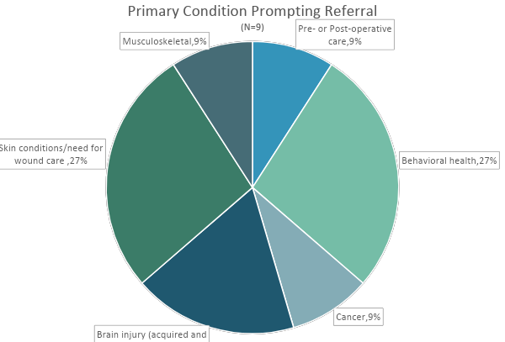
The Outcomes
Program Length of Stay
Average: | 61.2
Range: | 2-184

Slide 10
The Outcomes
Number of people served - 9 in the first year, 11 total.
Ages of people served - We have noticed most clients are aging Vermonters. Their ages have ranged from 27 to 83.
4 people transferred to the main shelter, 2 of which moved on to permanent housing after.
1 person moved into a GA hotel room
1 person moved directly into housing
1 person transferred to a higher level of care
1 person exited on their own
National Institute for Medical Respite Care Pilot Evaluation linked here

Slide 11
The Outcomes
Success stories:
RCP’s first guest was referred from the ED, recovering from a stroke and struggled with mental health. They created a care plan and took time to meet with doctors, they later transferred to our main shelter. From there, they were able to apply for grants to get adaptive equipment for their car, relearn to drive, and got their car back. Shortly after, they found an apartment.
A recent guest was referred to RCP, post-op from surgery. In their time recovering they managed their medications, re-connected with family and excelled in physical therapy. Benefiting from assistence offered and Both RCP and LCH, This guest moved on to income-subsidized housing close to their newly established support network.
Another guest had moved into RCP from a condemned and uninhabitable house with unmanaged health needs. He recovered at RCP and then sold his property, paid off his debt, and then used money to acquire independent living closer to his supports so his health could be better monitored.

Slide 12
The Outcomes
In just one year, surveyed partners stated that RCP did the following,
Filled gaps
Provided a safe discharge placement
An important part of the housing/ transition process
Support to address health needs not available in other services

Slide 13
Next Steps
6 more months of funding acquired - until December 2025
Program costs around $600k annually to run - could be more cost effective if we had a different location where more people we could be served without change of staffing model.
Learn more about LCH’s Recuperative Care Program on our website.
Reassessing the need - after a year of operations we are able to track trends and see what gaps are still occurring and how to address them.
Notes:
Speak to older vermonters and longer stays. Does RCP need to be a short term program, or would it be more impactful to have a holding space for folks moving into higher levels of care?

