Slide 1
Chittenden County Homeless Alliance
25 Voting Members of the Steering Committee
Expanded membership over the last year: Champlain Valley School District and KidSafe Collaborative
Working to connect with other regional municipalities
Five Year Strategic Plan Implementation
Collective Impact Funding
Monthly Data Review

Slide 2
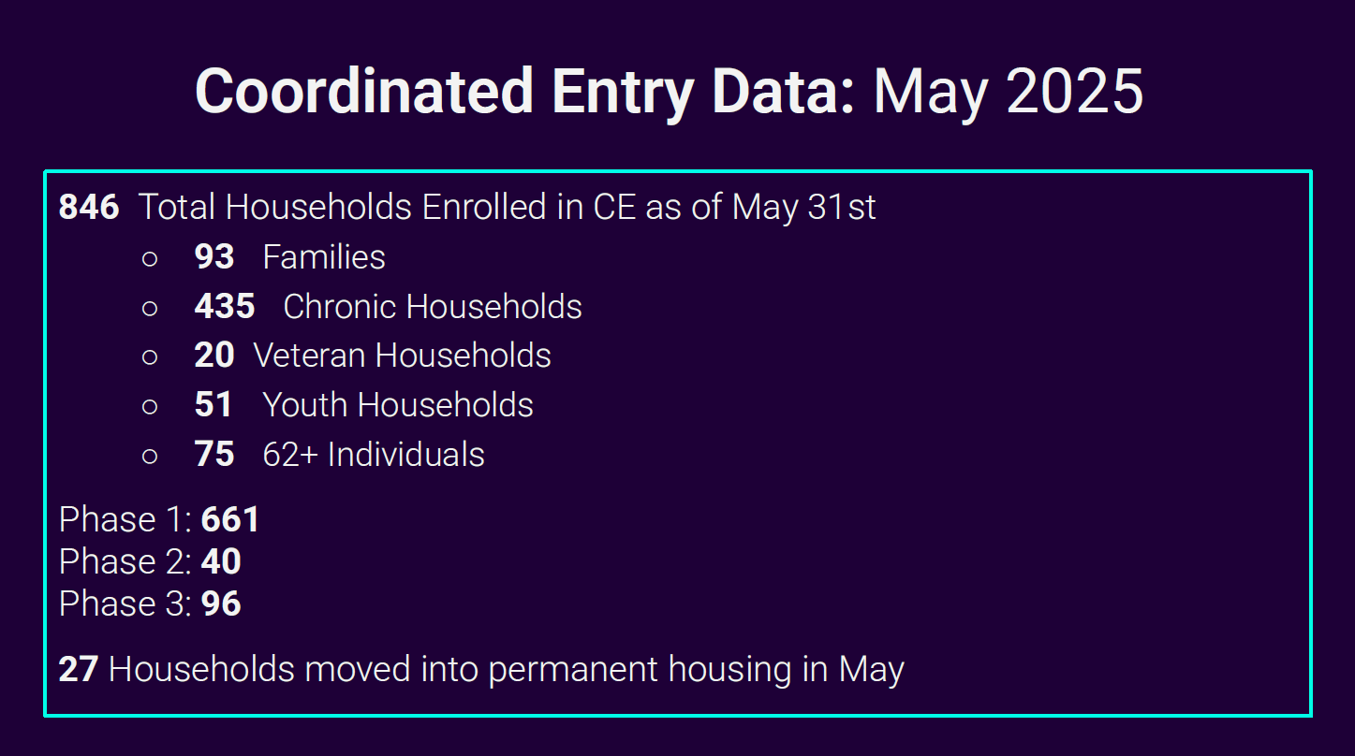

Slide 4
Unsheltered Homelessness
Data collected and reported monthly
2024 high: 370
2025 high: 267 (June, pre-7/1 exits)
Sheltering on Public Lands Policy (City of Burlington)
Cross-agency Outreach Coordination
Low-barrier shelter capacity

Slide 5
Current Shelter Capacity
Name of Shelter | Capacity | Operation | Barrier
Champlain Place | 42 beds | Year-round | Low
Champlain Place | 30 beds | Seasonal | Low
Waystation | 56 beds | Year-round | Mid/High
Family Shelter (2) | 15 rooms | Year-round | High
Williston Family Shelter | 7 rooms | Year-round | High
Smith House | 7 rooms | Year-round | High
Youth Shelter (2) | 18 beds | Year-round | Low
Elmwood | 35 beds | Year-round | Low
ANew – North Street | 20 beds | Year-round | High
Safe House (Steps – DV) | 21 rooms | Year-round | Mid
Harbor Place Med Respite | 7 rooms | Year-round | Mid
Howard Center – CSP | 6 beds | Year-round | Mid
Total Year-round | 227
Total Seasonal | 30 |  | Low
Total | 257 | Motel Capacity: 286 | Total: 484

Slide 6
ECWS Data 2024 – 2025
Mental health issues: 26 people - 12%
Substance use disorder: 45 people - 21%
Co-occurring MH/SUD: 69 people - 33%
Medical issues: 52 people – 24%
Intellectual disability: 6 people – 3%
Elderly (65+): 12 people – 5%
Other: 4 people – 2%
_______________________________________________________
CRC February Data: 227 Unsheltered

