Slide 1
Northeast Kingdom Local Housing Coalition (Caledonia/ Southern Essex LHC and Orleans/ Northern Essex LHC)
Co Chairs: Casey Winterson and Chris Mitchell

Slide 2
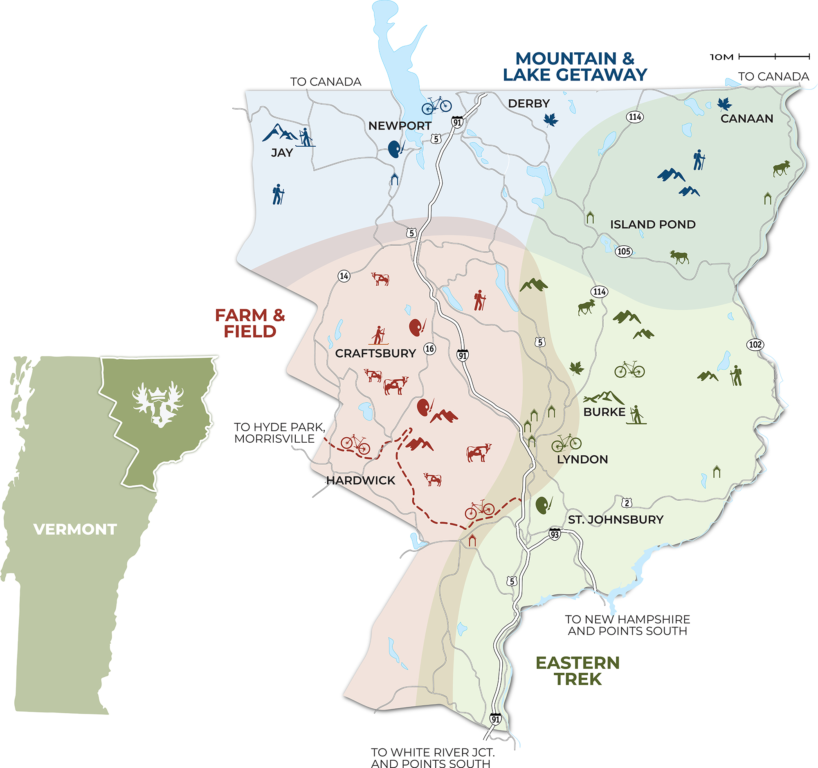
Info about the NEK:
3 Counties:
Orleans, Essex and Caledonia
2027 square miles (21% of VT)
~65,000 residents
Highest rates of poverty in Vermont
Lowest household incomes in VT
~175 individuals experiencing homelessness.

Slide 3
Health Equity Capacity Building Grant
Awarded to NEKCA
2022
Multi-year grant funding to address disparities of those experiencing homelessness and the effect it has on their health.
Research and Peer Review
2022-2023
Main barriers in NEK of those Experiencing Homelessness Identified:
1. Housing
2. Transportation
NEK LHC Identified Grant Goals 2023-2025
Pocket Sized Resource Guide
Healthcare Access at the Shelter at Moose River
Transportation Access at the Shelter at Moose River
3. Healthcare Access

Slide 4
Deep Dive: Transportation
The NEK LHC utilized half of our monthly meeting time to work on the goals outlined by the Health Equity Grant.
Members broke up into 3 committees based on their interest.
Transportation Group Focuses:
Asset Mapping
Needs Assessment
Identification of Possible Solutions

Slide 5
Deep Dive: Transportation
Recognized Need:
Folks identified transportation needed specifically on Saturdays to be able to get to appointments, but majorly to go to local resources such as grocery store, pharmacy as well as to see friends and family in different communities.
Looked at Local Assets:
Rural Community Transportation (RCT) has a bus line that operates M-F throughout St Johnsbury and Lyndonville.
Local taxi provider for needs outside of RCT provided routes.
Volunteers- willing to drive folks with advance notice.
Proposal of Solutions
Partner with RCT to provide Saturday bus service on the Jay-Lyn Route.
Partner with RCT to add bus stop at the Shelter at Moose River.
Partner with Town Taxi to provide transportation Monday- Saturday for locations outside of RCT Route.

Slide 6


Saturday Cold Weather Bus Route- Pilot
Due to the limited amount of funding a pilot project was created to assess the need for a Saturday service of the Jay-Lyn bus route.
Beginning in November of 2024 and running through April 2025 the pilot quickly showed the need for a Saturday service.
In the first three weeks over 100 riders were reported in just 3 days of operation. These were significant numbers as reported by RCT.
A stop directly at the Shelter at Moose River was created and has been maintained as a “on demand stop”.

Slide 7
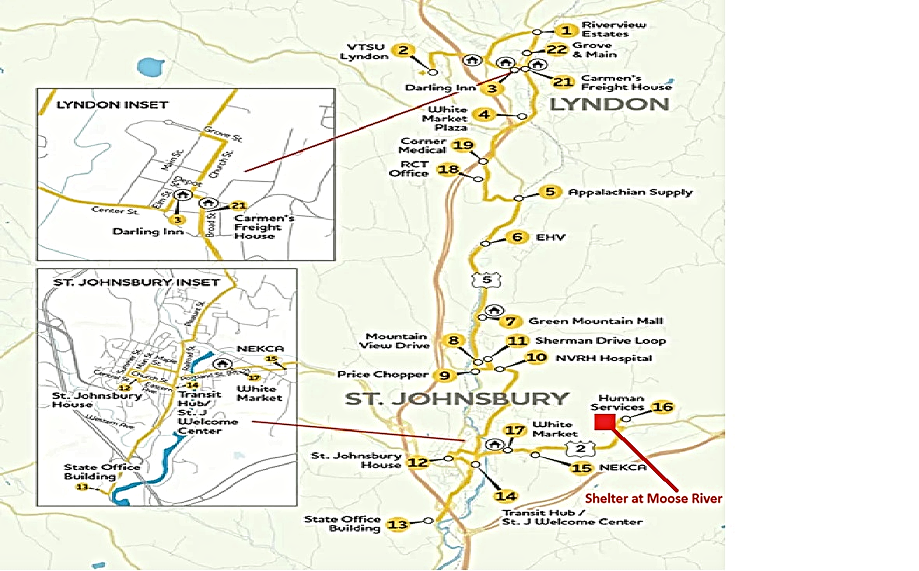

Slide 8
Saturday Cold Weather Bus Route Pilot- Results
Many of the riders were picked up and dropped off from known encampments along routes, as well as at The Shelter at Moose River.
Many of the riders utilized the bus to get to appointments, to go shopping and to see family and friends between the two towns.
Guests at The Shelter at Moose River reported how helpful this new route was and how much relief it brought them to not have to make the trek along the busy Route 2 during the winter.

Slide 9
Saturday Cold Weather Bus Route- Next Steps
A need has continued to exist for Saturday services for the Jay-Lyn Route between St. Johnsbury and Lyndonville.
RCT has applied for funding dollars to permanently add this route to their schedule for year-round operation.
NEKCA continues to search for additional funding which could be used to support another cold weather service of the Jay-Lyn Route if RCT is not granted the necessary dollars to operate it and/or look at additional needs around winter routes in the NEK.

Slide 10
No Bus Stop? No Problem!
The NEK LHC created procedures for folks experiencing homelessness who needed transport outside of the RCT routes. NEKCA partnered with our local taxi provider, Town Taxi to set up and pay for “on demand” trips.
Due to the bus being available on Saturdays, most were covered and did not need this option.
While utilization numbers were low for this service, a need was still present. NEKCA continues to seek additional funding to be able to continue this service.

Slide 11
Questions?

