Slide 1


Slide 2
PARTNERING TO SUPPORT EMPLOYMENT & HOUSING STABILITY
Assisting individuals with Disabilities or a Chronic Health Condition as they move toward employment, stability, and independence.

Slide 3
Work is more than a paycheck
Work defines us. It gives us purpose, independence, and community— contributing to a person’s overall quality of life.
For individuals experiencing homelessness, employment can be a critical step toward long-term housing stability.
Notes:
Work provides:
Purpose
Structure
Financial stability
Community connection
Increased self-confidence
When employment feels uncertain or out of reach — that’s where HireAbility Vermont can help.

Slide 4
What is HireAbility Vermont?
HireAbility Vermont is an employment and career development resource for Vermonters with disabilities and barriers to employment.
We help individuals:
Explore career paths
Prepare for and secure employment
Maintain employment
Access accommodations and supports
Navigate benefits and work incentives
We work statewide and partner with community organizations to reduce barriers and increase access.

Slide 5
Why this matters for the people you serve
Individuals experiencing homelessness often face:
Gaps in employment history
Limited transportation
Lack of stable communication access
Mental health or substance use challenges
Physical health conditions
Justice involvement
Fear of losing benefits
Lack of documentation
Employment can feel overwhelming without coordinated support.
Notes:
Speaker Notes:

Slide 6
How HireAbility Vermont Helps
Assessing Strengths & Interests
Creating Individualized Career Plans
Supporting Job Search & Placement
Providing Ongoing Job Retention Support
Notes:
We break down barriers to employment by:
Assessing Strengths & Interests
Helping individuals identify realistic, meaningful employment goals.
Creating Individualized Career Plans
No one-size-fits-all programs.
Supporting Job Search & Placement
Resume support, interview prep, employer connections.
Providing Ongoing Job Retention Support
We stay involved after hire.

Slide 7
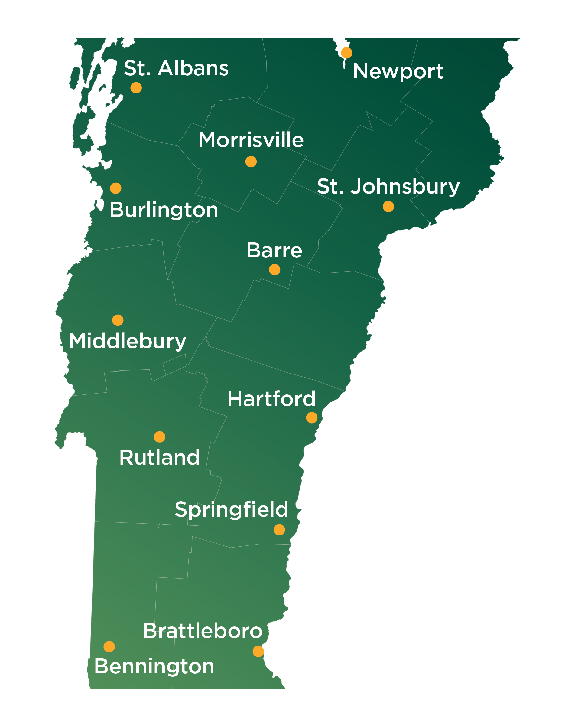
Connecting Passionate Employees With Local Employers By:
PROVIDING ACCESS TO FREE SERVICES & PROGRAMS
From Vocational and Work Incentives Counseling to getting help with job adaptions and post-employment support, HireAbility Vermont will provide the free support that is needed.
CONNECTING THROUGH STATEWIDE LOCATIONS
Our offices are located throughout Vermont—connecting job seekers with employers in VT and neighboring counties in NH, MA, and NY
Notes:
PROVIDING ACCESS TO FREE SERVICES & PROGRAMS
From Vocational and Work Incentives Counseling to getting help with job adaptions and post-employment support, HireAbility Vermont will provide the free support that is needed.
CONNECTING THROUGH STATEWIDE LOCATIONS
Our offices are located throughout Vermont—connecting job seekers with employers in VT and neighboring counties in NH, MA, and NY.

Slide 8
Free Services Available
Individuals you serve may benefit from:
Vocational counseling
Career assessments
Work Incentives Counseling
Job placement & retention services
Assistive technology
Job accommodations support
Post-employment follow-up
Training or education support

Slide 9
There Is No Standard Program.
CAREER SUPPORT RESPECTS INDIVIDUAL NEEDS—WE HELP SET A PATH FOR SUCCESSFUL EMPLOYMENT.
Individuals work one-on-one with their career counselor
Together, they will identify goals and set a plan
Determine which services and support are most useful
Coordinate training and education
Set up meeting with benefits counselor
Work with employers to accommodate unique needs
Guide individuals on exploring new career paths
Notes:
HireAbility Vermont isn’t based on a standard program.
Career support respects individual needs—we help set a path to achieve successful employment.
Individuals work one-on-one with their career counselor and together they will identify goals and set a career plan.
That plan will determine which services and support are most useful and coordinate any training or education that might be needed.
We also work with employers to accommodate unique needs, and guide individuals on exploring new career paths.

Slide 10
How we can partner with you
We can support your agency by:
Accepting direct referrals
Providing on-site or virtual information sessions
Coordinating around shared participants
Supporting employment components of housing programs
Assisting with employer outreach
Offering staff training on work incentives
We aim to complement — not duplicate — your services.

Slide 11
Next Steps
Let’s build pathways from instability to opportunity.
Contact us to:
Schedule a staff presentation
Discuss referral pathways
Coordinate services for shared participants
Request outreach materials
HireAbilityVT.com
Notes:
Together, we can help individuals move from crisis response to long-term stability.

Slide 12

Contact us at any time to request materials to provide your participants with more information.
HireAbilityVT.com

