Slide 1

HHAV’s Response to H.938
Testimony to Senate Health & Welfare Chad Simmons, HHAV Executive Director April 15, 2026

Slide 2
Build a Vermont where the fundamental right to housing is enjoyed by all

Slide 3
Guiding Principles
Role of Government
Equitable Access & Investments
Permanent Affordability
Fair Housing
Restorative

Slide 4
HHAV
Balance of State Continuum of Care (CoC)
Advocacy

Slide 5
Continuum of Care (CoC)
VT has two US Dept of Housing & Urban Development (HUD)-recognized CoCs:
Chittenden County Homeless Alliance (CCHA)
VT Balance of State (HHAV)
CoC is a community plan to organize and deliver housing and services to meet the specific needs of people experiencing homelessness. It includes action steps to end homelessness and prevent a return to homelessness.
A CoC consists of a partnership of service & resource providers, housing developers, state agencies, and others in the homelessness or low-income service system in a geographic region.

Slide 6
Continuum of Care (CoC)
CoCs monitor and address housing and service gaps through:
Community-led proactive solutions
Annual Point in Time Count of those experiencing homelessness
Manage the Coordinated Entry (CE) and HMIS system (below)
Apply for and manage annual funding from the HUD
Homeless Management Information System (HMIS): Required by federal HEARTH Act that all communities collect unduplicated counts of individuals and families experiencing homelessness, use of services & the effectiveness of VT’s homeless assistance system.​
Use of HMIS is required by HUD for recipients of CoC Program & Emergency Solutions Grants (ESG).

Slide 7
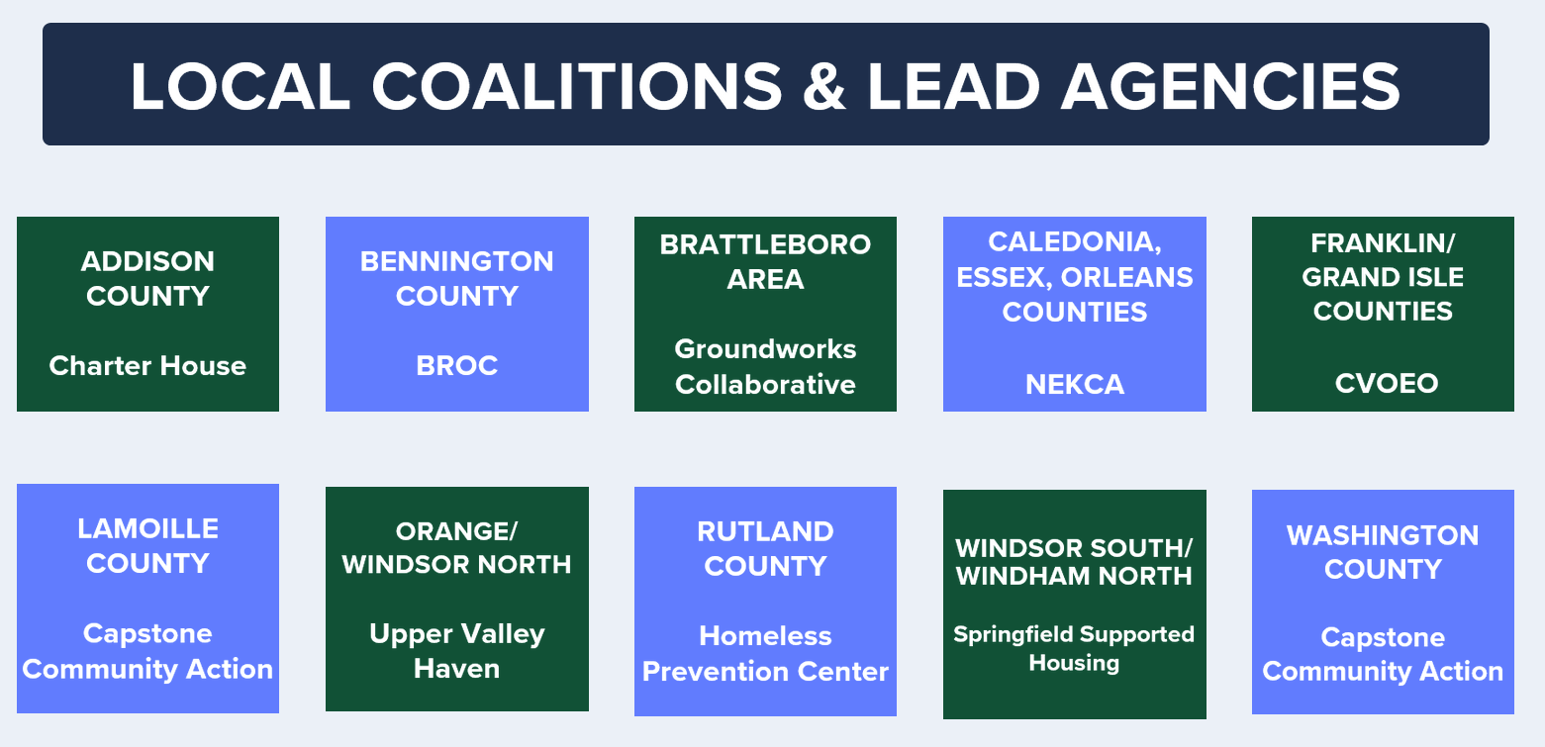
Local Housing Coalitions (LHCs)

Slide 8
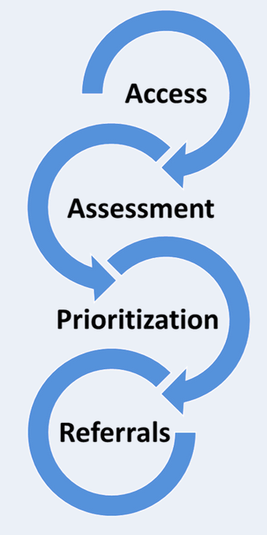
Coordinated Entry (CE)
Improves referral appropriateness and coordination​
Increases understanding among partners of what resources are available​
Decreases the time that people experience homelessness​
Helps people move in and out of the “homeless system” as quickly as possible​
Supports community-wide or system level planning and outcomes

Slide 9

Coordinated Entry Process

Slide 10
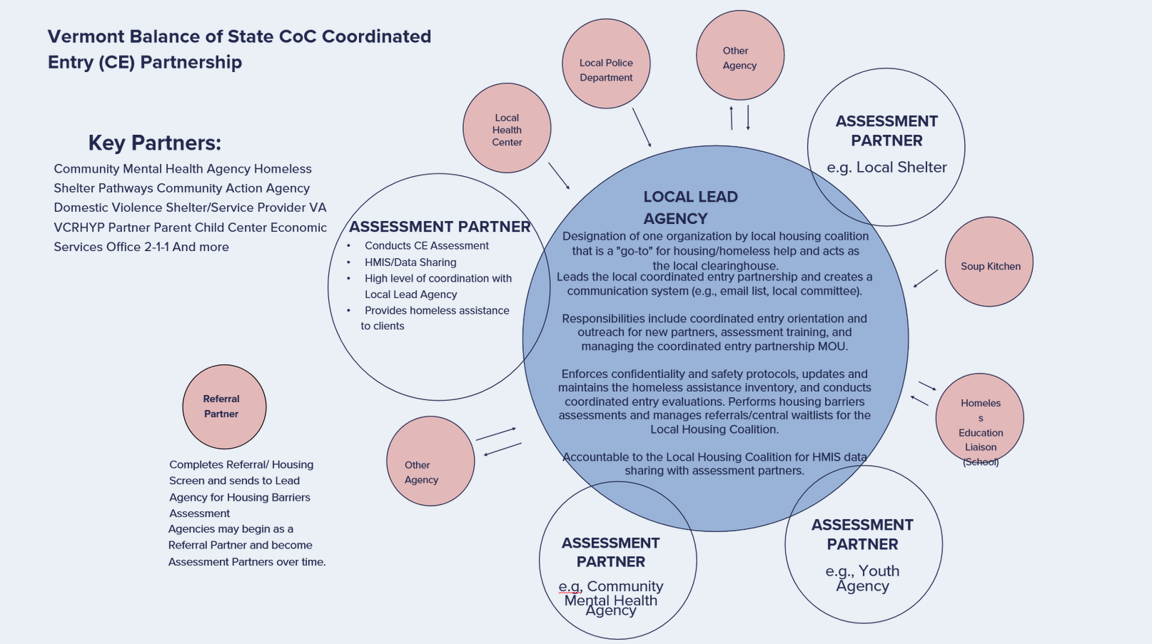

Slide 11
Point in Time (PIT)
A count of sheltered and unsheltered people experiencing homelessness on a single night in January. HUD requires that CoCs conduct an annual count of people experiencing homelessness who are sheltered in emergency shelter, transitional housing, and Safe Havens on a single night.

Slide 12
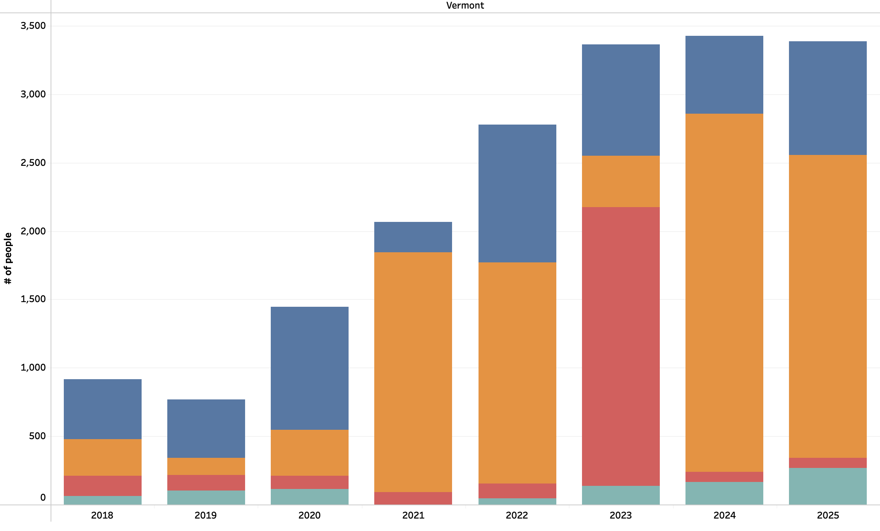
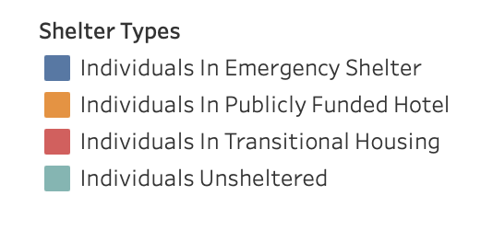
People experiencing homelessness
Individuals experiencing homelessness by shelter type

Slide 13
Housing Inventory Count (HIC)
A point-in-time inventory of provider programs within a CoC that provide beds and units dedicated to serve people experiencing homelessness (and, for permanent housing projects, where homeless at entry, per the HUD homeless definition), categorized by five Program Types: Emergency Shelter; Transitional Housing; Rapid Re-housing; Safe Haven; and Permanent Supportive Housing.

Slide 14
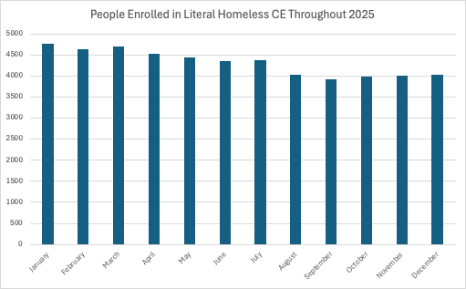

Slide 15
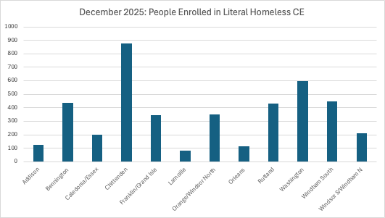

Slide 16
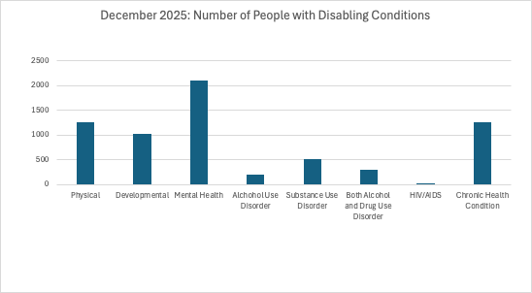

Slide 17
Vermont’s Housing Needs Assessment (HNA)
Done every five years
Required as part of the HUD Consolidated Plan
Comprehensive analysis used to identify current & projected housing needs
https://vhfa.org/pubs/housing-needs-assessment
‘23 HOME Act & ‘24 Act 181 requires the development of statewide & regional housing targets. This includes setting targets to “eliminate homelessness”

Slide 18
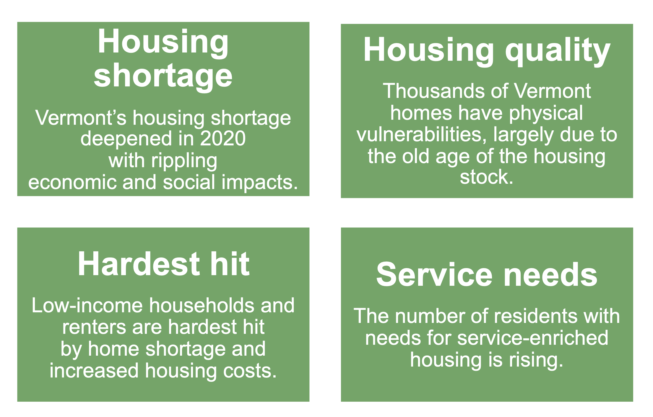
VT’s Top Housing Needs ‘25-’29

Slide 19
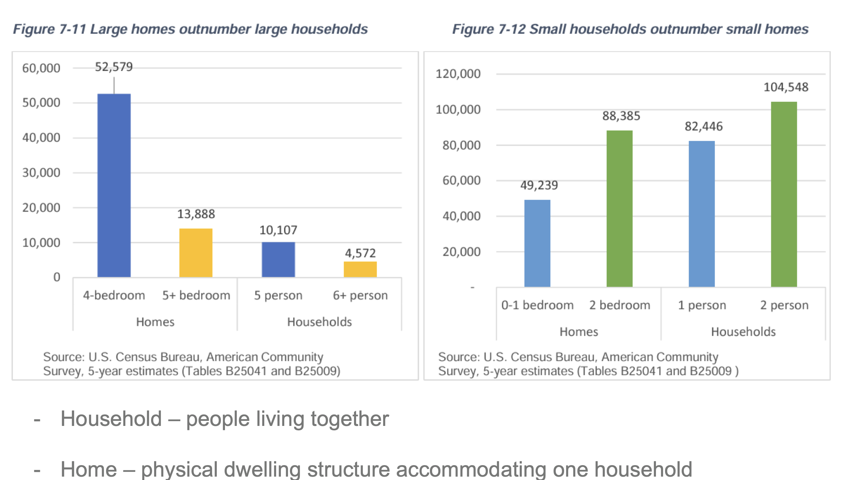
Home Size Compared to Household Size
Source: Vermont Housing Finance Agency (VHFA)

Slide 20
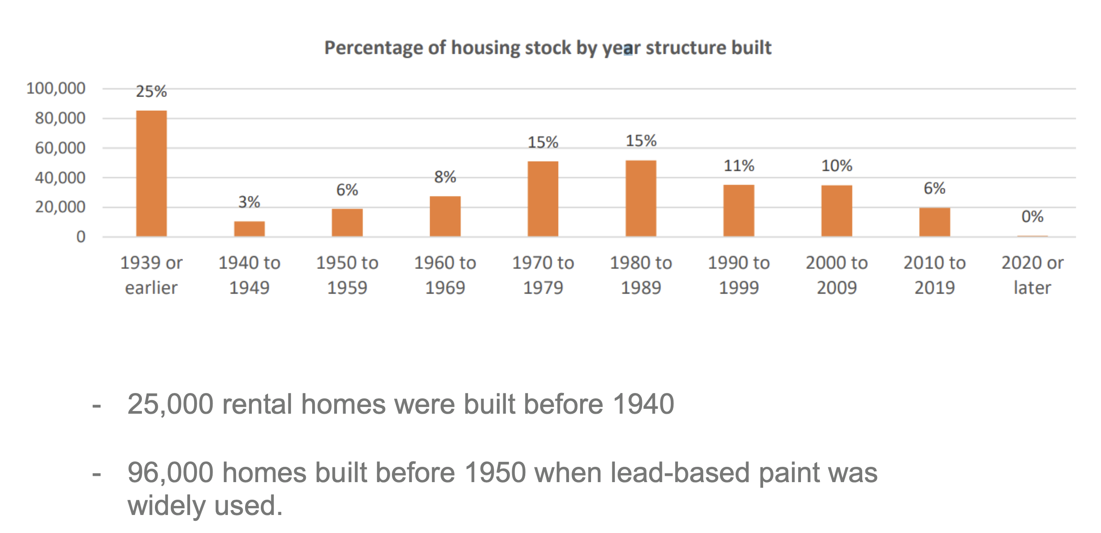
VT’s At-Risk Housing Quality
Source: Vermont Housing Finance Agency (VHFA)

Slide 21
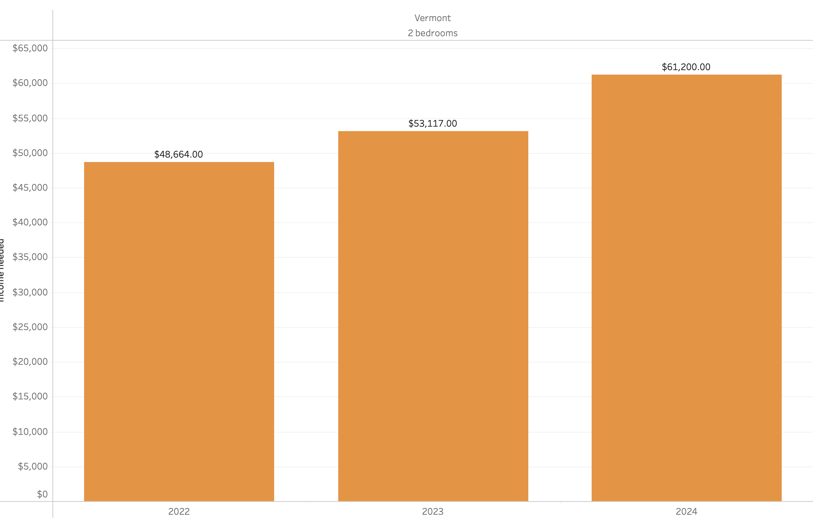
Housing wage needed is growing
Source: National low Income Housing Coalition (NLIHC)

Slide 22
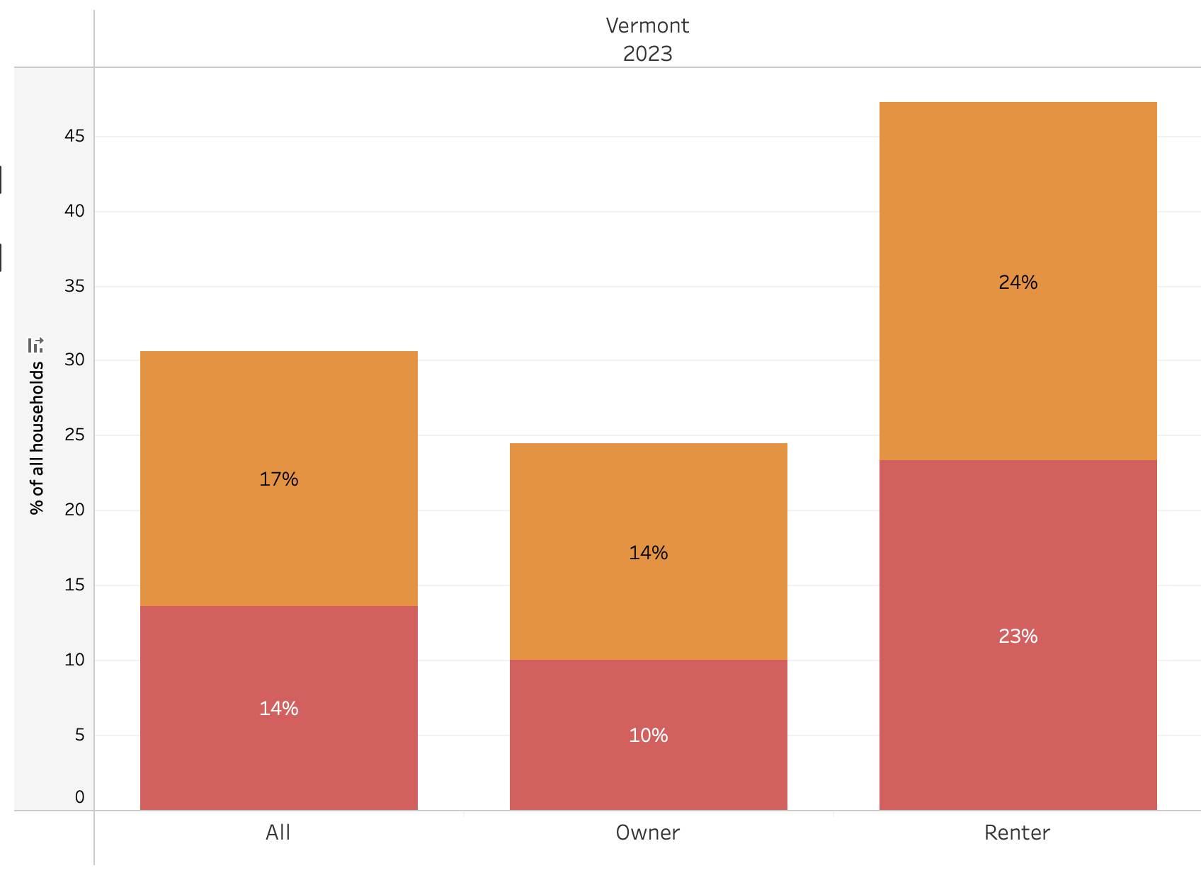
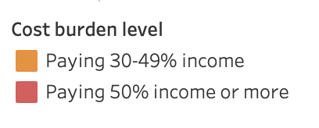
Housing costs are overwhelming
Housing Cost Burden: Housing costs as a % of household income
U.S. Census Bureau: American Community Survey

Slide 23
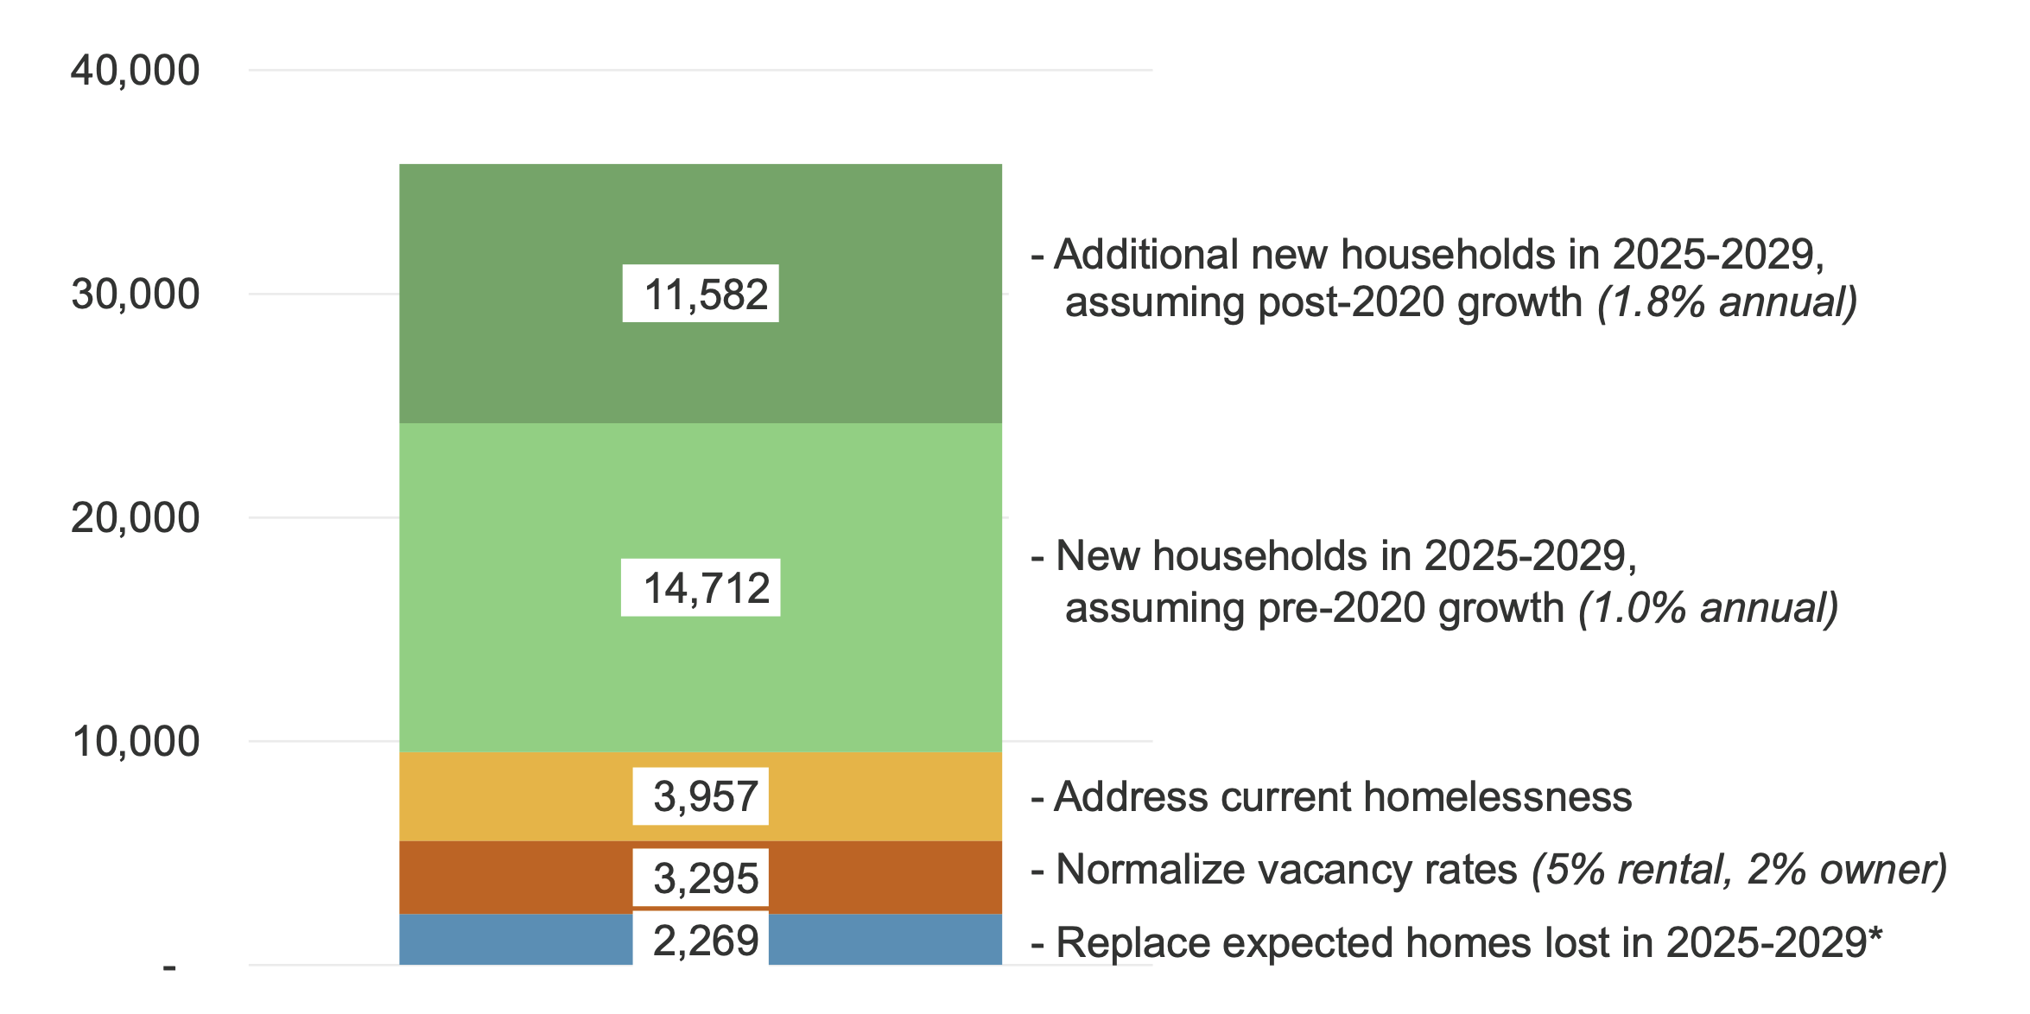
VT Needs More Homes
Source: Vermont Housing Finance Agency (VHFA)

Slide 24
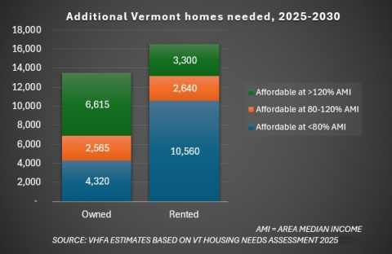
Homes needed by 2030
Source: Vermont Housing Finance Agency (VHFA)

Slide 25
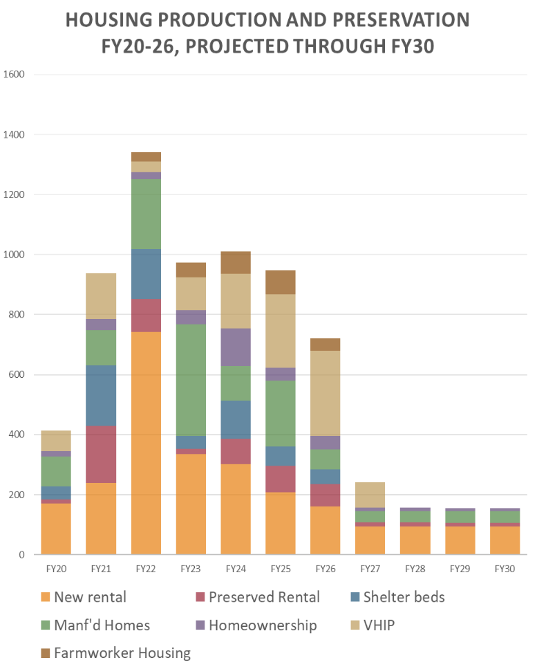
Estimated Affordable housing production
Source: VT non-profit housing providers

Slide 26
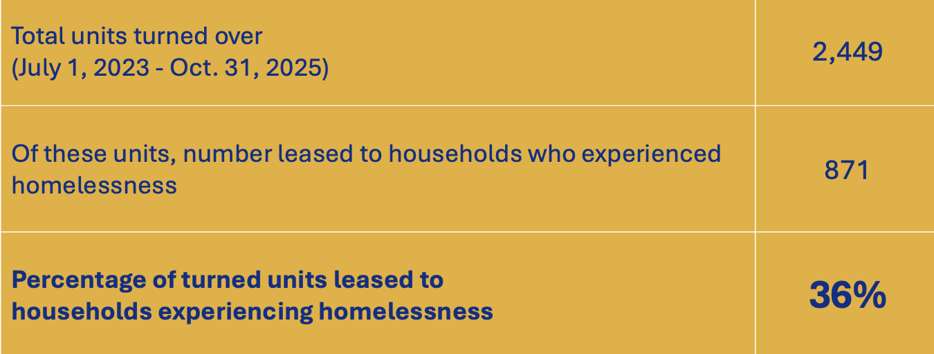
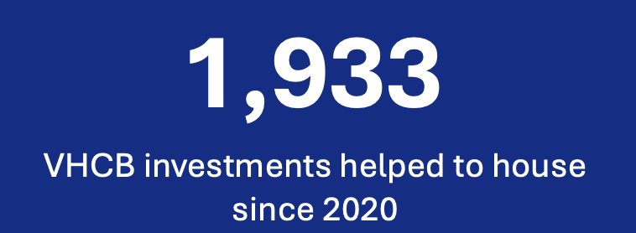
What VT has invested in since 2020
State investments made for permanently affordable rental homes through the Vermont Housing & Conservation Board (VHCB)
Source: VHCB

Slide 27
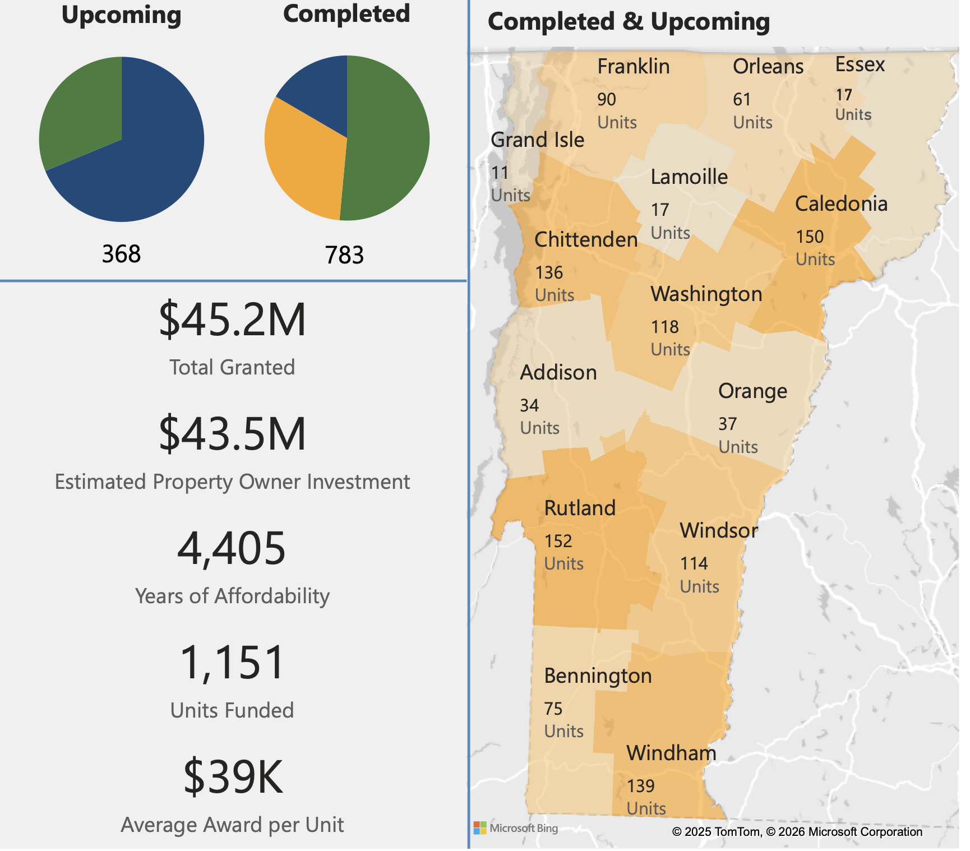
What VT has invested in since 2020
State investments made to rehabilitate rental homes through the Vermont Housing Improvement Program (VHIP)
Source: Department of Housing & Community Development (DHCD)

Slide 28
People are complex. Systems should be simple.

Slide 29

Performance by Yoann Bourgeois

Slide 30
What H.938 does well
create the shelter capacity that is required to address the various urgencies of lack of housing stock, rising housing costs, insufficient growth of the varying services needed, causing increased housing instability.
Creates framework for VT to systematically address homelessness
Creates intent and purpose
Identifies key priority areas such as:
prevention and diversion
case management/housing navigation
defines a diversity of shelter types
Bridge Rental Assistance Program
includes specific categories of funding/expenditures required to end homelessness
clear, inclusive definition of disability
fair appeals process

Slide 31
Recommendations to improve H.938
Add/reference need to create more permanent, safe, affordable housing. Tie to statewide/regional housing and affordability targets. Consider adding a new section explicitly naming long-term, permanent housing solutions
Update intent, purpose and definitions (sections 2, 3, 4)
Remove all references to ”levels” and requirements to move from one level to another. Homelessness is not linear. (section 4, § 2203)
Clarify Prevention/Diversion options are not acting as a gatekeeper to access emergency shelter (section 4)
Permanent Supportive Housing is a federally-defined program. Clarify this is not part of an emergency response system, comes with case management and should not be time-limited (section 4)

Slide 32
Recommendations to improve H.938
Remove eligibility and prioritization requirement as it relates to shelter types. (section 4)
Remove or significantly increase both the caps on hotel/motel use (700/1000) and the nightly cap (70 days). These are arbitrary. Align with actual need (section 4)
Clarify that merger of CoCs is encouraged and to be studied (section 5)

Slide 33
Recommendations to improve H.938
Rulemaking timeline needs to be much longer and process much more open & responsive (sections 7 & 8)
Payment rate structure should be a study only and specifically name shelter providers as one of the partner groups. (section 12)
The proposed expenditures do not adequately meet the need. If the budget remains the same, add language in each relevant section to plan for/address the lack of funding and steps the state will take (section 14)

